Slide 1
2nd Call for Proposals
OSI Infoday
OSI Specific Objectives 1.1 and 1.2
OSI Infodays| Zadar/ Udine

Slide 2
Priority 1 – Sustainable growth in the blue economy
Specific Objective 1.1
Developing and enhancing research and innovation capacities and the uptake of advanced technologies

Slide 3
Unlocking Innovation: OSI SO 1.1 for Cross-Border Growth in the Blue Economy
In the Interreg Italy-Croatia Programme 2021-2027, S.O. 1.1 focuses on boosting research and innovation capacities while driving the adoption of advanced technologies.
Key goal: Actively engage SMEs in cross-border innovation projects, particularly within the Blue Economy with the aims to:
Support sustainability
Create jobs
Foster the development of new, innovative products.

Slide 4
Key Objectives of S.O. 1.1: Driving Innovation, Sustainability, and Youth Engagement
The project proposals shall contribute to the achievement of all the following goals:
Strengthening Innovation Capacities: Empower SMEs by enhancing access to mature research outcomes and accelerating technology transfer across borders.
Youth Involvement: Foster the involvement of young researchers in business activities, connecting them with established enterprises and startups to drive innovation.
Environmental Sustainability: Prioritize sustainability by focusing on energy efficiency and promoting the circular economy to create greener, more resilient solutions.

Slide 5
Empowering Partnerships: a new role for project partners and SMEs
For the first time, the OSI Call introduces a groundbreaking collaboration model between Project Partners and SMEs:
Project Partners: Public now manage not only project implementation but also partnerships and direct support to SMEs. They supervise overall management, providing the financial and technical resources to help SMEs innovation and grow.
SMEs: SMEs directly benefit from grants, allowing them to access innovation and research opportunities. SMEs focus on creating new products and sustainable solutions.

Slide 6
Partnership activities supported under OSI 1.1
Partnership building
Awareness raising
Coaching
Activities to build up SMEs partnership such as e.g. B2B events, fairs, specialised meetings, online tools, etc
Activities to increase SMEs awareness on specific topics, such as e.g. conferences, promotional campaigns, specialised meetings, targeted advice, etc.
Activities to increase SMEs capacity, such as e.g. targeted trainings, advice, workshops, etc.

Slide 7
Transforming SMEs: Driving Sustainability and innovation (Expected outcome at SMEs level)
Sustainability and Growth: Foster sustainable growth through the creation of new jobs, startups, and the development of eco-friendly products.
Technology Transfer: Accelerate technology adoption and innovation, helping SMEs reduce administrative burdens and embrace the digital and circular economy

Slide 8
Building a Strong Partnership for OSI 1.1 Projects
A successful partnership connects innovative organisations, research institutions, and public bodies across Italy and Croatia. It combines expertise in the Blue Economy and digitalization, fosters cross-border collaboration, and drives sustainable innovation.
The key to success?
Strong cross-border partnerships to enable cutting-edge innovative SMEs to foster knowledge transfer on sustainability and collaborative growth.

Slide 9
Inspiring Examples of Innovative SMEs Projects
1. Eco-Friendly Packaging: SMEs from Italy and Croatia collaborate on sustainable packaging for fishery products using cutting-edge materials.
2. Blue biotechnology: SMEs apply innovative blue technology for the valorisation of by-products with the extraction of bioactive substances.
3. Smart Fishery Monitoring: A joint platform created by SMEs improves fishery sector monitoring through data analytics.
4. Marine Biotech Breakthroughs: SMEs team up with universities to create innovative biotechnological products from marine resources.
5. Sustainable Wastewater Management: SMEs pioneer eco-friendly technologies to revalorize wastewater in marine environments.

Slide 10
Priority 1 – Sustainable growth in the blue economy
Specific Objective 1.2.
Developing skills for smart specialisation, industrial transition and entrepreneurship

Slide 11
SO 1.2 – Main characteristics
Blue economy
Development of skills for smart specialisation
SME involvement in cross-border cooperation
Innovative processes, solutions, technology and applied research in the SME operations
Internationalisation

Slide 12
SO 1.2 – Objectives
The project proposals shall contribute to the achievement of all following specific objectives:
To enhance SMEs collaboration practices, supporting their innovation efforts in competitive domains, including internationalization
To strengthen SMEs capabilities to adapt to transformative changes, while fostering the adoption of innovative processes, solutions, technology and applied research in the SME operations

Slide 13
Type of activities for the benefits of SMEs (outside Voucher schemes)
Partnership building
Awareness raising
Coaching
Activities to build up SMEs partnership such as e.g. B2B events, fairs, specialised meetings, online tools, etc
Activities to increase SMEs awareness on specific topics, such as e.g. conferences, promotional campaigns, specialised meetings, targeted advice, etc.
Activities to increase SMEs capacity, such as e.g. targeted trainings, advice, workshops, etc.

Slide 14
Vouchers to SMEs to develop skills for smart specialisation, industrial transition and entrepreneurship
EXAMPLES

Slide 15
Strategic partnerships and internationalization capacity in blue economy sectors
Two aquaculture SMEs in Italy and Croatia establish a strategic partnership to improve their knowledge and capacity to take new market opportunities through
networking and trade missions
Innovation providers facilitate international trade missions, fairs and networking events, and vouchers are provided to cover expenses associated with participating in these events
Both aquaculture SMEs receive services from provider “A” to participate in organised trade missions to key international fishery markets, engaging in B2B meetings and networking sessions
One SMEs receives services from provider “C” to identify and establish strategic partnerships with international fishery firms, fostering long-term business relationships
Both SMEs receive services from the provider “B” to attend international fishery fairs and exhibitions.

Slide 16
E-commerce platforms in blue economy sectors
A group of maritime freight transport SMEs in Italy and Croatia seek to expand their sales channels through an increased knowledge and use of e-commerce opportunities and through the set-up of cross-border e-commerce platforms for maritime freight transports.
VOUCHER TO SMEs:
SMEs receive services from provider “A” for establishing an e-commerce platforms capable of handling and optimising vessels loads and the sales of transport services and to train the SMEs staff to develop, maintain and use these.
SMEs receive services from provider “B” to integrate secure and efficient payment gateways for international transactions and to train SMEs staff.
SMEs receive services from provider “C” to streamline their logistics and supply chain processes and to train the SMEs staff, ensuring timely service delivery and customer satisfaction.

Slide 17
Digital upgrading in blue economy sectors
A group of SMEs tour operators specialized in green and blue tourism in Italy and Croatia seek to enhance their digital capabilities to improve operational efficiency and online customer engagement.
Vouchers are provided to cover the costs of digital transformation services from a catalogue of innovation providers
SMEs receive services from a provider “A” to migrate their customers’ and suppliers’ data to cloud platforms, enhancing scalability and access to advanced computing resources, and to train the SMEs staff to use the platforms
SMEs receive services from Provider “C” to establish cybersecurity measures, ensuring data protection and compliance with regulations and to train SMEs staff on cyber-security
SMEs receive services from Provider “B” to develop e-commerce websites and implement digital marketing strategies to reach a broader audience and train SMEs staff to use and maintain these

Slide 18
Innovative manufacturing processes in blue economy sectors
Two SMEs specialized in manufacturing innovative products deriving from processing sea algae in Italy and Croatia seek to modernize their manufacturing processes through the adoption of advanced manufacturing technologies
Vouchers are provided to SMEs to cover the cost of upgrading to advanced manufacturing solutions from selected innovation providers.
One SME receives services from Provider “A” to integrate robotic systems into their production lines both in the collection and processing of algae, enhancing efficiency and precision and to train the SME staff to use it.
One SMEs receive services from Provider “B” to implement IoT solutions through targeted Staff trainings, enabling real-time monitoring and optimization of manufacturing processes

Slide 19
Health & safety in blue economy sectors
A group of Italian and Croatian SMEs delivering services in marinas of the area aim to improve workplace health and safety by adopting innovative health and safety technologies and procedures
Vouchers are provided to SMEs to cover the cost for adopting new health and safety technology solutions
SMEs receive services from Provider “A” to equip employees with devices that increase their health and safety, as well as necessary training
SMEs receive services from Provider “B” to install advanced water and energy supply systems in the concerned marinas, ensuring a safe work environment, while training staff in charge of the maintenance of these systems
SMEs receive services from Provider “C” to redesign workspaces and introduce safer equipment, reducing the risk of workplace injuries, while SMEs staff is trained on health and security at the workplace

Slide 20
Management skills in blue economy sectors
Startups in Italy and Croatia specialized in biotechnologies used in the extraction of marine bioactive substances, intend to build their internal capabilities and skills through specialized training programs
Vouchers are provided to cover costs associated with training and capacity-building activities
Skill development: Training programs in areas such as leadership, management, and technical skills related to bio-technologies
Workshops and Seminars: Attending bio-technology workshops and seminars to stay updated on the latest trends and bio-technologies
Engaging in mentorship programs with experienced bio-technology professionals

Slide 21
2nd Call for Proposals
OSI Info day
OSI Specific Objectives 1.1 and 1.2
AID SCHEMES
OSI Infodays| Zadar/ Udine
1

Slide 22
Aid Schemes in OSI 1.1 and 1.2
22

Slide 23
Key thematic difference
1.1
Technology
& mature research to bring
New products /services
To the market
1.2
Capacity / skills
To apply
Process
Innova- tion
GRANTS
VOUCHERS
23

Slide 24
Key concepts for the OSI 1.1 and 1.2
NO Direct aid: State aid relevant activities of project Partners are not foreseen.
YES Indirect aid: Aid granted to third parties outside the partnership
Programme
Beneficiary (LP+PP)
Third party (indirect beneficiary, SME)
24

Slide 25
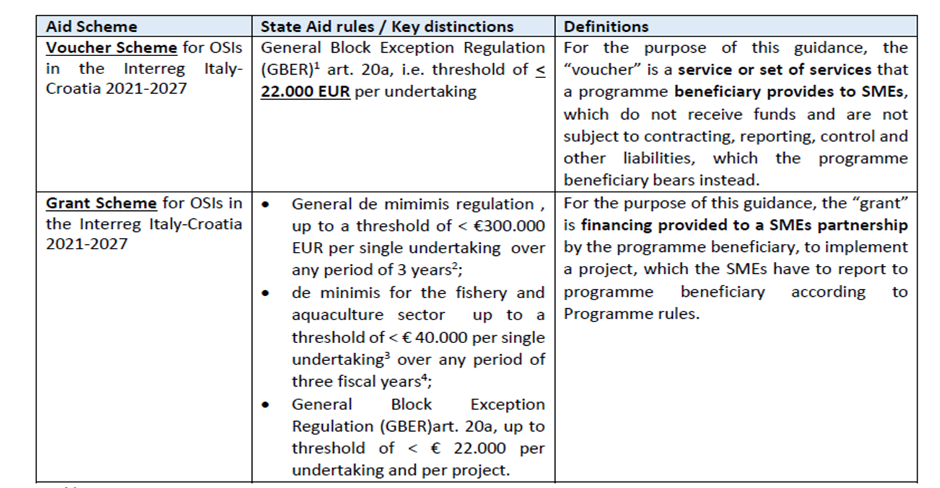
Aid schemes
25

Slide 26
Warning
- Annex 2 guidance: main aspects
- NOT exhaustive set of rules
- Adaptations / deviations may be necessary
- JS assistance during implementation
26

Slide 27
Features of the Aid Schemes OSI 1.1 & 1.2
Grants -1.1
Set of services provided by partners to SMEs
SMEs partnership selected through call
Mainly services
Funds to SMEs partnership
To implement a project selected through call
Incl. services or equipment (no infrastructures)
Vouchers -1.2
27

Slide 28


CROSS-BORDER DIMENSION
SMEs shall apply in partnership
Both Italian and Croatian SMEs covered by the Scheme
Receive joint services / equipment from the IT or HR provider
Notes:
To ensure a cross-border dimension of the Voucher Scheme, SMEs shall apply in partnership with SMEs of the other country, and receive joint services from the service provider

Slide 29
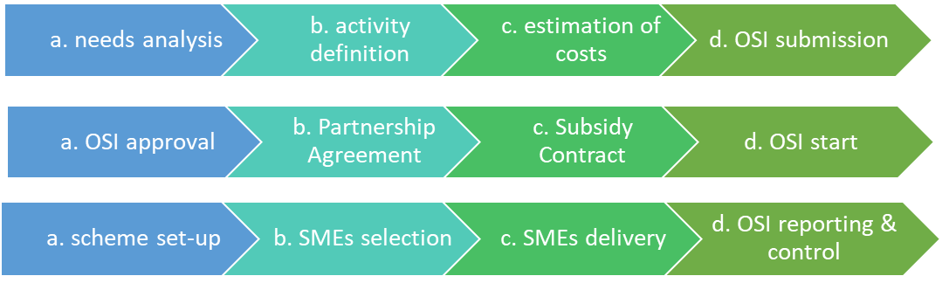
Aid schemes phases
❶
❷
For both schemes: ) Planning; ) Selection/ contracting; ) Implementation / reporting
❸
❶
❷
❸
29

Slide 30
PARTNERS PROVIDING AID SCHEMES
Only public / public law bodies
Previous experience with aid schemes
Set up of a competent “management team”
Support building-up of SMEs partnerships, in addition to GRANTS / VOUCHERS schemes
Services such as e.g.
  partnership building, B2B, events / tools
  awareness raising events / tools
  coaching, fairs, etc.
30

Slide 31
SMEs SELECTION THROUGH OPEN CALLS
Transparent, fair, non-discriminatory procedure, open to SMEs both IT & HR
Check all minimum requirements annex 2
- Prior to the call: Consultation with JS
- After the call: Partner submits State Aid data to MA
- MA releases it before awarding
31

Slide 32
GRANTS / OSI 1.1
32

Slide 33
PARTNERS’ KEY ACTIONS FOR GRANTS
SUPPORT TO SMEs to build up SMEs partnerships
MONITORING, ASSISTANCE & verification
CALL FOR SMEs PROJECTS & selection
33

Slide 34
PARTNERS’ KEY ACTIONS FOR GRANTS
SUPPORT TO SMEs to build up SMEs partnerships
MONITORING, ASSISTANCE & verification
CALL FOR SMEs PROJECTS & selection
34

Slide 35
BUDGET SHARES
MAX. 25% MAGMT. MIN. 75% SMES SUPPORT
OUT OF 75% SMES SUPPORT: E.G. 50% BEING GRANTS
LP MAY HAVE BIGGER SHARE OF MANAGEMENT
25% OTHER SUPPORT TO SMEs
35

Slide 36
Grant Scheme budget structure example
25%
MGMT. COSTS
FLAT RATES Staff / T&A / O&A
Possible E.E.&S
75%
E.E.& S. to SMEs OF WHICH:
50%
E.E.& S. GRANTS
25%
E.E.& S. support
36

Slide 37
Max. grant value
Total grants budget
Divided / 20 (min no. Exp. )
Max. grant value 78.000 €
37

Slide 38
Grant Scheme eligibility - verifications
Report separate “GRANT” item in ext.e.&s.
Staff / O&A / T&A : FLAT RATES
Ext.e.&s. / equipment: REAL COSTS
NO WORKS / INFRASTRUCTURES
SME
PP
NC
MA
LP
EC
Partners are responsible i.e. verifies SME’s expenditures, prior to National Control
38

Slide 39
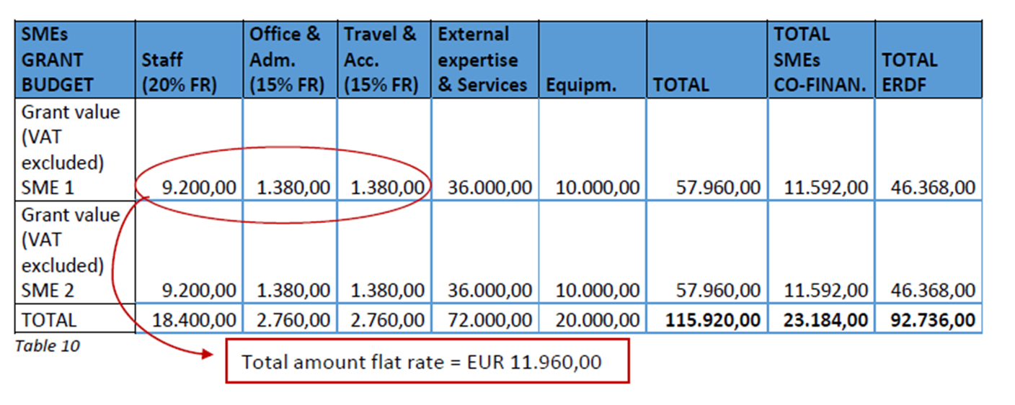
Grants EXAMPLE for SMEs PROJECTS
39

Slide 40
VOUCHERS / OSI 1.2
40

Slide 41
PARTNERS’ KEY ACTIONS FOR VOUCHERS
PUBLIC PROCUREMENT
for set of services (needed tools possible)
CALL FOR SMEs PARTNERSHIPS
who applies to receive services
SUPPORT TO SMEs to build up SMEs partnerships
41

Slide 42
SERVICES SET IN VOUCHERS
INITIAL SMEs NEEDS ANALYSIS
CAPACITY TO DELIVER TO IT & HR SMES
FLEXIBLE SET OF SERVICES: REALITY CHECK
SMEs SHALL CONFIRM DELIVERY
42

Slide 43
BUDGET SHARES
MAX. 25% MAGMT. MIN. 75% SMES SUPPORT
OUT OF 75% SMES SUPPORT: E.G. 50% BEING VOUCHERS
LP MAY HAVE BIGGER SHARE OF MANAGEMENT
25% OTHER SUPPORT TO SMEs
43

Slide 44
Expected no. of vouchers in previous example
Total vouchers budget
Divided / 22.000 (max value)
At least 114 vouchers
44

Slide 45




Veneto Region
Area for Economic Policies, Human Capital
and Programming of European Funds
Directorate for Joint Programming
Italy – Croatia Managing Authority and Joint Secretariat
  Dorsoduro, 3494/A - 30123 Venezia Italy
  italia.croazia@regione.veneto.it
  italia.croazia@pec.regione.veneto.it
  +39 041 2791781
  www.italy-croatia.eu

