Slide 1
2nd Call for Proposals
OSI Infoday
Anna Flavia Zuccon – Head of MA
OSI Infodays| Zadar/ Udine

Slide 2
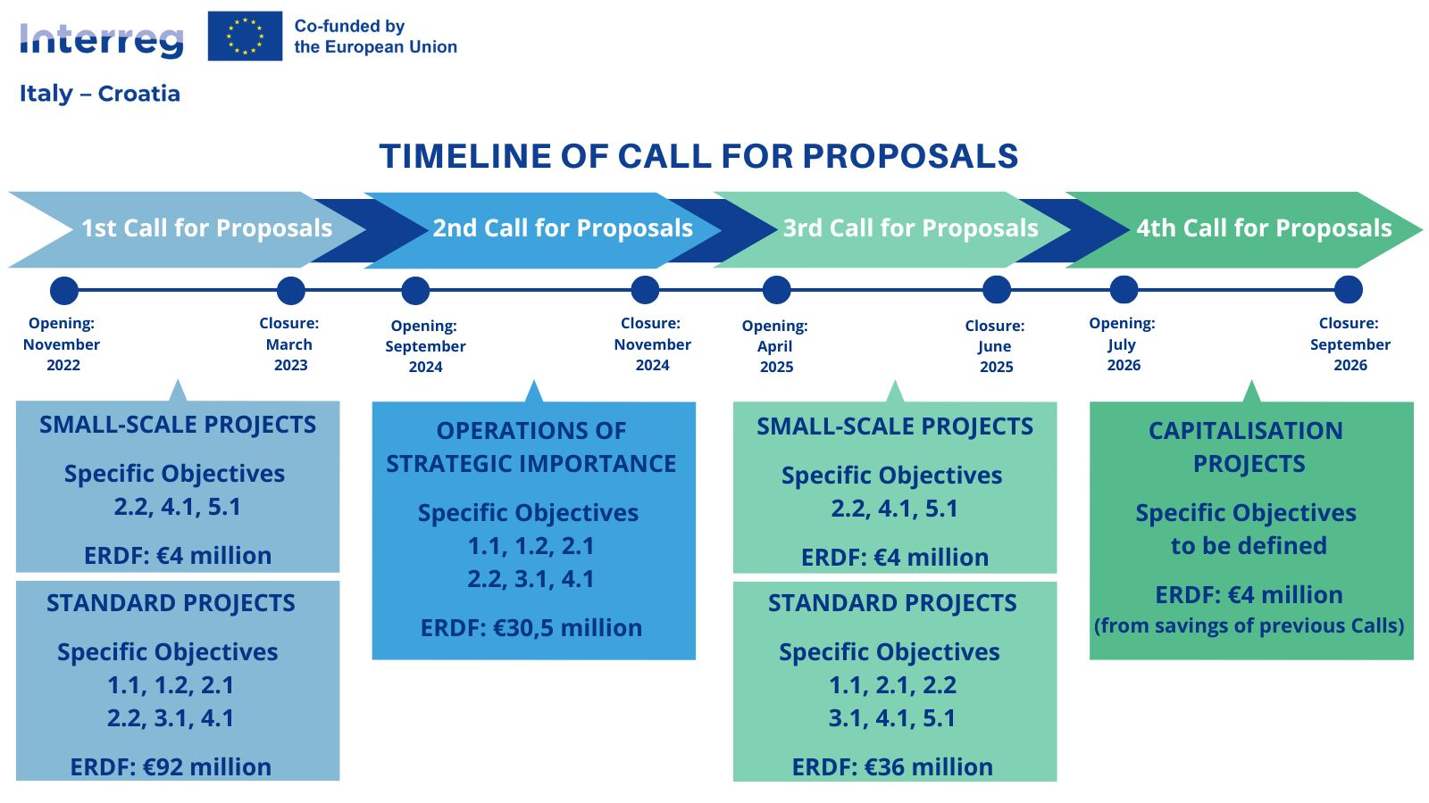
TIMELINE CALL FOR PROPOSALS
2

Slide 3
OPERATIONS OF STRATEGIC IMPORTANCE (OSIs)
As defined in EU Regulation 2021/1060 (Art. 2, c5), OSIs are operations that make a significant contribution to the achievement of Programme's objectives and are subject to special monitoring and reporting measures. OSIs are also critical because of their ability to bring together different expertise toward the common goal of improving the cross-border area.
OSIs are thus new types of projects, born with the current 21-27 Programming period, financed by the European Union through the Interreg Programs; their activity aims, through networking, to tell their results and impacts in the community.
3

Slide 4

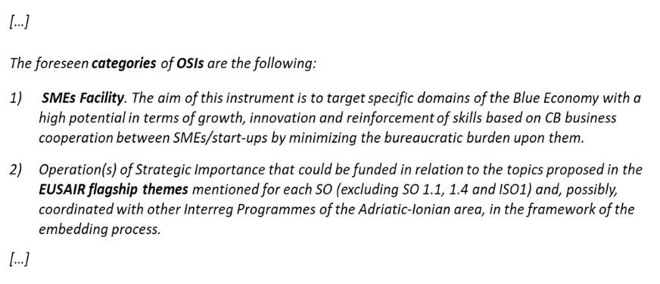
APPENDIX 3 INTERREG VI A
IT-HR PROGRAMME
4

Slide 5
OSI PROCESS - Top-down approach
JUNE
2023
JULY
2023
FEBRUARY 2024
ELABORATION OF SUPPORTING DOCUMENTS
FINALISATION OF THE CONTENTS
DESK ANALYSIS
THEMATIC EXPERTS
  Interreg Italy-Croatia 2014-2020 projects results
  Interreg Italy-Croatia 2021-2027 expected results
  EUSAIR Flagship actions
  Thematic Descriptive Sheets (all SOs)
  SMEs Facility Schemes
(Priority 1)
OSI WG SUPPORT
INCEPTION PAPERS
39 meetings, around 7 per each SO
5

Slide 6

OSI PUBLIC CONSULTATION (April 2024)
111 survey answers collected
1
Discuss about Objectives and Types of activities defined for each OSI theme
2
Understand if the identified OSI themes meet the needs of the Programme territorial area from different points of view
150 Participants
3
Investigate operational aspects to be included in the Call for Proposal
6

Slide 7




Veneto Region
Area for Economic Policies, Human Capital
and Programming of European Funds
Directorate for Joint Programming
Italy – Croatia Managing Authority and Joint Secretariat
  Dorsoduro, 3494/A - 30123 Venezia Italy
  italia.croazia@regione.veneto.it
  italia.croazia@pec.regione.veneto.it
  +39 041 2791781
  www.italy-croatia.eu
7

