Slide 1
2nd Call for Proposals
OSI Infoday
Jems Application and Submission
OSI Infodays| Zadar/ Udine

Slide 2
Jems Application Form – introduction
„Manual for Submitting Project Application in Jems” can be found at the following link:
  Jems Manuals
The access to a Jems Application Form (AF) requires a previous registration in the Jems homepage of the Interreg IT-HR Programme:
  Jems Homepage
Off-line AF Template is included in the Application Package in order to allow applicants to prepare the entire AF before starting to insert the necessary data in Jems.
When preparing data to be entered in the AF, make sure to have carefully studied the relevant Call’s Guidelines for Applicants, Call Announcement and Off-line Application Form template documents.

Slide 3
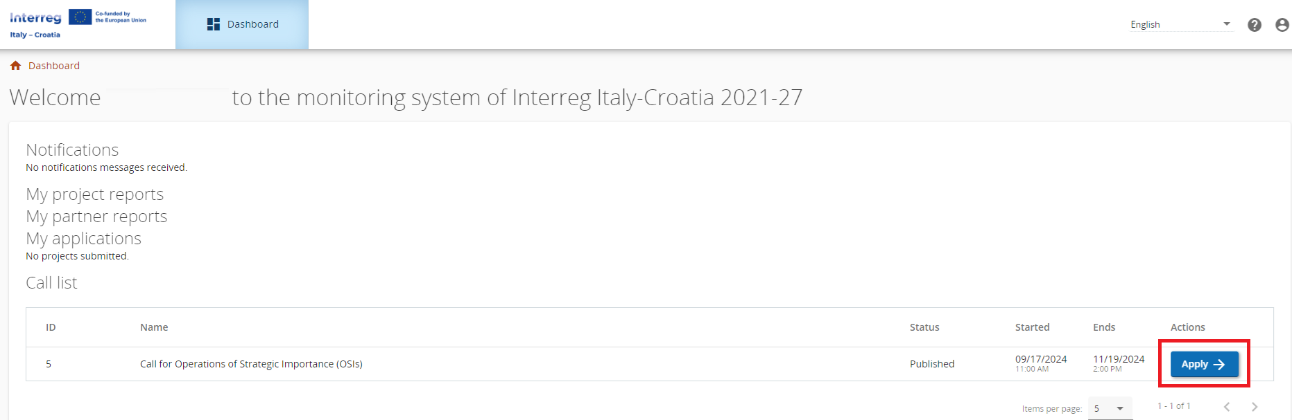
Jems Application Form – creation
After logging in, you will land directly on the Dashboard as a start page, or you can click on the Dashboard tab in the top menu bar to access it.
To create a new project application, click on “Apply” at the end of the relevant Call’s row in the "Call list" section.
In the next window, insert the acronym of your project (which can always be modified) and click on “Create project application”.

Slide 4
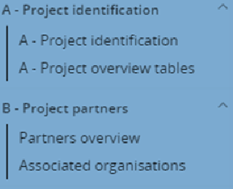
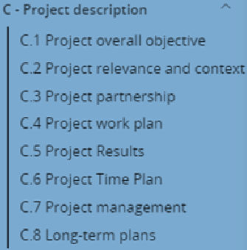
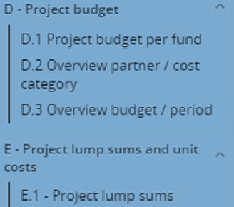
Jems Application Form – parts
All AF sections will appear in the menu on the left

Slide 5
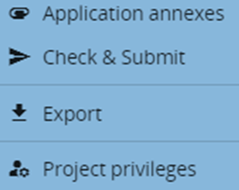
Jems Application Form – working in parallel
Beneath the AF sections are present four additional functions:
Project privileges function is to be used to manage all the users working on the project application.
Only users with the “edit” or “manage” privileges can submit the proposal.
When working in parallel, users must make sure that they are not working simultaneously in the same section or subsection as there is the risk of overwriting information.

Slide 6
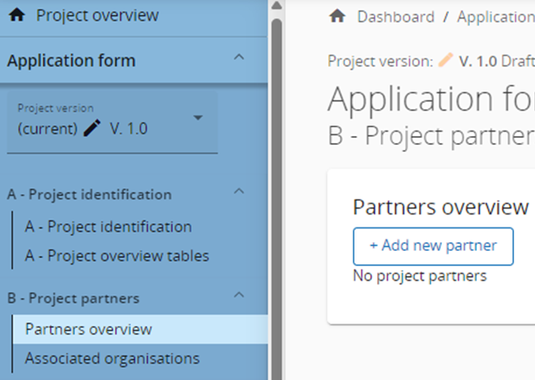
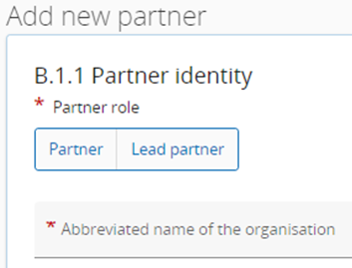
Jems Application Form – adding a project partner
Always start with the LP.
Assign the role of PP/LP to each partner.
Repeat part B of the AF for all partners.

Slide 7
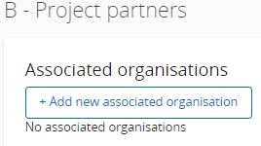
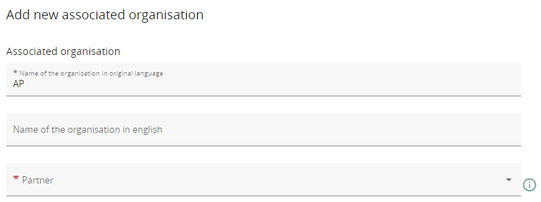
Jems Application Form – associated organisations
Each AP can be associated to only one of the LP/PPs by selecting them from the drop-down menu.
Therefore, it is mandatory to insert LP/PPs before their related APs.

Slide 8
Jems Application Form – check and submission
Each Application form requires a successful pre-submission check of content before it can be submitted. Before submitting the Application Form, the pre-submission-check needs to be valid, and the signed Application form must be uploaded in the “Application annexes” section.

Slide 9
Jems Application Form – check and submission
● Error messages block the submission of the AF. It is strongly recommended to run the pre-submission check already during filling in of different sections of the AF and early enough before the deadline. Therefore, do not wait until the very last minute since you might run out of time for solving issues and keeping the deadline for project application submission.
● Results do not update automatically, requiring that the check is performed again after any changes in the AF.
If the pre-submission check passed successfully, the “Submit” button will become active. DO NOT CLICK IT YET!

Slide 10
Jems Application Form – downloading of the AF
Download the AF version which is to be signed by the legal representative ONLY once the AF is finalized and its pre-submission check is valid.

Slide 11
Jems Application Form – uploading of the signed AF
Always verify before uploading that the correct location in the Attachments menu is highlighted. Only the signed AF and NOTHING ELSE must be uploaded in the root section highlighted below.

Slide 12
Jems Application Form – uploading of other annexes
In case of users without a Digital Signature, the beneficiary should print and manually sign the relevant documents and then upload their scanned versions, alongside the Identity Document (ID) of the signatory.
If the beneficiary is not sure where to upload a required document, please upload it in the LP’s section.
Although Jems supports a variety of file formats, .pdf is preferred. Please upload only the necessary documents, especially taking care of choosing the correct location beforehand.

Slide 13
Jems Application Form – uploading of other annexes
Insert a short description of the file to facilitate the overview of all annexes.
Be reminded that the production and uploading of a Delegation Act is compulsory only in case the signatory of the AF is different from the legal representative.

Slide 14
Jems Application Form – final check and submission
Only after uploading the signed AF and uploading all the other required annexes to the AF, the beneficiary should continue to finally submit their project application in the “Check & Submit” section.
It is necessary to run the pre-submission check one last time before submission for the “Submit project application” button to become active again.

Slide 15
Jems Application Form – after submission
Once the project application has been submitted, it will no longer be possible to modify it.
As a confirmation that the application has been submitted, its status will change to Submitted on your list of Applications on the Dashboard.
In case the Application Form print-out document was not uploaded in JEMS at the time of submission of the proposal, or if it was not signed before being uploaded, the Lead Applicant may send the signed Application Form to the Managing Authority via certified email at italia.croazia@pec.regione.veneto.it, within 5 working days from the submission of the proposal in JEMS.

Slide 16




Veneto Region
Area for Economic Policies, Human Capital
and Programming of European Funds
Directorate for Joint Programming
Italy – Croatia Managing Authority and Joint Secretariat
  Dorsoduro, 3494/A - 30123 Venezia Italy
  Franka Lisice 77, 23000 Zadar, Croatia
  js.italy-croatia@regione.veneto.it
  js.it-hr.antenna@mrrfeu.hr
  +39 041 279 3120
  +385 23 670 412
  www.italy-croatia.eu

