Slide 1
2nd Call for Proposals
OSI Infoday
OSI Call Announcement
OSI Infodays| Zadar/ Udine

Slide 2
2CfP: Application package
Call announcement
Annex 1 to the call announcement “Thematic descriptive sheets”
Annex 2 to the call announcement “Guidance on Aid Schemes for Priority 1”
Project selection procedure
Annex 1 to the Project selection procedure “Assessment criteria”
Guidelines for Applicants
Off-line Application Form template for OSIs (for information purposes)
Lead partner (LP) Declaration template
Project partner (PP) Declaration template
Associated partner (AP) Declaration template
Subsidy Contract template (for information purposes)

Slide 3
2CfP: How to apply and Assistance
Project proposals must be submitted in English and only through Jems
The LP is in charge of the submission of the project proposal
Support to applicants is provided by the JS in Venice (IT) and Zadar (HR)
Useful information
FAQs
Updates on Infodays
Recommended consultations with the JS
New Partner search tool
Useful documents
EU Policy Framework documents
Interreg Programme
SEA Environmental Report
Programme Implementation Manual
Programme Intervention logic
Contribution to EUSAIR Flagships
Programme Capitalisation plan
Beneficiary financial capacity
DNSH procedure
Manual for Submitting Project Application in Jems

Slide 4
2CFP: Typology of supported projects
Operations of Strategic Importance (OSI) projects:
high-quality cross-border strategic projects in which organisations can cooperate to address common relevant thematic issues and very concrete needs in the area;
complex cooperation projects typically originating from a top-down process, guided by the Programme decision-makers, who acknowledge a need or a potential for a cross-border solution.

Slide 5
2CfP: Objectives of the Call and SOs - OSI
OSI Projects shall address the following SOs
 | Specific Objective (SO)
1 | 1.1 Developing and enhancing research and innovation capacities and the uptake of advanced technologies
 | 1.2 Developing skills for smart specialisation, industrial transition and entrepreneurship
2 | 2.1 Promoting climate change adaptation and disaster risk prevention, resilience taking into account eco-system based approaches
 | 2.2 Enhancing protection and preservation of nature, biodiversity and green infrastructure, including in urban areas, and reducing all forms of pollution
3 | 3.1 Developing and enhancing sustainable, climate resilient, intelligent and intermodal national, regional and local mobility, including improved access to TEN-T and cross-border mobility
4 | 4.1 Enhancing the role of culture and sustainable tourism in economic development, social inclusion and social innovation

Slide 6
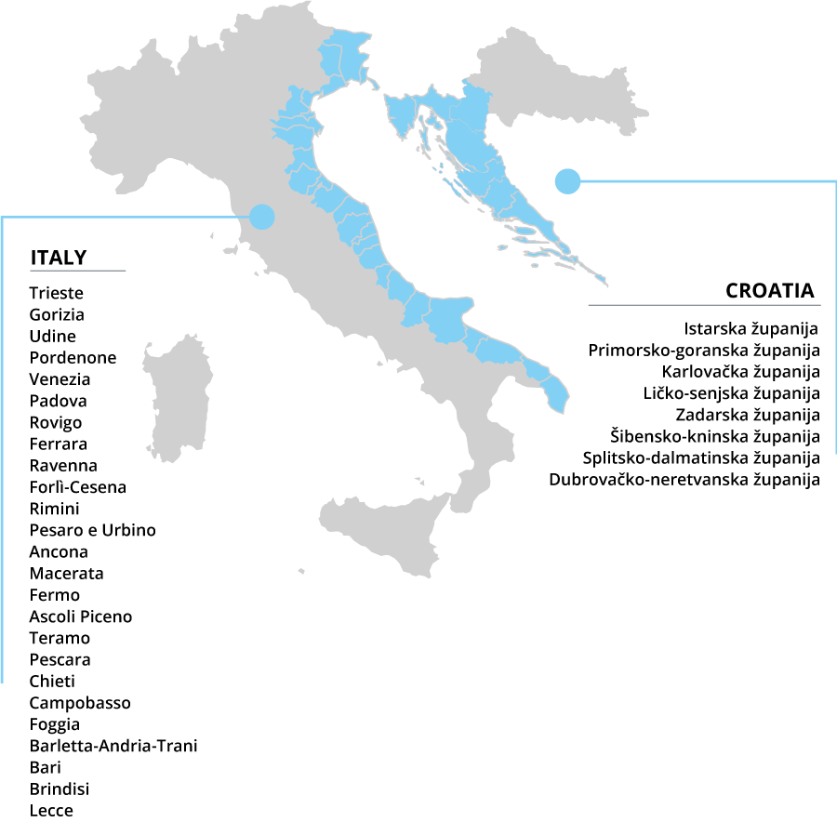
2CfP: Programme cooperation area
Projects should clearly create benefit for the Programme area
25
8

Slide 7
2CfP: Call budget and co-financing
Call ERDF BUDGET: 30,5 MEUR
ERDF rate: 80%
Total Budget: 38,1 MEUR
 | OSI projects Expected budget (ERDF) | Number of Projects
1.1 | 2.500.000,00 | 1
1.2 | 5.000.000,00 | 1
2.1 | 6.000.000,00 | 1
2.2 | 5.500.000,00 | 1
3.1 | 6.000.000,00 | 1
4.1 | 5.500.000,00 | 1
TOTAL | 30.500.000,00 | 6
A 20% co-financing not covered by ERDF funds must be ensured by national/own resources for each project/ partner
Italian national co-financing is ensured by the State (Fondo di Rotazione) for all PPs

Slide 8
2CfP: Duration and budget size
DURATION
Max. 42 months
end date by 31/12/2028
SOs | Minimum ERDF per PP (EUR)
1.1 | 300.000,00
1.2
2.1
2.2
3.1
4.1
Budget size per PP

Slide 9
2CfP: Budgeting options
Cost categories | Option A |  | Option B |  | Option C
 | Real costs | Flat rate | Real costs | Flat rate | Real costs | Flat rate
STAFF COSTS | Part time with fixed percentage method or Full-time |  |  | 20% of other direct costs | Part time with fixed percentage method or Full-time
O & A |  | 40% of Staff costs |  | 15% of Staff costs |  | 15% of Staff costs
TRAVEL AND ACCOMMODATION |  |  |  | 15% of Staff costs |  | 15% of Staff costs
EXTERNAL EXPERTISE AND SERVICES |  |  | Real costs |  | Real costs
EQUIPMENT* |  |  | Real costs |  | Real costs
INFRASTRUCTURE AND WORKS* |  |  | Real costs |  | Real costs
3 equally available financial options
The use of SCOs is mandatory, varying per option
Additionally:
Lump sum for preparation costs
17.500,000 EUR
Lump sum for closure costs
  3.000,00 EUR

Slide 10
2CfP: ELIGIBILITY of applicants
General provisions
Potential applicants must fulfill all the following criteria:
Be established under the national law of Italy or Croatia (except for international organisations)
Have their official seat or seat of operations in the Programme area, as long as the official seat is active for at least twelve months and the seat of operation is active for at least six months before the date of publication of this call announcement and its location in the area is demonstrated through official documentation
Be endowed with legal personality

Slide 11
2CfP: ELIGIBILITY of applicants
PUBLIC ENTITIES | PRIVATE BODIES | INTERNATIONAL ORGANISATIONS
National, regional and local public bodies and their associations Bodies governed by public law, as defined in point (4) of article 2(1) of Directive 2014/24/EU on public procurement, and their associations | Non-profit organisations Profit-making organisations | International organisations acting under the national law of an EU Member State International organisations acting under the international law

Slide 12
2CfP: ELIGIBILITY of applicants
Rules for participation
each organisation can take part in a maximum of 2 proposals, out of which maximum 1 as Lead Partner
Participation per “department” possible for:
Ministries
Regions/Counties
Universities/Research institutions

Slide 13
2CfP: ELIGIBILITY of applicants
Assimilated partners
Italian and Croatian entities located outside of the Programme area that:
are competent in their scope of action for certain parts of the Programme area
carry out activities that are beneficial for the Programme area

Slide 14
2CfP: provisions applying to the LEAD applicant
Lead Applicants - Only Eligible public entities (reported below) can act as Lead Applicant
S.O. | Eligible organisation typology
1.1 1.2 | A) Regional public administrations / Counties, such as through the departments having competence in economic development B) Public sectorial agencies, such as regional development or innovation agencies C) Business support organisations, such as chambers of commerce / economy D) Universities
2.1 | A) Regional public administrations / Counties, such as through the departments having competence in civil protection B) Public sectorial agencies, such as regional civil protection agencies
2.2 | A) Regional public administrations / Counties, such as through the departments having competence in environmental issues B) Public sectorial agencies, such as regional or national environmental management public authorities or agencies
3.1 | A) Regional public administrations / Counties, such as through the departments having competence in maritime transports B) Public sectorial agencies or authorities, managing public infrastructures, such as Port authorities
4.1 | A) Regional public administrations / Counties, such as through the departments having competence in touristic or cultural development B) Public sectorial agencies, such as agencies in charge of touristic or cultural development or tourism boards

Slide 15
2CfP: PARTNERSHIP requirements
Minimum partnership requirements
It is recommended to involve an appropriate number of partners, with a balanced participation between Italian and Croatian partners, as follows:
For specific objective 1.1 maximum 4 project partners
For specific objective 1.2 maximum 8 project partners
For priorities 2, 3 and 4 maximum 12 project partners are recommended, with a balanced participation between Italian and Croatian partners.
Priority 1 | Priorities 2, 3 and 4
at least 2 partners, out of which 1 Italian, and 1 Croatian partner | at least 6 eligible partners, out of which at least 3 Italian, and 3 Croatian partners

Slide 16
2CfP: PARTNERSHIP requirements
Associated partners
Partners, may be outside the Programme area or from third countries, without project budget, but which directly contribute to the achievement of project’s objectives:
Their participation may be important for capitalizing achieved results;
Their participation may be important for synergies and complementarities among projects, programmes and EU macro-regional strategies;
IMPORTANT! The number of Associated partners shall not exceed the number of project partners.

Slide 17
2CfP: PARTNERSHIP requirements
RULES ON PARTNERSHIPS
Minimum number of partners per project in Priority 1 | 2 (one from IT, one from HR)
Minimum number of partners per project in Priorities 2, 3 and 4 | 6 (three from IT, three from HR)
Minimum ERDF budget per partner | 300.000 EURO
Recommended maximum no. of partners per project in S.O. 1.1 | 4
Recommended maximum no. of partners per project in S.O. 1.2 | 8
Recommended maximum no. of partners per project in S.O. 2.1, 2.2, 3.1 and 4.1 | 12
Maximum n. of associated partners per project (all SOs) | Equal to no. of partners (LP + PPs)

Slide 18
2CfP: Contribution to indicators
«Annex 1 to the Call Announcement» provides figures of expected contribution to output and result indicators per each OSI project
Examples of intervention logic are also provided
Also check the “Intervention Logic” document for more information on the definitions of each indicator
The assessment foresees the verification of the compliance with intervention logic and indicators’ expected values

Slide 19
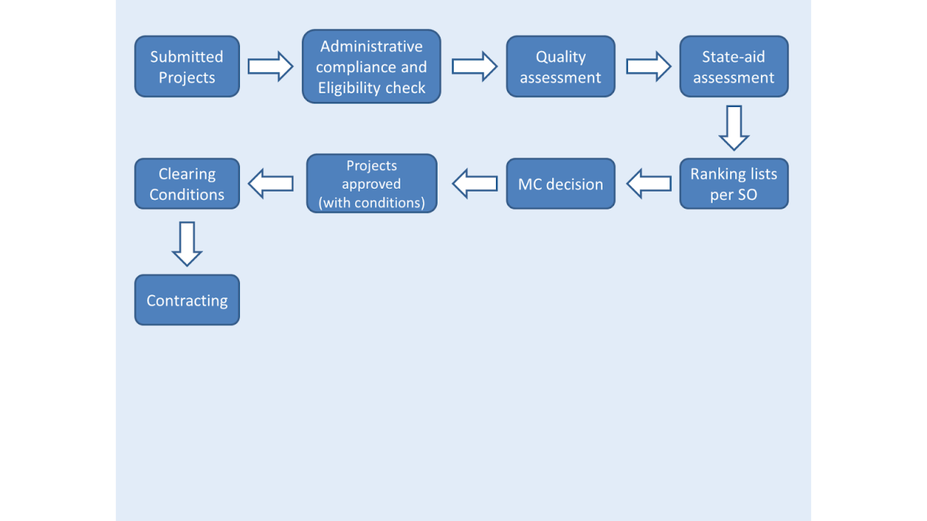
2CfP: Assessment procedure

Slide 20
2CfP: Timeline
17/09/2024
OPENING of
2nd CALL
19/11/2024
Submission DEADLINE
Nov 2024/ Mar 2025
ASSESSMENT
By June 2025
PROJECTS START

Slide 21




Veneto Region
Area for Economic Policies, Human Capital
and Programming of European Funds
Directorate for Joint Programming
Italy – Croatia Managing Authority and Joint Secretariat
  Dorsoduro, 3494/A - 30123 Venezia Italy
  italia.croazia@regione.veneto.it
  italia.croazia@pec.regione.veneto.it
  +39 041 2791781
  www.italy-croatia.eu

