Slide 1
ARCHAEODIGIT
Digital Paths for Sustainable Archaeological Tourism
Claudio Carlone - Project Coordinator, Municipality of Macerata

Slide 2
ARCHAEODIGIT in short
ARCHAEODIGIT developed an innovative Methodology, an Integrated Strategy and advanced skills for preserving, interpreting and valorising archaeological areas, integrating them into wider cultural and tourism territorial ecosystems.
The Methodology has guided partners in analysing the selected archaeological areas (identifying its territorial context, connecting tangible and intangible heritage, and selecting the most suitable digital and management solutions).
This methodology has been then applied in 4 test areas (in Italy and Croatia) as follows:
Elaboration of 4 management plans
New services and digital tools developed and a common digital platform
Pilot actions implementing the plan ad testing the proposed solutions and training contents
Formal adoption of management plans
Definition of follow up joint strategy to consolidate the project results

Slide 3
Pilot actions in practice
Proposed digital and physical solutions include:
Interpretation of archaeological heritage
Orientation and visitor engagement
Storytelling based on tangible and intangible heritage
Links between archaeological sites, landscapes and local routes
More inclusive and attractive tourism experiences
The ULTIMATE GOAL was to demonstrate how proposed digital and physical solutions make archaeological heritage more accessible and connect the sites with their wider territorial context.

Slide 4
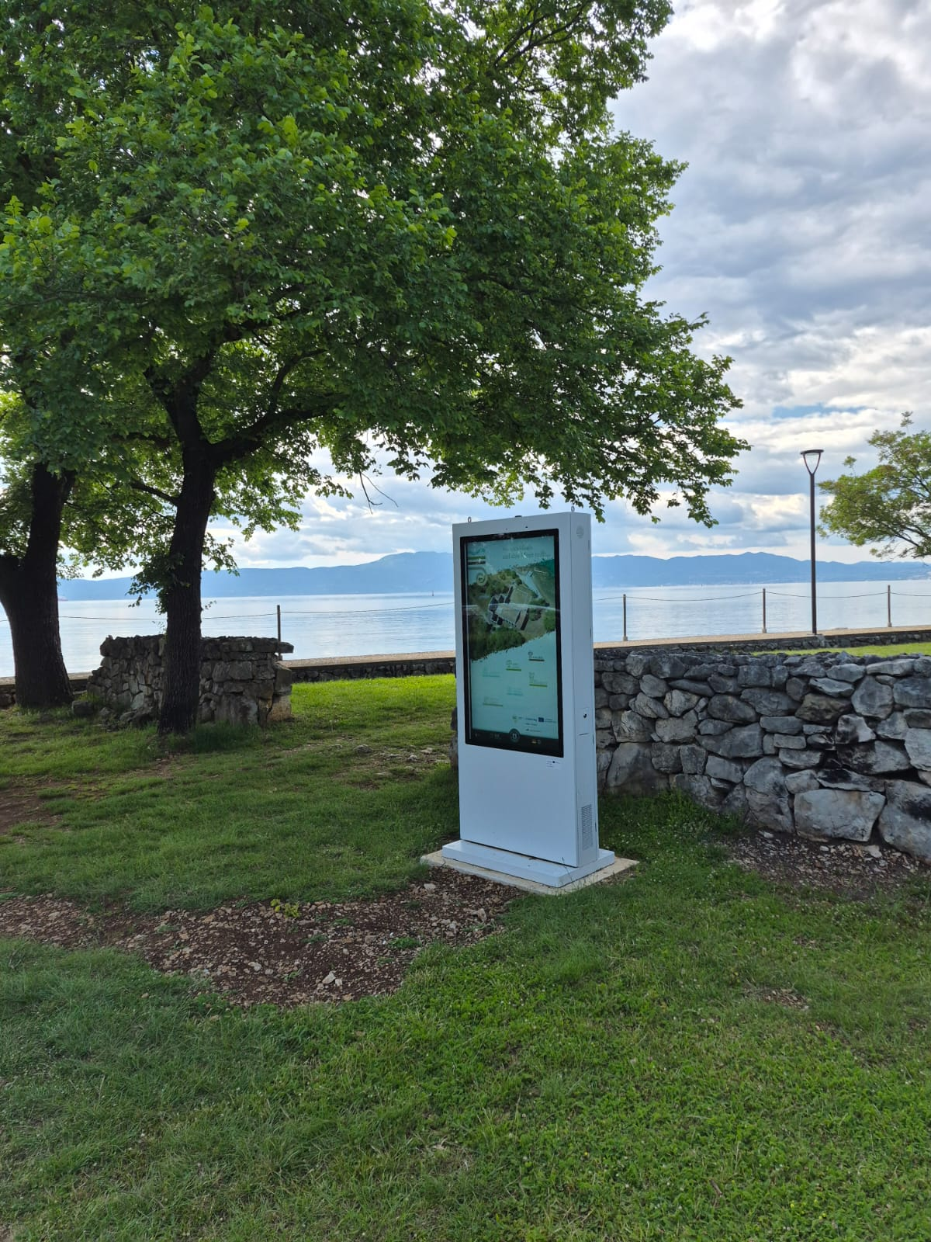
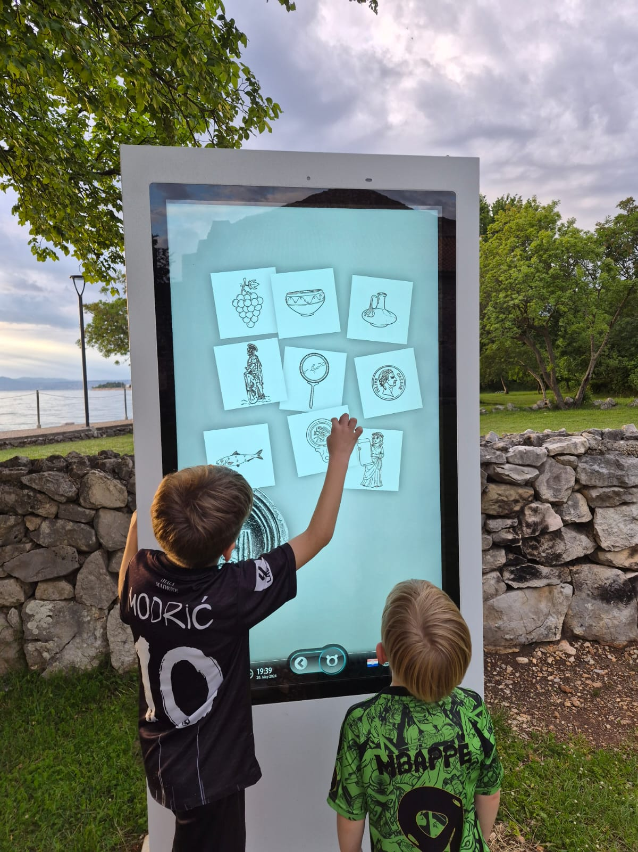
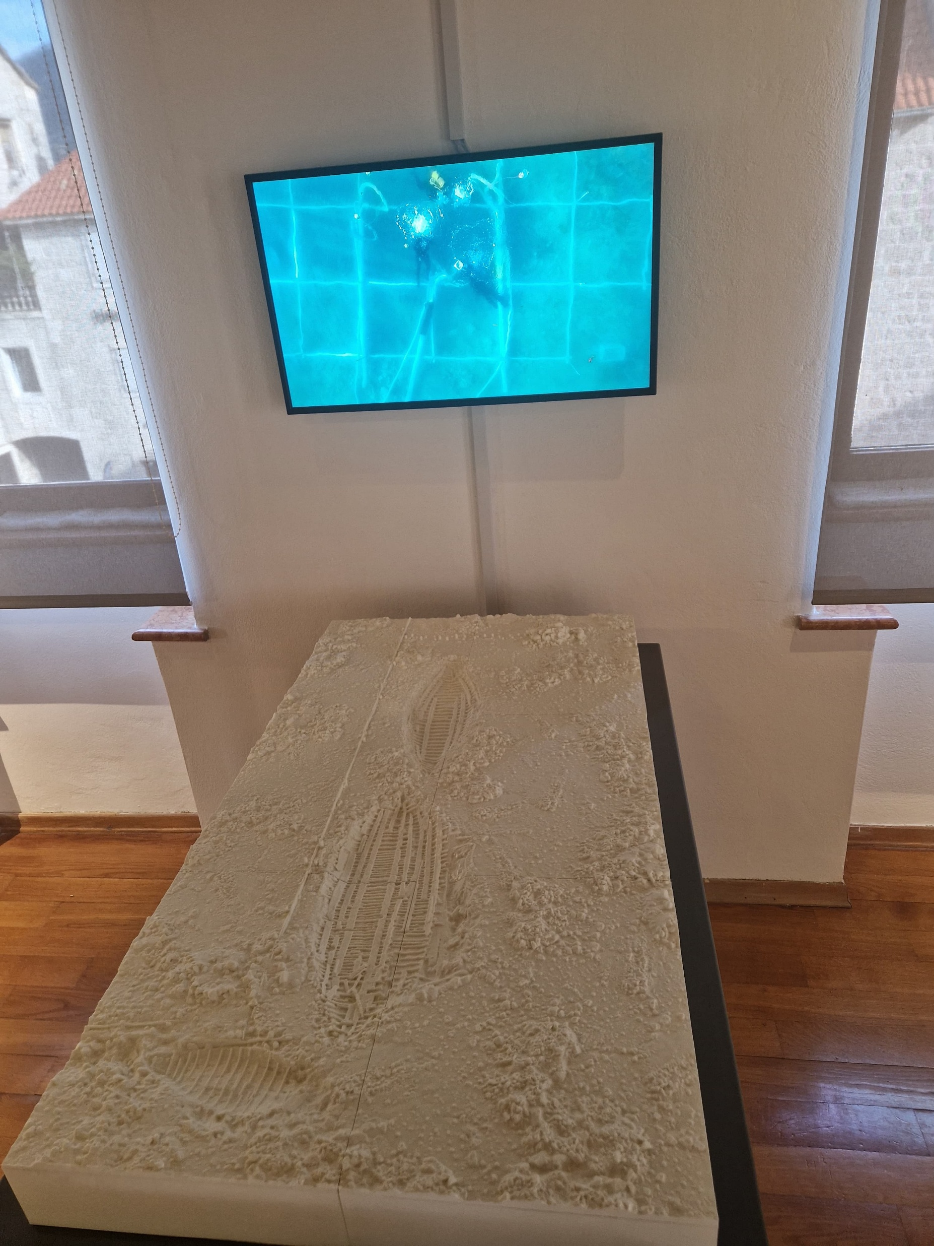
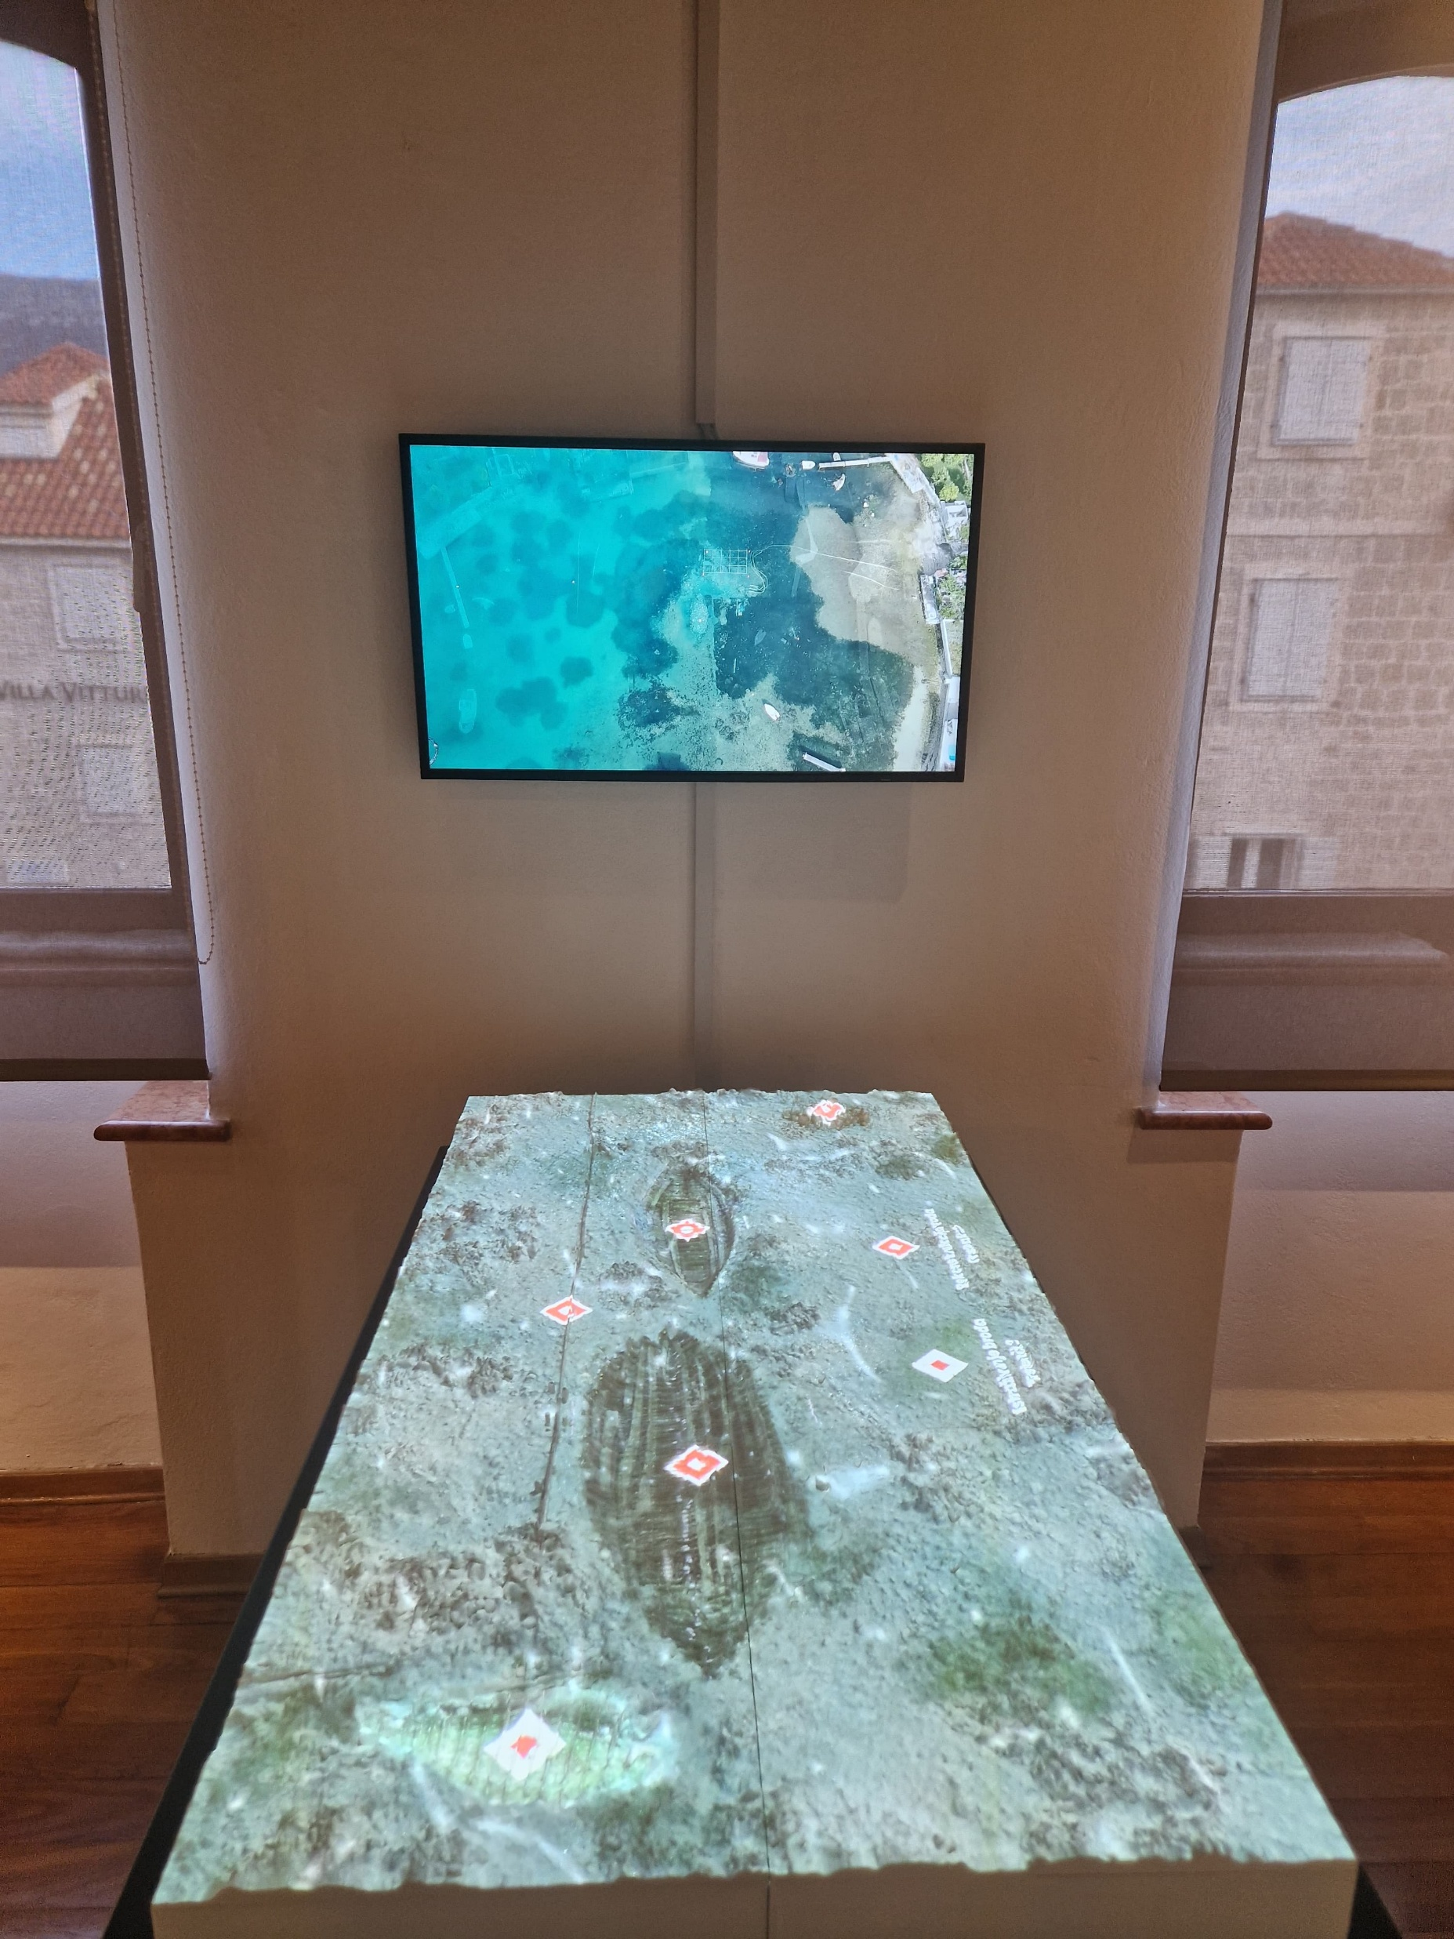
Kaštela / Trstenik–Salona
Tactile 3D model and multimedia storytelling for accessible heritage
Omišalj / Fulfinum-Mirine
Outdoor interactive totem and family-oriented digital engagement

Slide 5
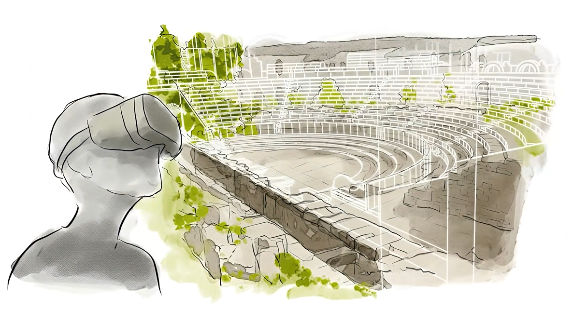
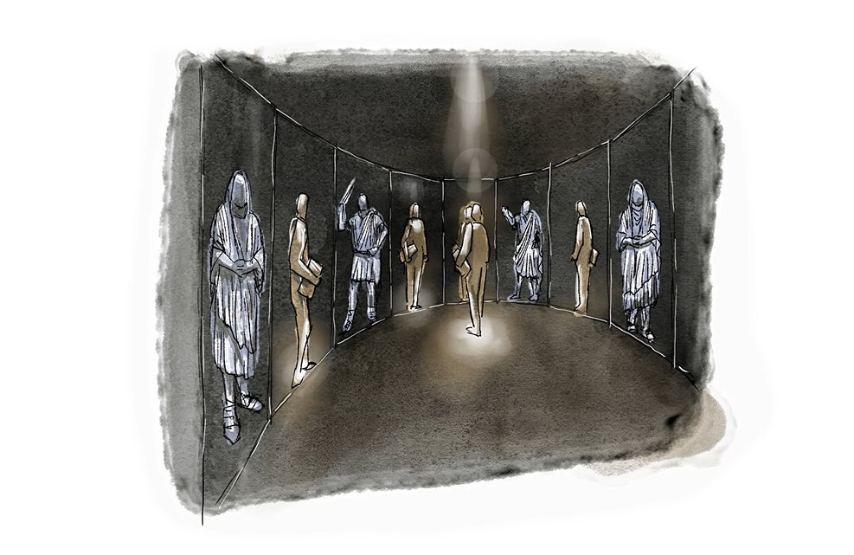
Macerata / Helvia Ricina
Immersive and interpretive visitor experience
Sepino / Saepinum
3D reconstruction and VR-based archaeological interpretation

Slide 6
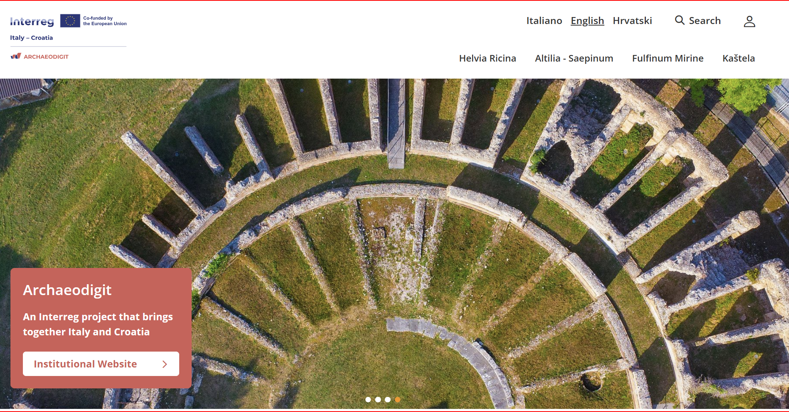
A digital platform for the four archaeological sites
ARCHAEODIGIT develops a joint digital ecosystem composed of four mobile visitor applications and a dedicated joint platform, where each test area can adapt/add contents based on its identity, audiences and visitor needs.
Through the mobile apps and the platform, visitors can:
Follow map-based itineraries and Points of Interest
Access concise interpretive texts, images and audio contents
Discover storytelling formats for adults, families and young audiences
Connect monuments with landscapes, museums, cities and local routes
https://archaeodigit-stg.virtualcontent.it/it/home

Slide 7
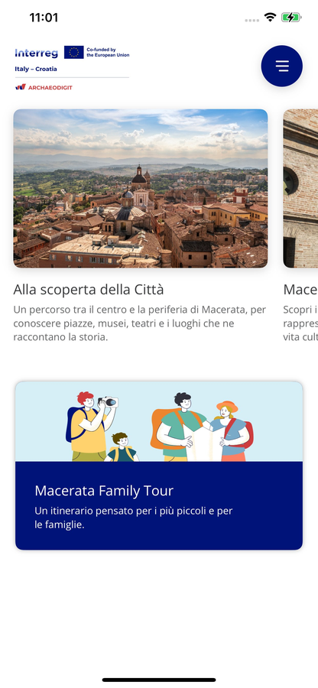
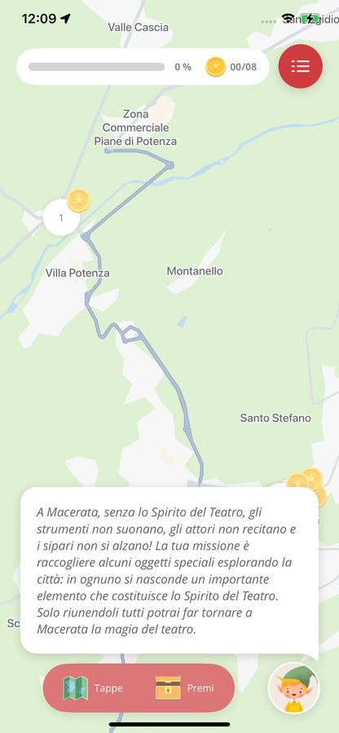
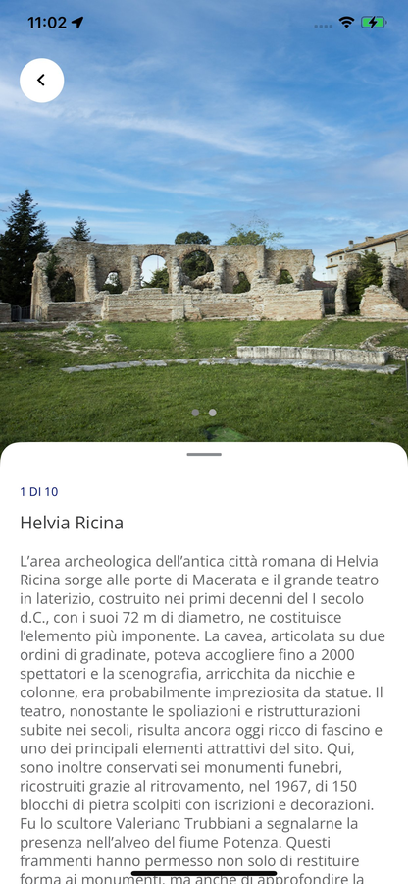
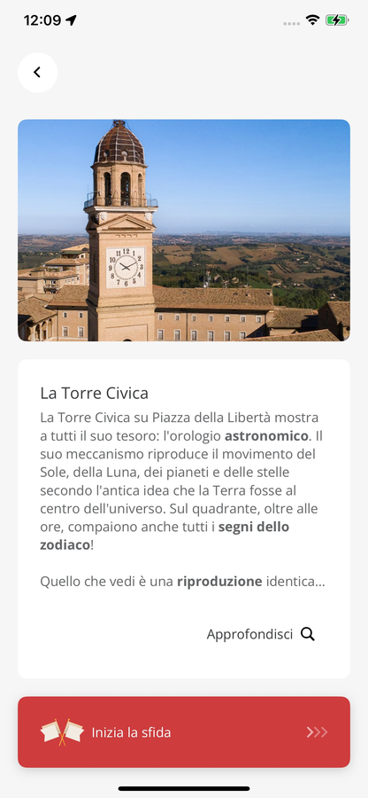
Example from Macerata test area: a gamified visitor experience
Interactive task
engage through interactive storytelling
Point of Interest
access heritage content
Home
choose the visitor experience
Gamified route
follow a geolocated path

Slide 8
A transferable and sustainable methodology for Mediterranean destinations
ARCHAEODIGIT can be adapted to other territories, indeed test areas have different features in terms of:
Level of jurisdictional competences for archaeological heritage protection (national and local)
Capacity and level of innovation in archaeological heritage management;
Touristic ecosystems’ features: some are in very popular coastal destinations, other in inland areas where touristic opportunities are less exploited).
Transferability and sustainability is also ensured by a strong co-creation approach (transnational co-creation workshops and territorial local hubs) and sustainable capacity building measures (MOOC, Train the trainer) and the elaboration of a follow up Joint Strategy.
ARCHAEODIGIT turns archaeological heritage into accessible, digital and sustainable tourism paths.

Slide 9


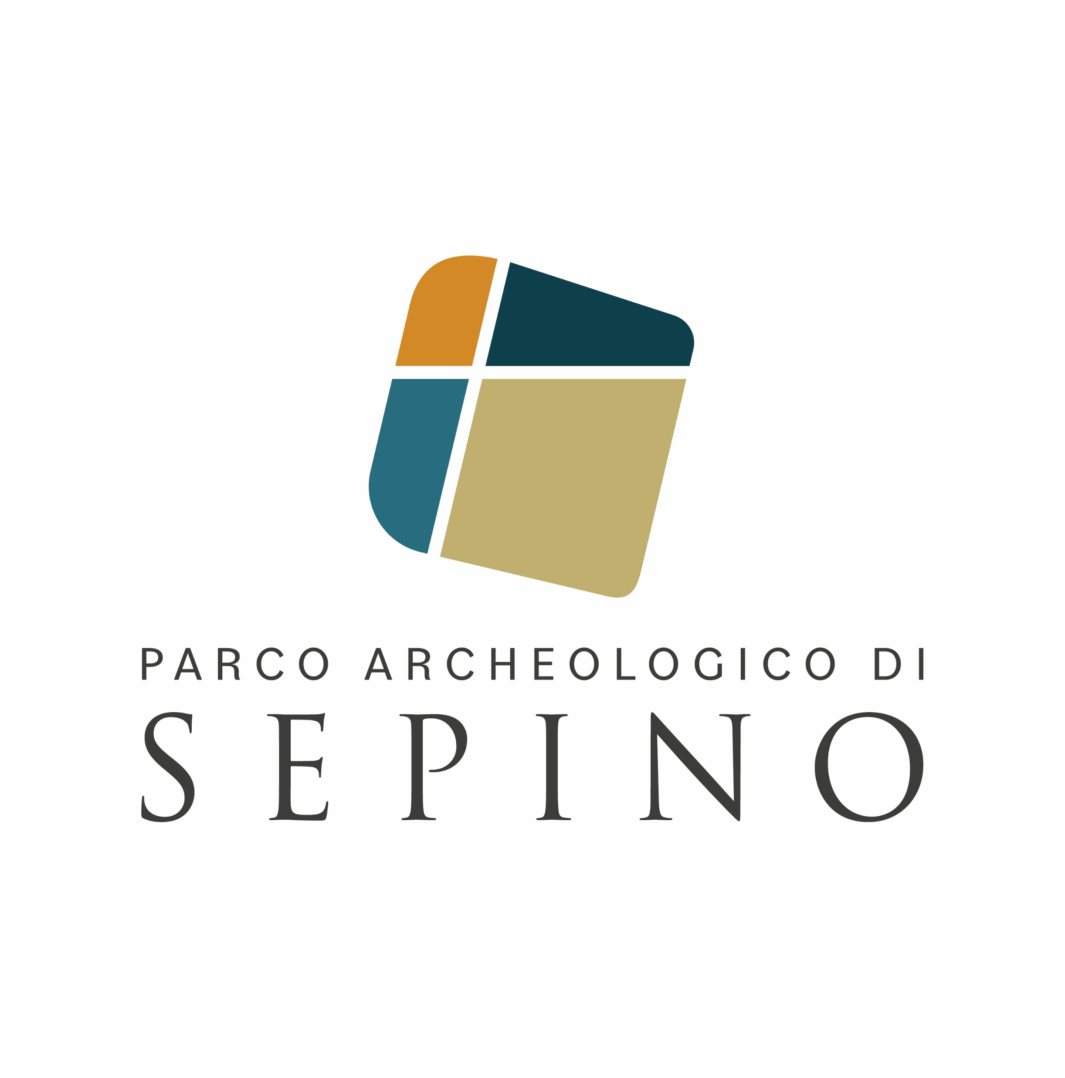






Claudio Carlone
Email: ufficio.europa@comune.macerata.it

