Slide 1

6TH ADRIATIC IONIAN YOUTH
ORGANISATIONS FORUM
EU opportunities for creating an ecosystem of informed young stakeholders to shape the future of the Adriatic and Ionian Region
Adriatic Ionian Euroregion
15 May, Sibenik V

Slide 2



DEVELOPMENT EDUCATION AND AWARENESS RAISING (DEAR) PROGRAMME
The EU DEAR Programme funds projects that engage people in Europe in worldwide issues of social, economic and environmental development and cooperation. It supports civil society organisations and local authorities to promote global justice, human rights, sustainable development and democratic participation. It empowers people, especially young people, to take action

Slide 3
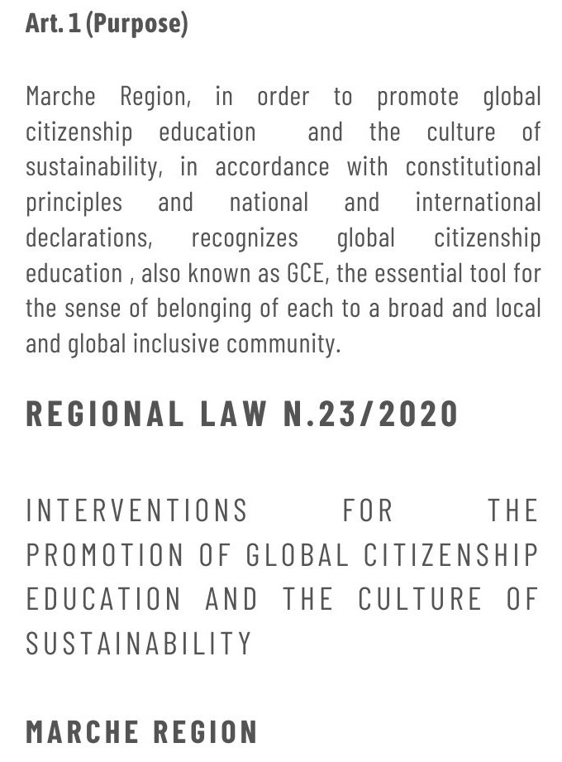

GEAR UP! PROJECT

Slide 4
GEAR UP! FOCUS
Supporting the initiatives of local authorities and civil society organizations in 8 EU countries AND 5 IPA COUNTRIES (7 eusair countries) through financial support instruments
Strengthening capacities, competences, exchange processes and resources of local authorities and civil society organisations on GCE through capacity building and networking activities at regional and European level
increasing awareness and sensitivity towards Sustainable Development and global challenges among young people (15-30 years old) of the 8 EU territories involved, through their involvement in ECG actions promoted by local authorities and civil society organizations
increasing knowledge and awareness on gender and non-discrimination in the debate between associations, networks and young people, ensuring a balanced application in the activities, in terms of policies and practices adopted

Slide 5
CONSORTIUM
PARTNERS
ASSOCIATES
THURINGIA REGION (GERMANY)
EMILIA ROMAGNA REGION (ITALY)
PROVINCE OF ZARAGOZA (SPAIN)
PROVINCE OF BARCELONA (SPAIN)
BUDAPEST CAPITAL CITY IX DISTRICT (HUNGARY)
RIGA CITY MUNICIPALITY (LATVIA)
CONCORD ITALIA (ITALY)
ADRIATIC-IONIAN EUROREGION (CROATIA)
CITY OF ZAGREB (CROATIA)
CROSOL – CROATIAN PLATFORM FOR INTERNATIONAL CITIZEN SOLIDARITY (CROATIA)
EWNT THÜRINGEN – GERMAN PLATFORM OF NGOS (GERMANY)
FORS - CZECH FORUM FOR DEVELOPMENT COOPERATION (CZECH REPUBLIC)
HAND - HUNGARIAN ASSOCIATION OF NGOS FOR DEVELOPMENT AND HUMANITARIAN AID (HUNGARY)
HAUTS-DE-FRANCE REGION (FRANCE)
LAPAS - LATVIAN PLATFORM FOR DEVELOPMENT COOPERATION (LATVIA)
ZARAGOZA CITY COUNCIL (SPAIN)

Slide 6







KEY DATA
42 months
Targets
1) Small and medium-sized local authorities at national and regional level (approx. 50)
2) Small and medium-sized civil society organisations active in sustainable development, ECG and youth involvement (approx. 250).
Final beneficiaries
1) Young people aged between 15 and 30 (approx. 25,000)
2) Citizens of the 8 territories involved (approx. 120,000)
Financial supporting instruments
220 for the whole project
90 for EUSAIR Countries
25 for IPA Countries
€ 5.951.605 TOTAL BUDGET
€ 5.356.444
EU FUNDS

Slide 7


WORKPLAN
CLUSTER A -
FINANCIAL SUPPORT TO THIRD PARTIES
CLUSTER B -
CAPACITY BUILDING AND NETWORKING ACTIVITIES
CLUSTER C -
GENDER EQUALITY
CLUSTER D -
CROSS-CUTTING ACTIVITIES

Slide 8
CONNECTIONS WITH EUSAIR
The actions will be developed in IT, ES, DE, FR, CZ, LV, HR, HU with a focus on IPA countries Albania, Bosnia and Herzegovina, Montenegro, Serbia and North Macedonia.
GEAR UP! Activities in EUSAIR countries is based on the existing and on-going experiences:
Youth engagement in EUSAIR through 2 projects: EUSAIR Facility Point and AI-NURECC PLUS;
Adriatic Ionian Youth Organisations Forum, started in 2019 by AIE to promote transnational and interregional cooperation in the AI Macroregion, highlighting the need for more concrete communication with young people in EU and Western Balkans;
YAP – Youth Action Plan 2022/27 (EC) with aims to increase the voice of young people in policy and decision-making at all levels, address inequalities and providing young people with the skills and resources they need to achieve their potential, foster opportunities for young people and create network and exchange with their peers.
GEAR UP! 2024-2026 Activities in EUSAIR Countries will take in consideration also the results achieved by the EUSAIR Youth Council

Slide 9
ACTIVITIES IN IPA COUNTRIES
In the next 4 years the project will put all its efforts to
provide financial support to associations in all IPA countries through training and awareness-raising activities for young people on the topics of:
    SDGs , Climate change, Sustainable economy, Gender equality
Promote youth engagement, providing them greater knowledge and awareness on sustainability and global justice, developing their critical spirit and involvement in active citizenship actions, as well as greater involvement in community participatory processes with the following activities:
    Realize Local multi-stakeholder capacity building​ (2 local event in Bosnia and Albania) to increase knowledge on GCE
    Organize specific training sessions on specific thematic priorities for LAs and CSOs​ (North Macedonia and Montenegro) in order to raise competences and skills in GCE, SDGs, gender equality, youth engagement and global/local interdependencies​
    Networking activities at country level​ (in Serbia and Bosnia) to create local networks on GCE
    Networking activities at EU level with European seminar on SDGs contents (Sarajevo)

Slide 10
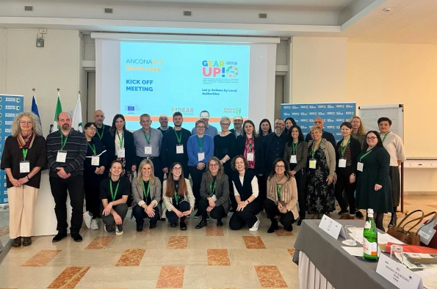
GEAR UP! PROJECT
Thank you for your attention!
GEAR UP! Project partners
Marche Region Lead Partner

