Slide 1

The goals of DEMY-Coop as a
capitalisation of AI-NURECC PLUS
youth engagement actions
Maria Luisa ESPOSITO| Communication Mng

Slide 2
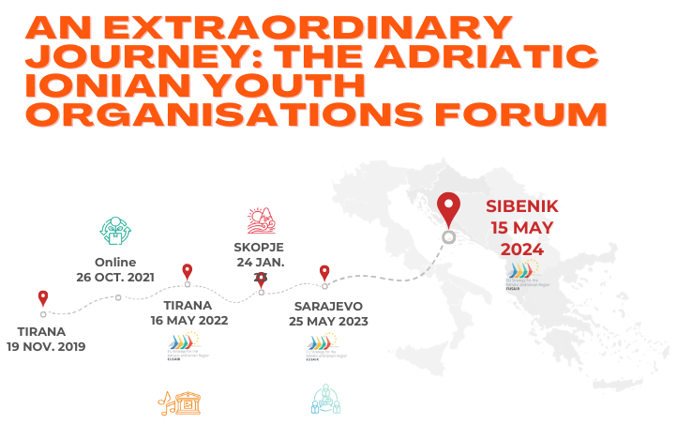





A dynamic and inclusive platform for youth engagement and collaboration in the vibrant Adriatic Ionian region.
AIE-AIYN Declaration of Intents signed in September 2023 to reinforce cooperation after the closure of AI-NURECC PLUS.
AIYN is part of AIE’s Working Group on Youth, a statutory body.
@AIYN.eusair
@adriatic.ionian.youth.network

Slide 3
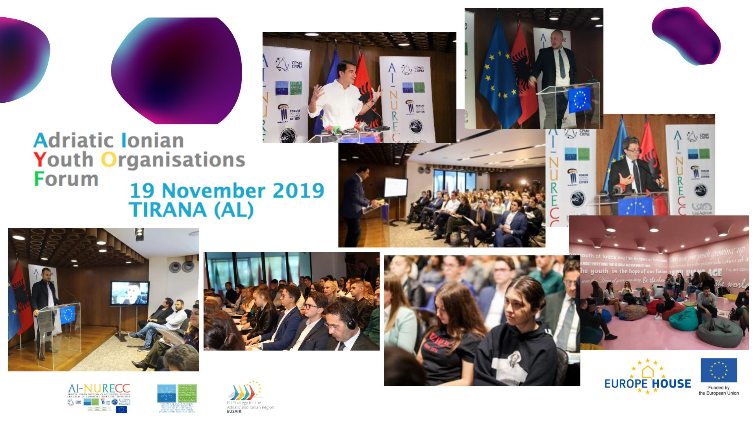

Slide 4
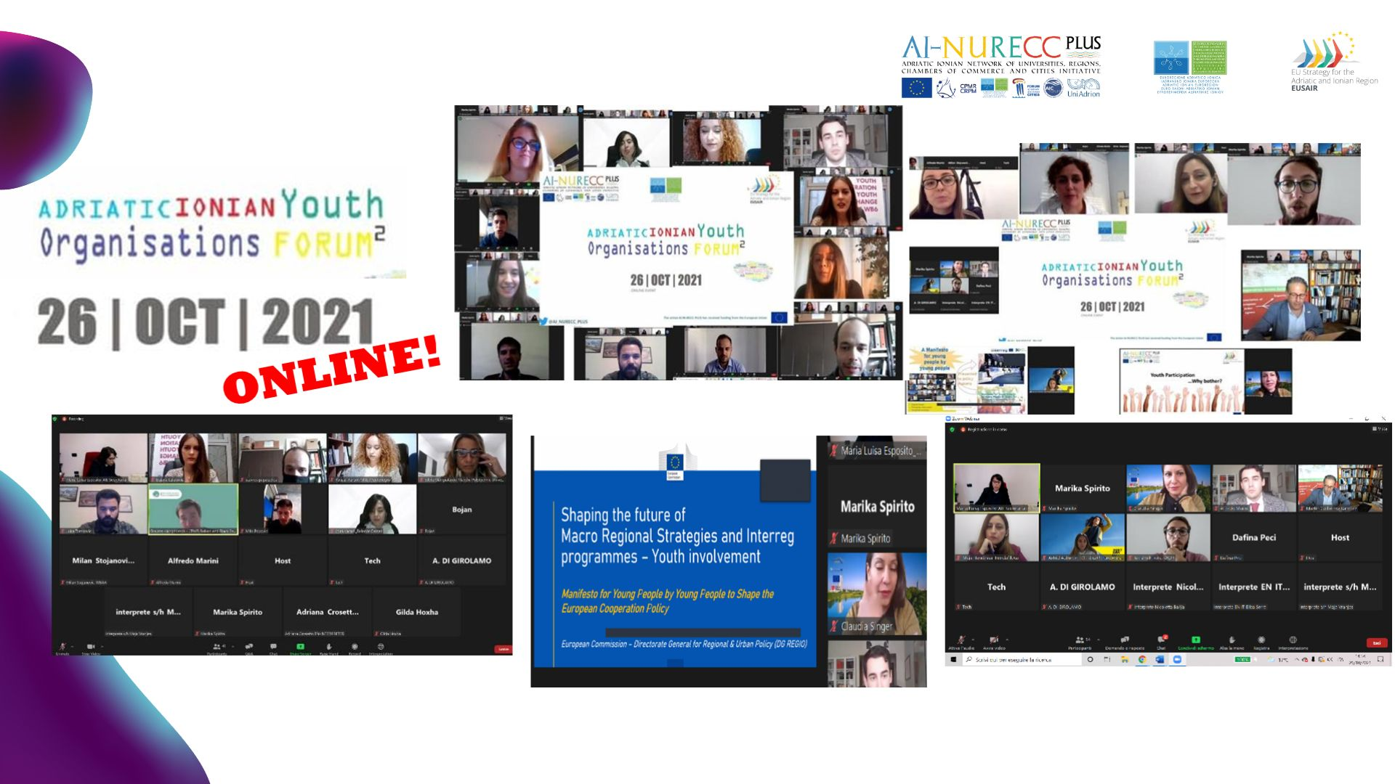

Slide 5
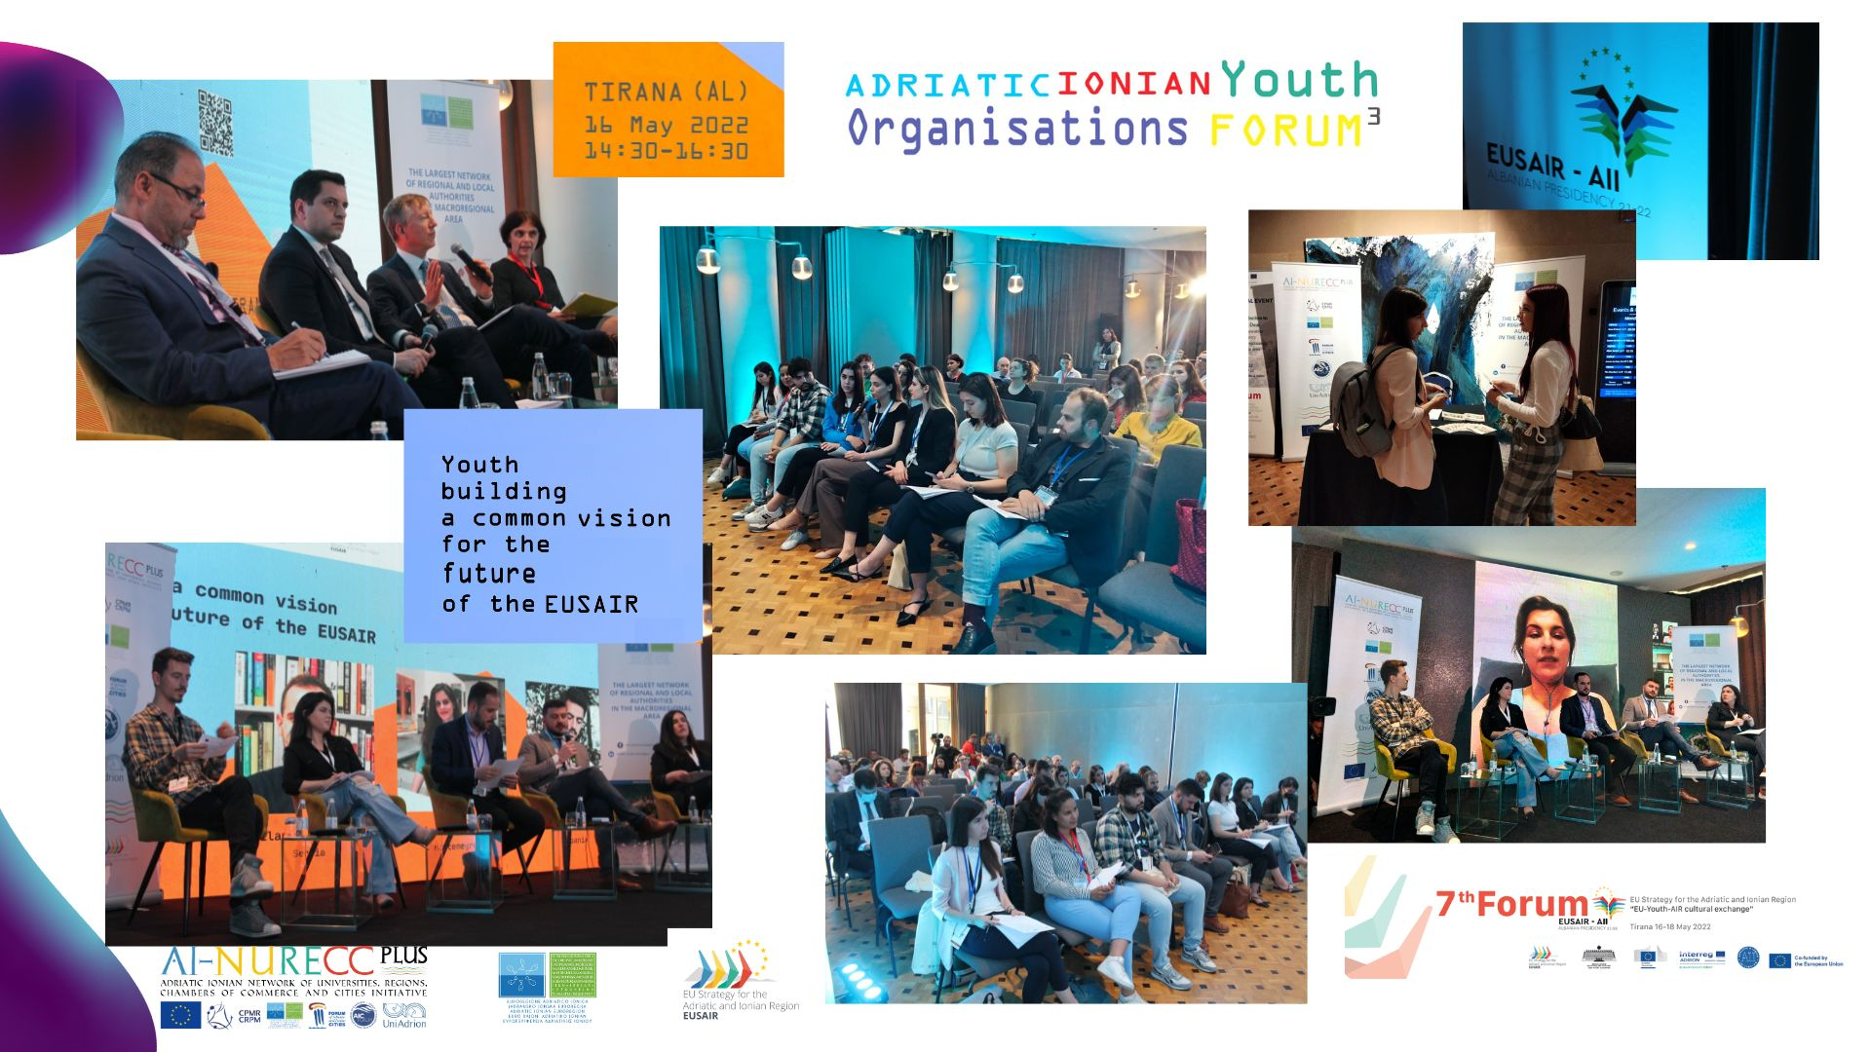

Slide 6
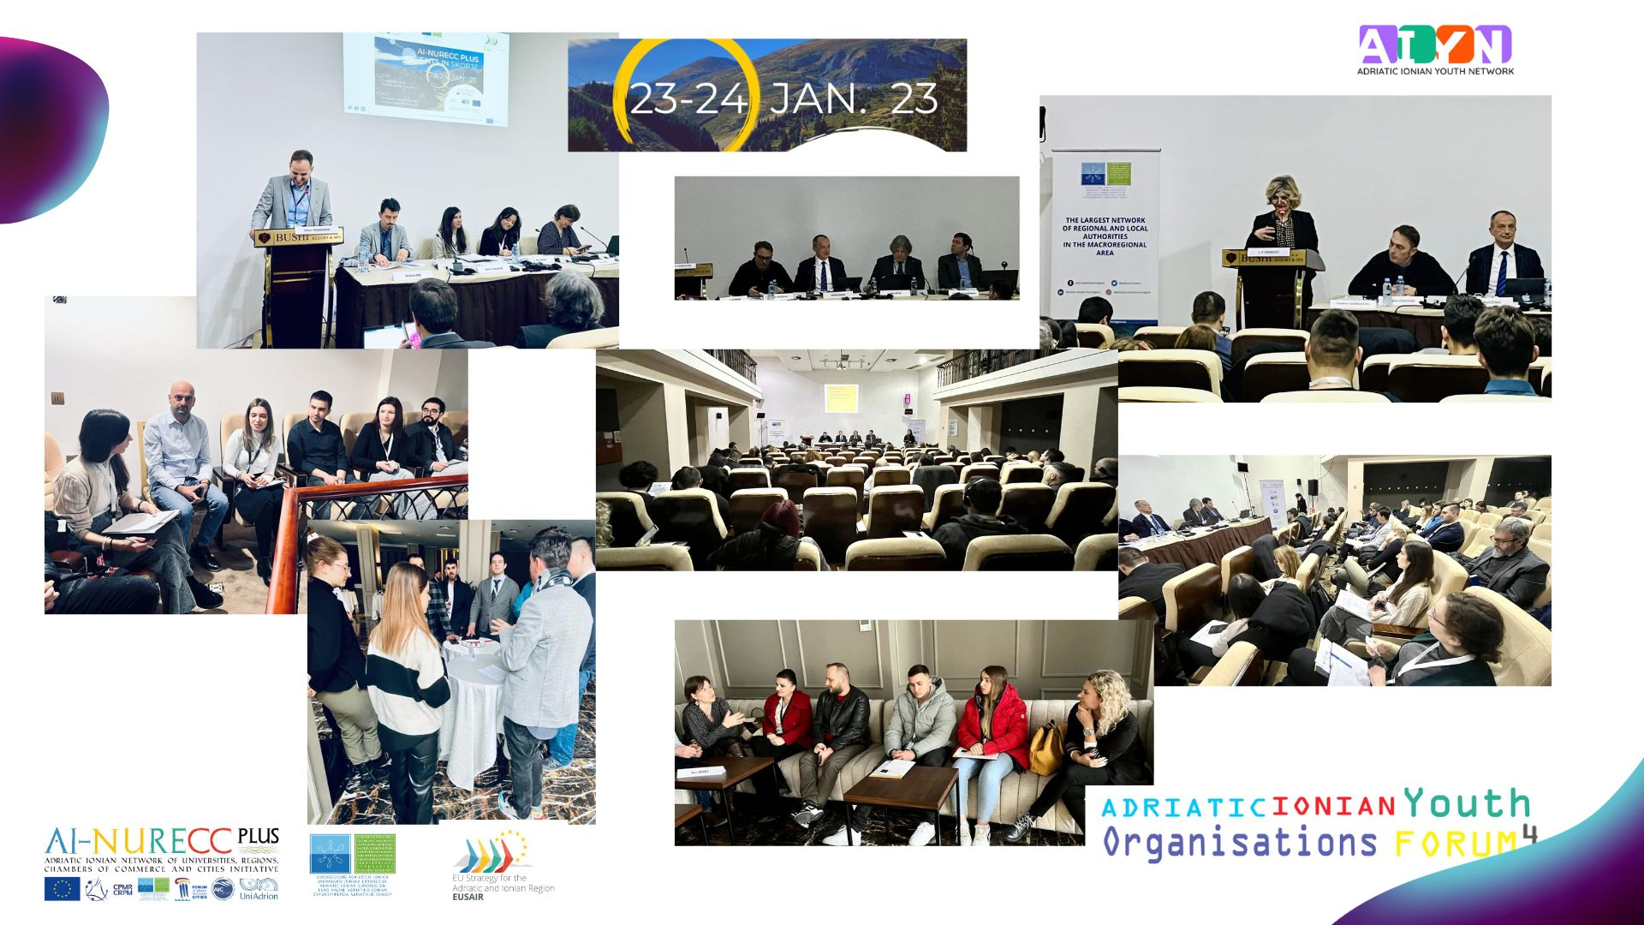

Slide 7
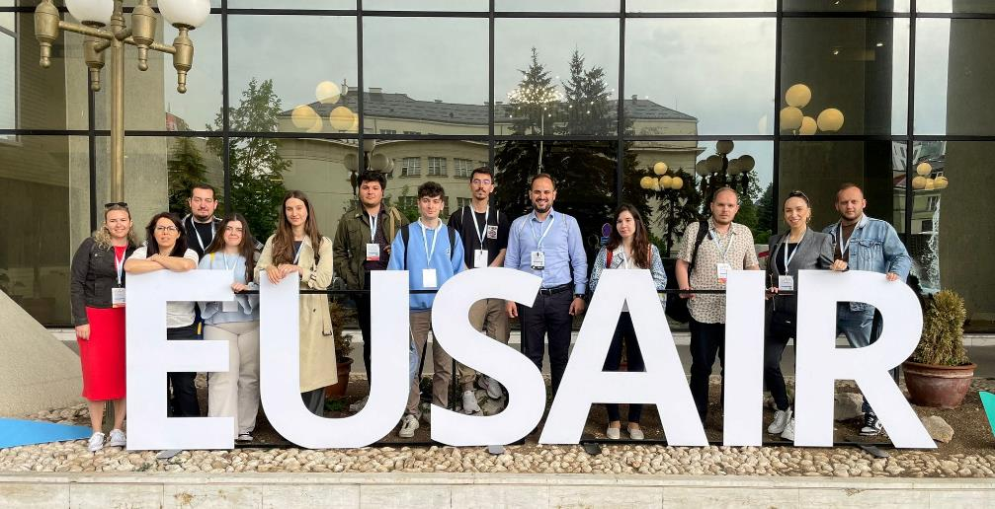

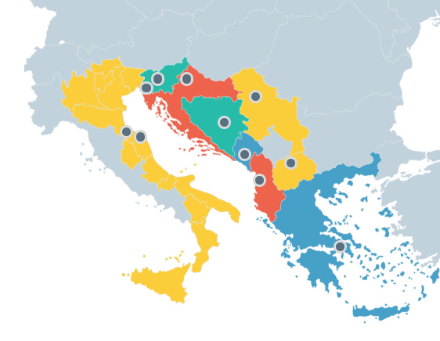


Slide 8
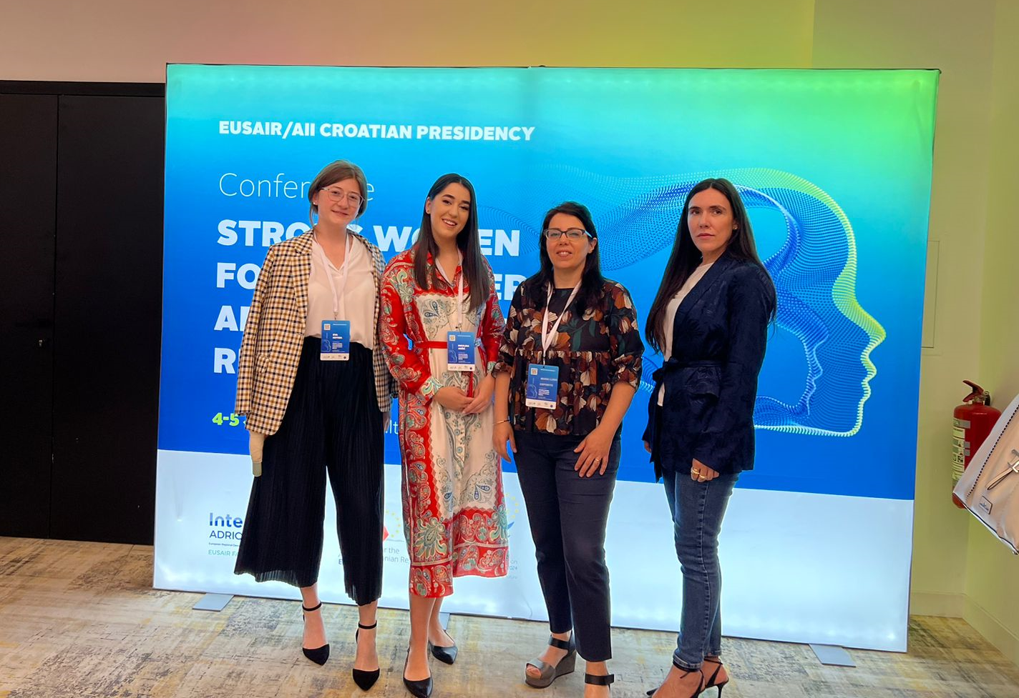
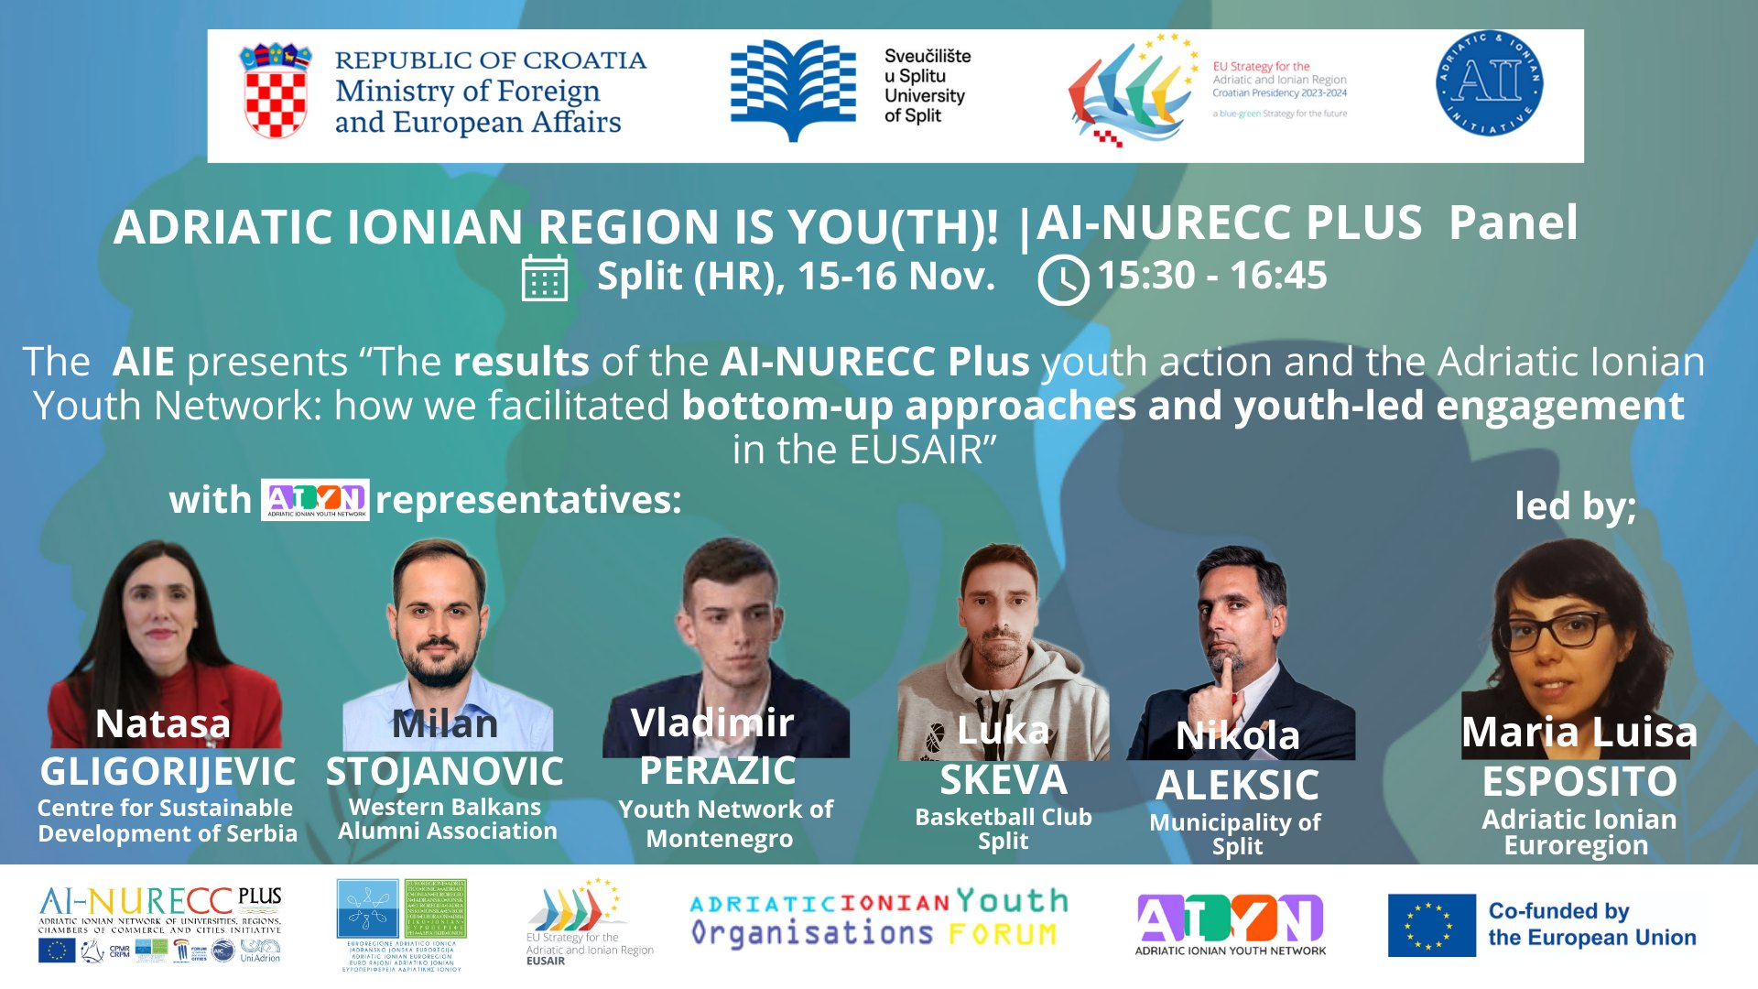
International conference “Strong Women for a Stronger Adriatic-Ionian Region”, July 4 and 5, Zagreb (HR)
Youth Conference “Adriatic Ionian Region Is You(th)” November 15 and 16, Split (HR)

Slide 9

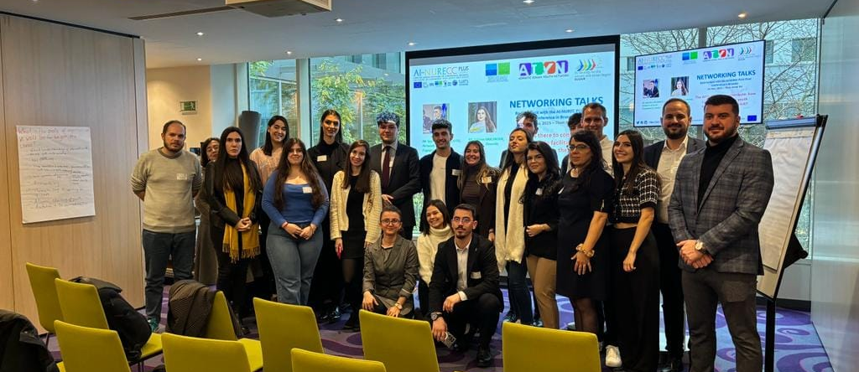
NETWORKING TALKS
The Adriatic Ionian Youth Network is there to contribute:
how can we help the EUSAIR in
facilitating youth engagement?
Presentation of 3 papers on Sustainable Tourism, Ciruclar Economy and Cultural and Creative Industries
AI-NURECC PLUS Final Conference in Bruxelles

Slide 10

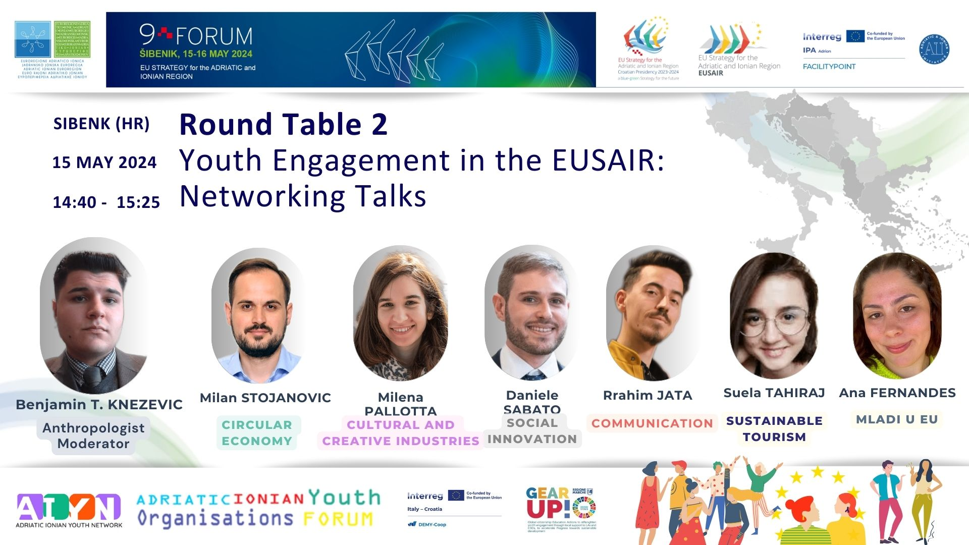
AIYN 1st GENERAL ASSEMBLY
on 15 May in Sibenik
and

Slide 11
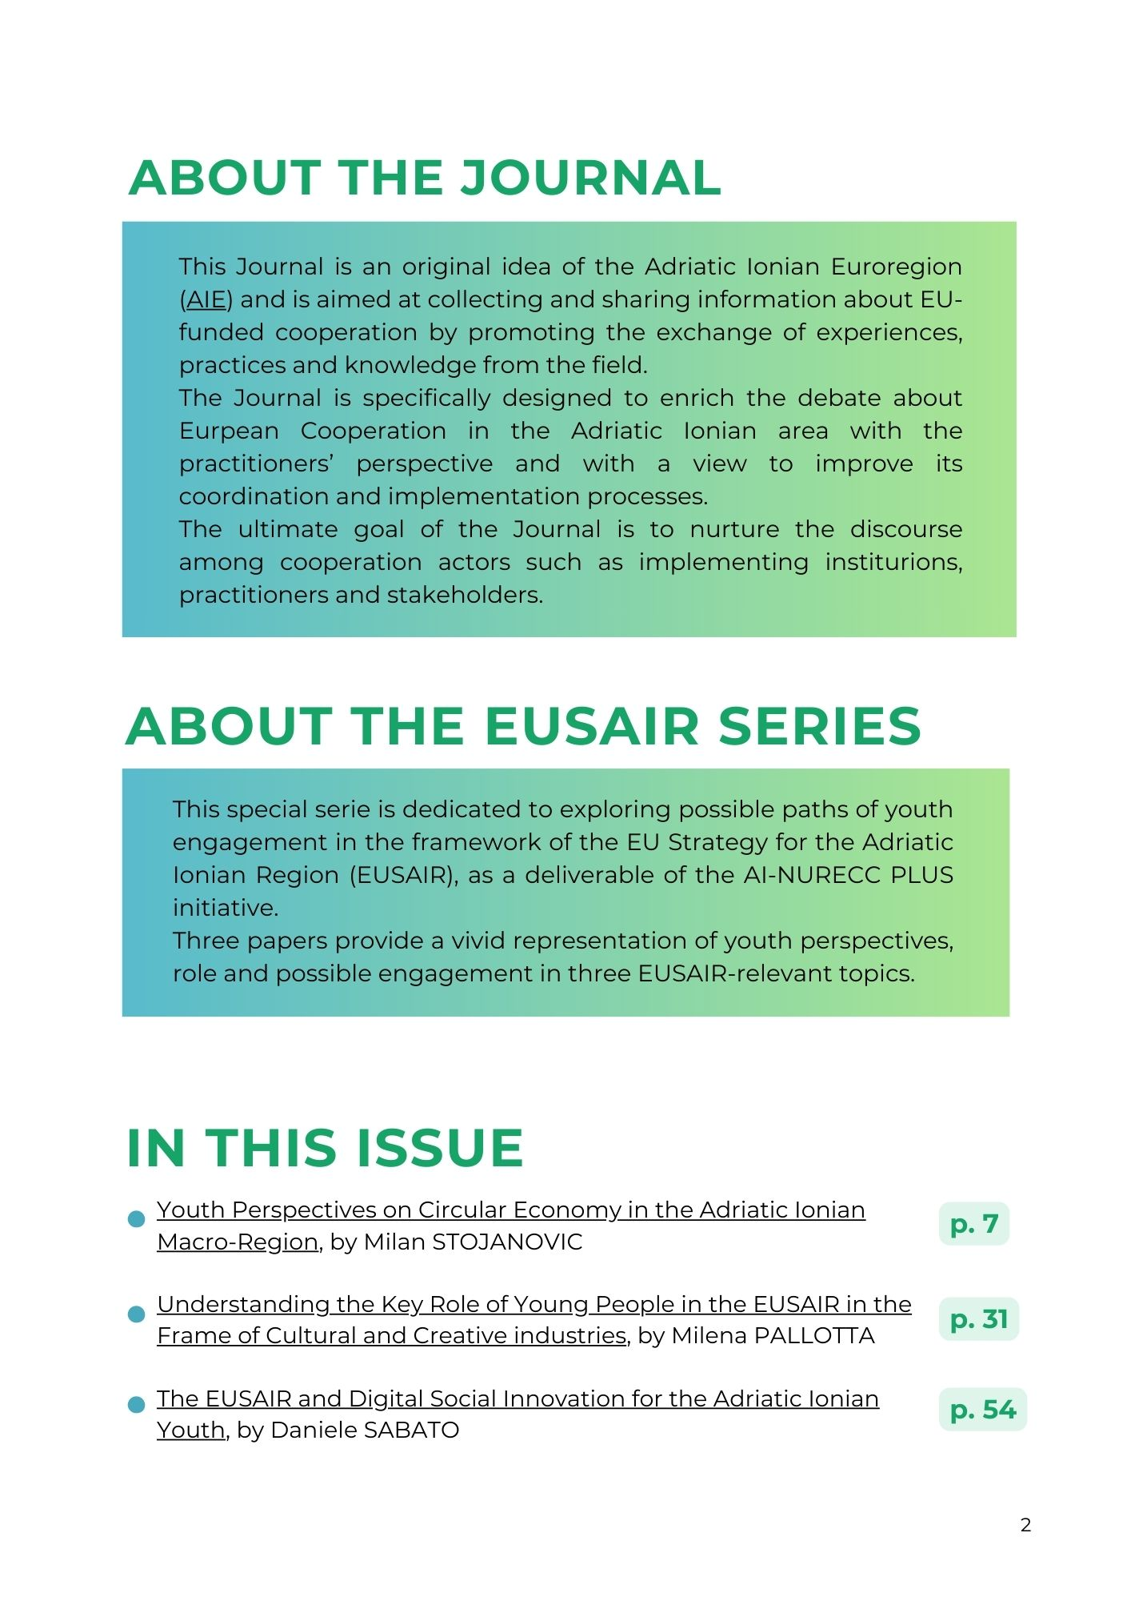



Slide 12








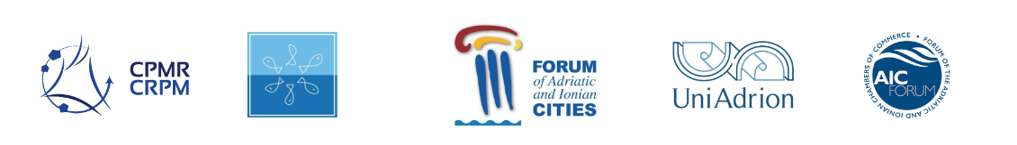
DEMY-Coop Decision-Making Youth for CB COOPeration is a pilot action that capitalises the results of the youth engagement actions undertaken by the AI-NURECC PLUS initiative
Territorial coverage:
5 - Integrated governance for stronger cooperation
SO 5.1 - Better cooperation for governance
Source of financing: ERDF
Programme: Interreg CBC Italy-Croatia 2021-2027
Duration: August 2023- December 2024
Partnership:
and supported by
AI-NURECC PLUS – Adriatic Ionian Network of Universities, Regions, Chambers of Commerce and Cities PLUS
Source of financing: DG Regio (Direct Grant)
Territorial coverage: 10 EUSAIR countries
Duration: April 2021 - December 2023
Partnership:

Slide 13
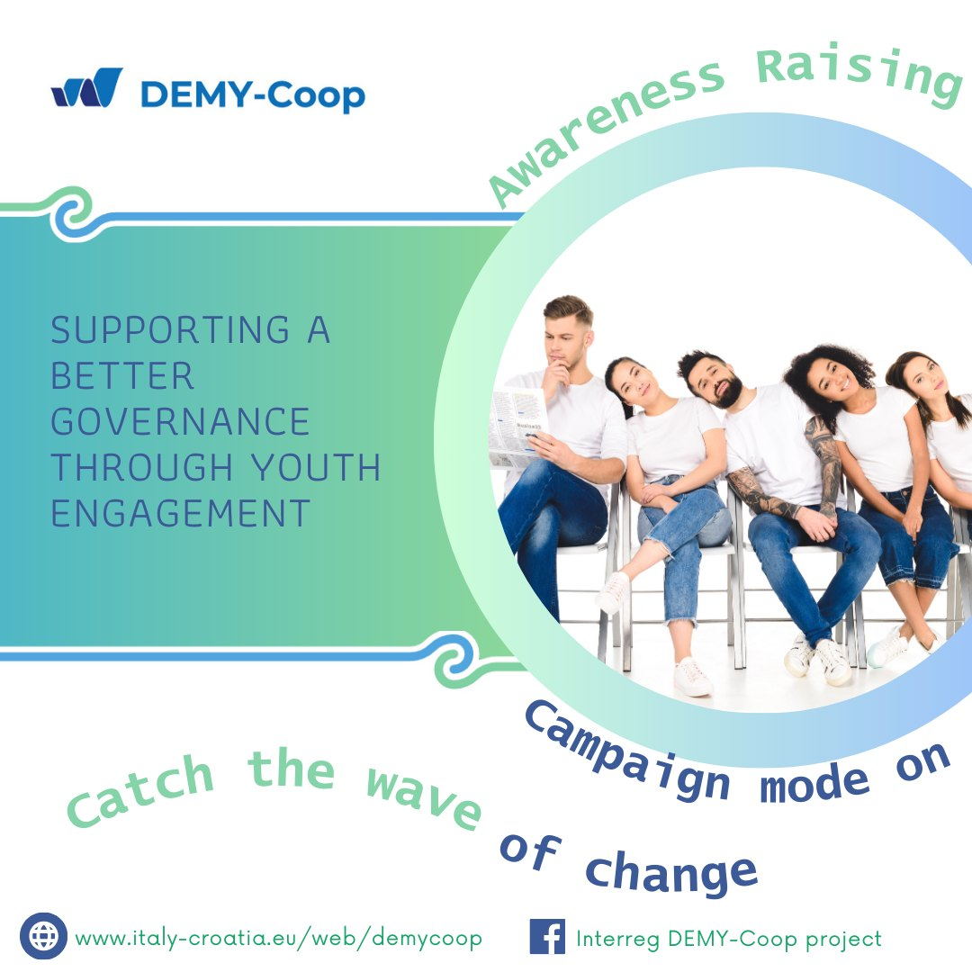
General objective: supporting a better cooperation for improving youth engagement in strategic decision-making by stimulating Italian and Croatian local and regional governing bodies in identifying youth as stakeholders and in overcoming the possible cultural, legal and administrative obstacles to their involvement in strategic decision-making.
Activities: Facilitation of youth engagement, Awareness raising campaign, Local meetings, 2 2 CB Youth Fora, Final Conference, Communication materials

Slide 14


Thank you for your attention! And …
Stay tuned for the next events!
To stay in touch with us…
…visit:
and like:
Local events in Summer 2024
Two CB Youth Fora in early Autumn 2024
www.italy-croatia.eu/web/demycoop
Interreg DEMY-Coop project

