Slide 1
6th Adriatic Ionian Youth Organisations Forum (AIYOF6)
EU Opportunities for the Adriatic Ionian youth
IPA/EUSAIR/SEE Accession Negotiations Team Leader, REGIO D1, Gilles Kittel
Šibenik, 15 May 2024

Slide 2
In this presentation…
Our reference and methodology
Ideas for better youth involvement
1
2

Slide 3

1
Our reference and methodology

Slide 4
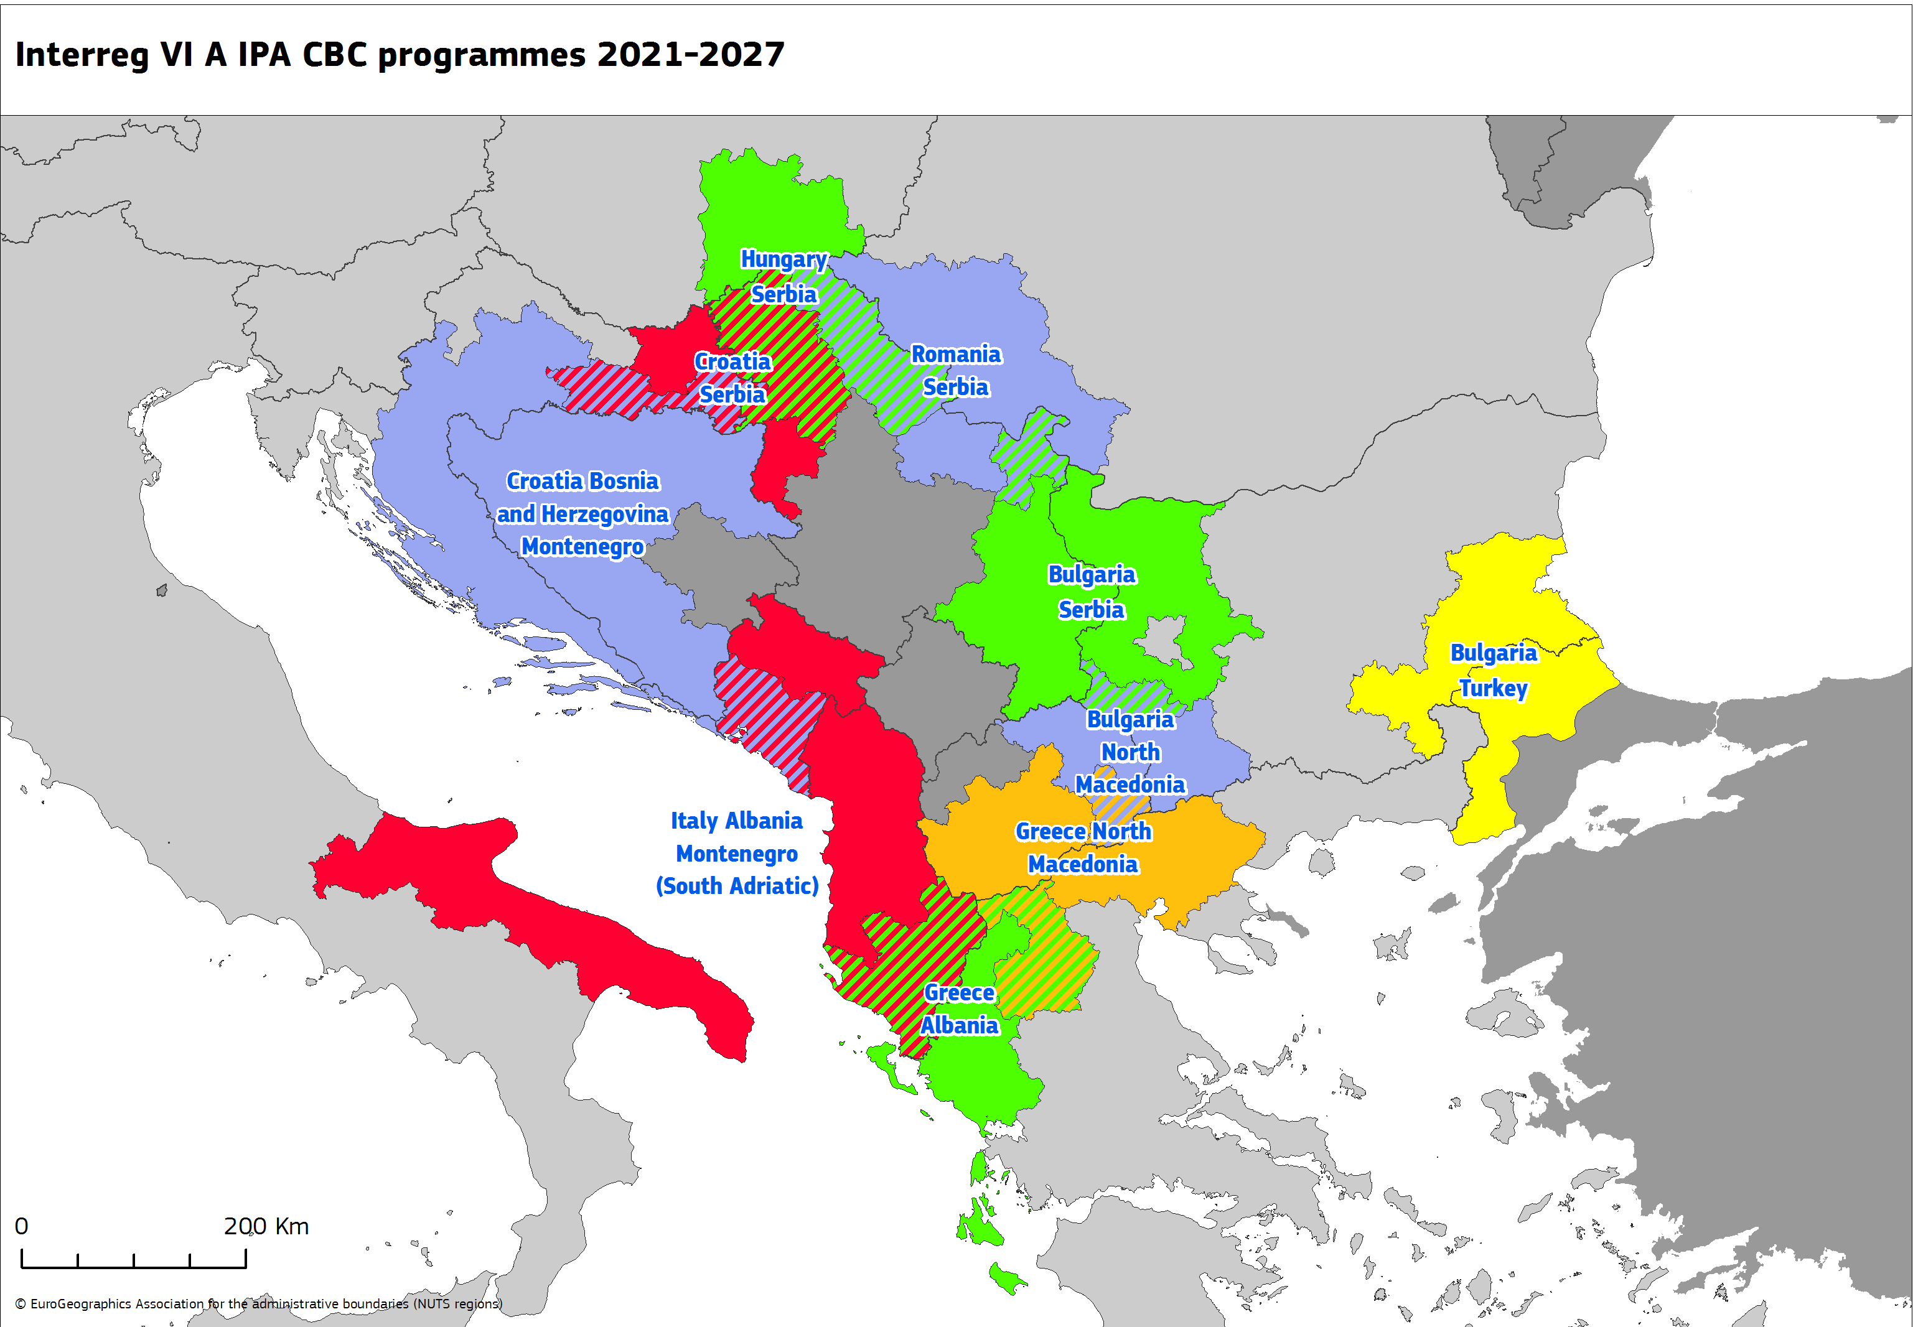

Interreg IPA programmes strand A
10 Interreg IPA CBC programmes
  2021-2027 Interreg IPA programmes -> much more « IPA » oriented programmes
  2021-2027 IPA allocation: +6,2% vs 2014-2020 allocation
  For all Interreg IPA CBC, IPA allocation > ERDF allocation
© European Union

Slide 5

Interreg IPA programmes strands B & C
3 Interreg IPA TN & 1 Interreg IPA IR programmes
+ URBACT IV (enlarged to 5 IPA countries)
© European Union
NB: EURO NEXT MED & NEXT Black Sea -> also partially financed through IPA.
  IPA Adrion –> supports EUSAIR -> its 2021-2027 IPA allocation has been multiplied by 351% vs 2014-2020 -> main purpose: higher degree of territorial integration

Slide 6

Ideas for better youth involvement
2
Notes:
Photo credit: Jordan Mc Donald – via Unsplash

Slide 7
Main Challenges for Youth Participation
Economic barriers: limited economic resources, including high costs of political engagement and a lack of funding mechanisms for youth engagement activities
Available opportunities: lack of opportunities allowing meaningful participation, including provided by authorities and addressing youth interests and needs
Distrust: distrust in public institutions and decision-making processes, sceptical about whether their actions will be considered/followed by the public authorities
Information: lack of adequate information on opportunities of youth participation

Slide 8
What are the main barriers for young people to meaningfully participate in our Programmes?
Lack of awareness | Limited
Complexity of the Programme | Predominant
Lack of interest | Insignificant
Lack of opportunities | Limited

Slide 9


EUSAIR under revision & formal set-up of the Strategy’s new Youth Council
Notes:
Photo credit: Umit Yildirim – via Unsplash

Slide 10
To support young people participation in European Territorial Cooperation (ETC) & EUSAIR, what should be prioritised by the EU to have the greatest impact?
Capacity-Building: Support capacity-building activities to improve competences and skills for young people and youth organisations involved in ETC and EUSAIR
Youth Structures: Foster the development of and provide support to new or existing independent youth organisations and structures involved in ETC and EUSAIR
Equal access and inclusion: Implement and promote actions to ensure equal access to opportunities for young people to engage in interregional cooperation
Youth Participation in decision-making: Promote the participation of youth in engaging with decision-makers in planning and delivering on EUSAIR, ETC’s policies and programmes
Awareness raising campaigns: Implement and support awareness raising campaigns on the importance of meaningful youth participation in ETC and EUSAIR
Youth Participation in the programme cycle: Foster meaningful and inclusive youth participation and empowerment in all phases of design, implementation and projects
Youth mainstreaming: Promote youth mainstreaming (youth reflected in all thematic areas) in EUSAIR and ETC

Slide 11


Let’s work together!
Any Questions?

Slide 12
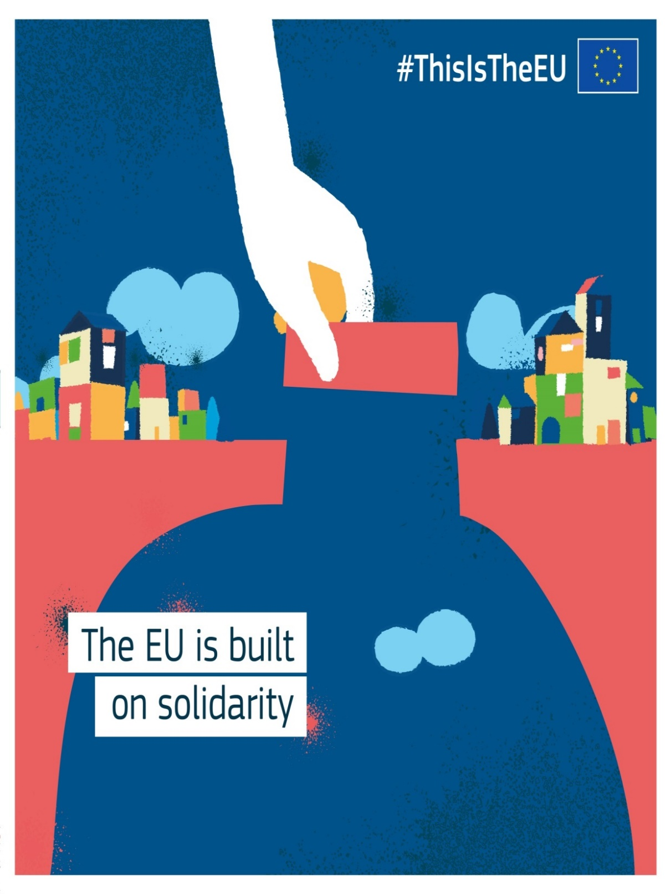
#ThisistheEU
Notes:
The visual care of your presentation is, at least, as important as the content.
http://adobomagazine.com/global-news/5-reasons-why-beauty-matters-according-stefan-sagmeister
Photo credit: Filip Pizl

Slide 13

Thank you
© European Union 2024
Unless otherwise noted the reuse of this presentation is authorised under the CC BY 4.0 license. For any use or reproduction of elements that are not owned by the EU, permission may need to be sought directly from the respective right holders.
Pictures, source: Unsplash

