Slide 1



Young people in post-2027 Interreg
Clara Menasseyre
Directorate-General for Regional & Urban Policy, European Commission
18 December 2024

Slide 2

Youth4Cooperation Group
The brand gathering all youth initiatives related to Interreg and
Macro-Regional Strategies.
A group of young people meeting regularly online to discuss topics of common interest
exchange with Commission officials
launch initiatives across borders
take part in consultations on the future of Interreg
9

Slide 3
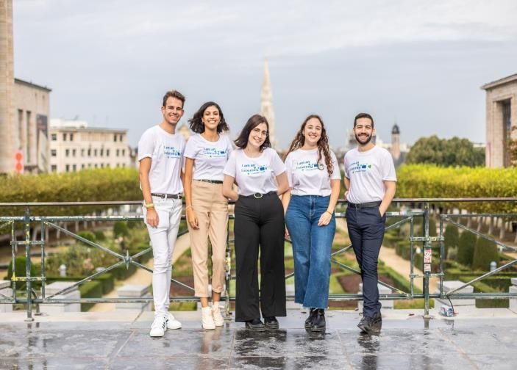


Many opportunities to get involved in Youth4Cooperation
Interreg Volunteer Youth (IVY)
Youth Councils of Macro-Regional Strategies
Voice of youth in each MRS
Involvement in governance and projects
Cross-Border
Ambassadors
Youth component of the Border Focal Point Network
Up to 6 months volunteering opportunity
Get involved
in an
Exchange with professionals on topics related to cooperation
Interreg programme or
project
There are always open opportunities!
Check the MRS in your area and apply to become a councilor!
10

Slide 4

11

Slide 5
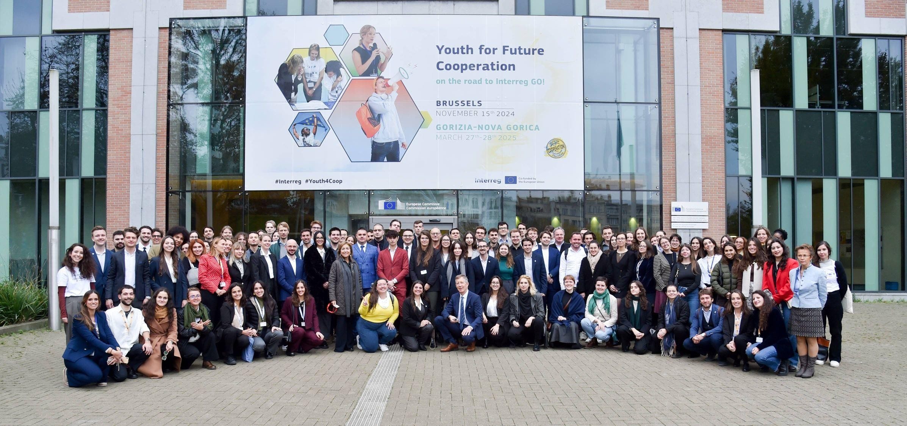
13

Slide 6
Youth for Future Cooperation – On the road to Interreg GO!” event -
Brussels, 15 November 2024
  100 young participants shared their perspectives on territorial cooperation post2027
  Youth Declaration on the future of cooperation/Interreg and Macro- Regional Strategies
Interreg GO! Event - 27-28 March 2025 in the twin cities of Gorizia (Italy) and Nova Gorica (Slovenia)
  The youth Declaration will be presented to a wider audience of policymakers across Europe, and the insights gathered will help shape future EU regulations on territorial cooperation
12

Slide 7

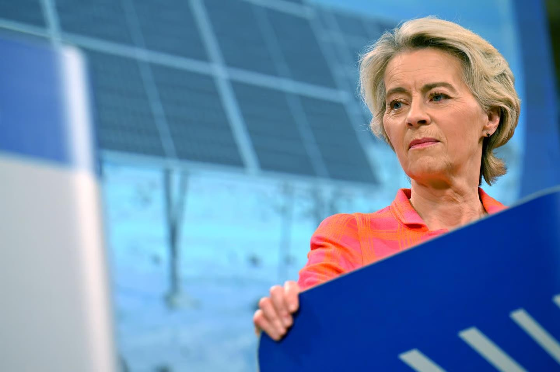
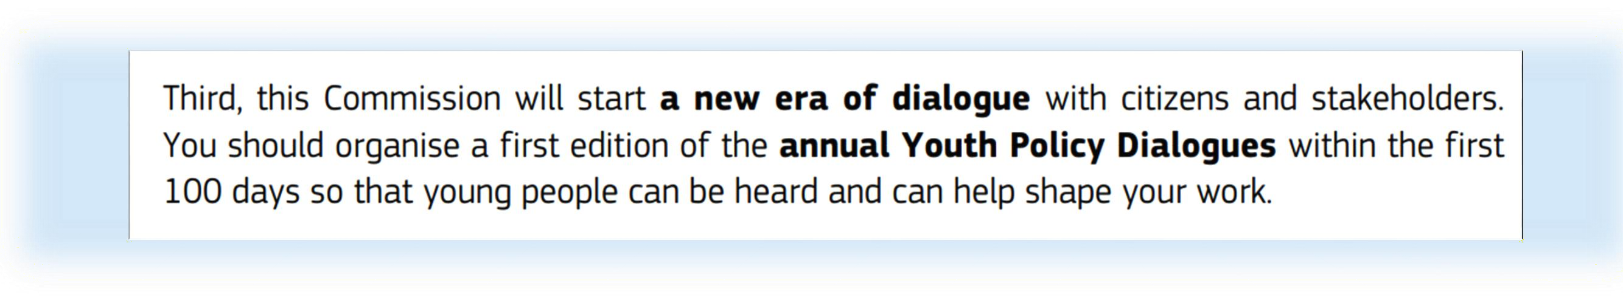
Towards a new Commission (2024-2029)
Mission letters to Commissioners
6

Slide 8
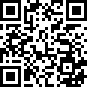








Keep in touch
A LinkedIn group to stay engaged on all opportunities for young people in relation to territorial cooperation:
REGIO-YOUTH4COOPERATION@ec.europa.eu
europa.eu/
europeancommission
@EU_Commission / @RegioInterreg
@EuropeanCommission
EUTube / @EUinmyRegion
@EuropeanCommission / EU REGIO Interreg
European Commission / EU Funds / Youth4Cooperation
EU Spotify

Slide 9

Thank you for your attention!
© European Union 2024
Unless otherwise noted the reuse of this presentation is authorised under the CC BY 4.0 license. For any use or reproduction of elements that are not owned by the EU, permission may need to be sought directly from the respective right holders.
Slide xx: element concerned, source: e.g. Fotolia.com; Slide xx: element concerned, source: e.g. iStock.com
15

