Slide 1


MODULE 4 | Digital and offline marketing
Strategies and actions for rural and inland tourism destinations
Gianluca Sarti
Maria Celeste Clarembaux

Slide 2

0
Introduction

Slide 3

Online vs. offline
In today's interconnected world, digital marketing has become an essential tool for promoting rural and inland tourism destinations.
This comprehensive presentation illustrates the various strategies and channels that can be leveraged to attract visitors to rural and inland areas.
From website optimization and social media marketing to content creation and email campaigns, the digital landscape offers numerous opportunities to showcase the unique attractions of rural destinations.
However, offline & more traditional marketing applied to tourism cannot be set aside, such as the participation to trade fairs, organization of fam trips and press conferences.

Slide 4


1
Common elements of tourist marketing

Slide 5

1. Emphasize unique experiences and authenticity
Develop a strong brand narrative that highlights the area's unique selling points
Create immersive storytelling that connects visitors to local traditions and way of life
Showcase authentic, behind-the-scenes experiences that can't be found in urban areas

Slide 6
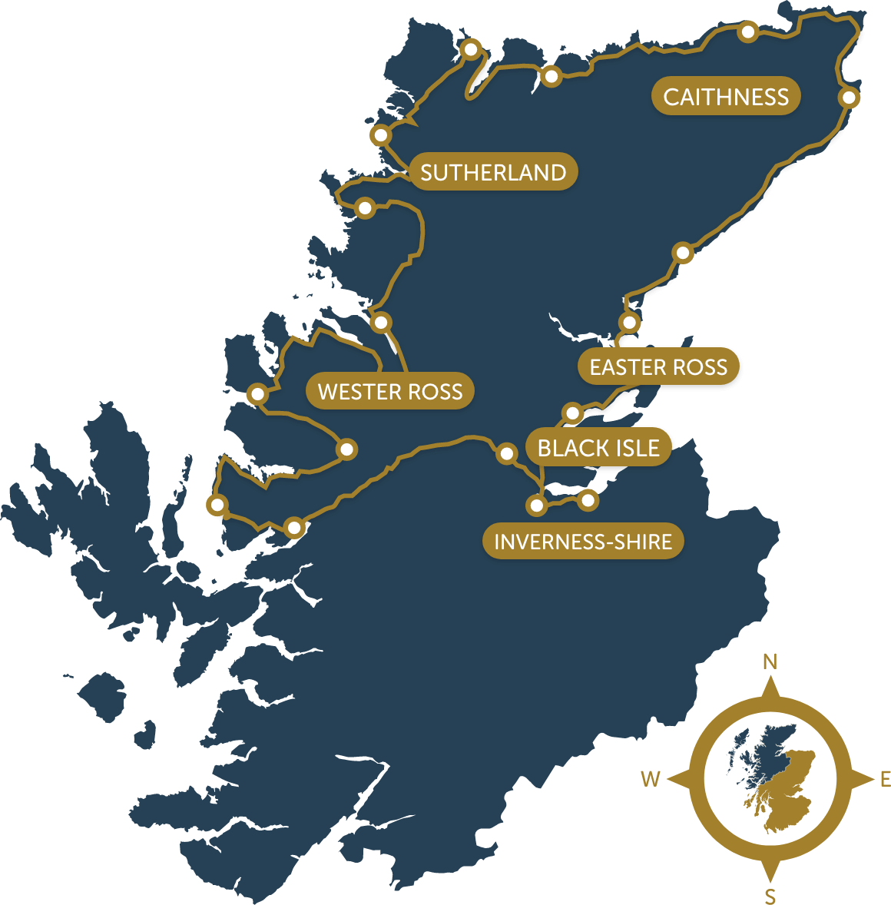
Scotland’s North Coast 500 route
EXAMPLE
The scenic driving route showcases authentic Scottish experiences and unique landscapes
VISIT: www.northcoast500.com

Slide 7
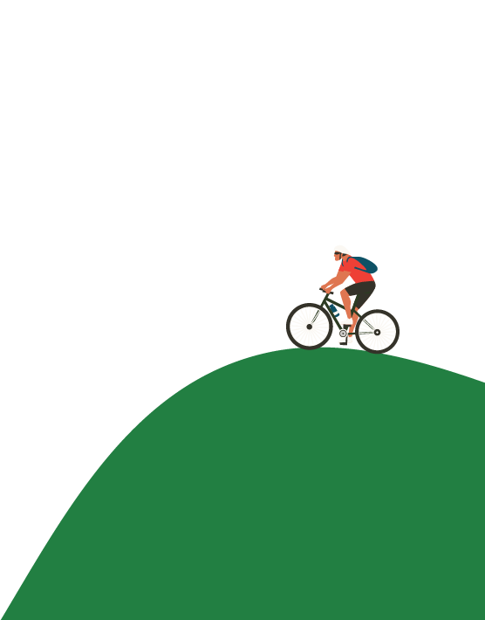
2. Highlight natural beauty and local culture
Use professional photography and videos to capture landscapes in different seasons
Create virtual reality experiences that allow potential visitors to "explore" before booking
Develop interactive maps highlighting points of interest, scenic routes, and hidden gems

Slide 8
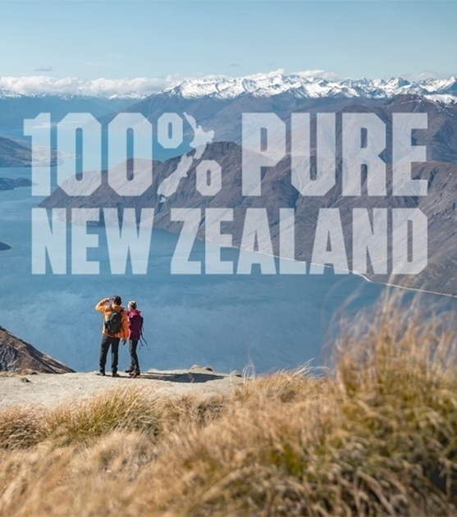
New Zealand’s Pure campaign
EXAMPLE
This long-running campaign effectively highlights the country's natural beauty and Maori culture.
VISIT: www.newzealand.com/int

Slide 9
3. Showcase sustainability and eco-friendly practices
Highlight initiatives such as renewable energy use, waste reduction, and conservation efforts
Display organisations with eco-certifications
Create content educating visitors on how to travel responsibly in rural areas

Slide 10

Costa Rica’s Certification for Sustainable Tourism (CST) program
EXAMPLE
This national program certifies and promotes sustainable tourism practices.
VISIT: www.turismo-sostenible.co.cr

Slide 11
4. Use high-quality, immersive imagery and video content
Invest in drone footage for aerial views of landscapes and properties
Create time-lapse videos showcasing day-to-night transitions or seasonal changes
Develop 360-degree photos and videos for an immersive online experience

Slide 12
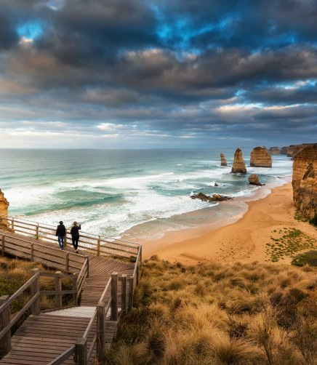
Use high quality immersive imagery and video content
EXAMPLE
Tourism Australia example
VISIT: www.australia.com/en/discover-your-australia

Slide 13
5. Leverage user-generated content and reviews
Implement a system to encourage and reward guests for sharing their experiences online
Create branded hashtags for visitors to use on social media
Showcase guest testimonials and photos prominently on website and marketing materials

Slide 14
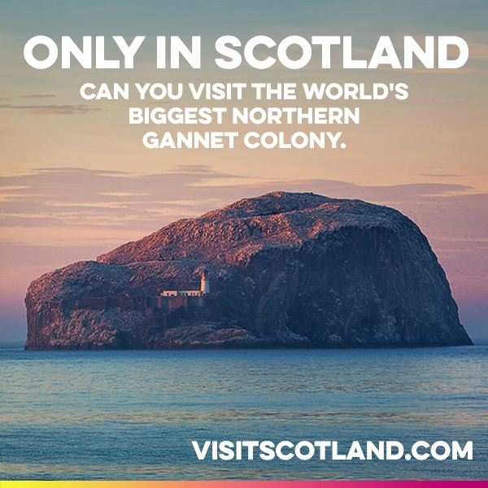
Scotland’s ”Only in Scotland” Campaign
EXAMPLE
Uses user-generated content to showcase unique experiences across Scotland, including many rural areas.
By encouraging visitors to share their unique experiences, VisitScotland creates a constantly updating, genuine representation of what the country offers to tourists.
VISIT: www.visitscotland.com/see-do

Slide 15

2
Digital strategies

Slide 16
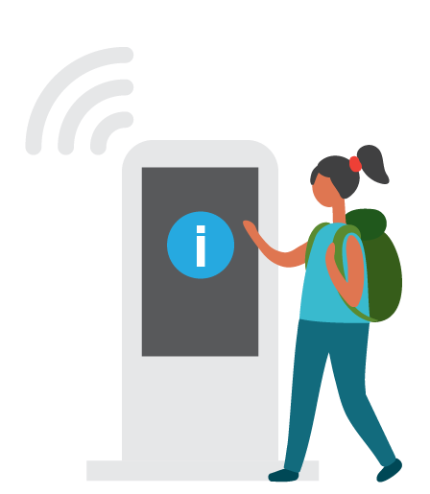
1. Website optimization
MOBILE FRIENDLY DESIGN
Implement responsive design that adapts to all screen sizes
Optimize page load times for slower rural internet connections
Use larger, touch-friendly buttons for easy navigation on mobile devices

Slide 17
1. Website optimization
EASY BOOKING SYSTEM
Implement a user-friendly, secure online booking and payment system
Offer flexible booking options (e.g., pay on arrival, free cancellation)
Provide real-time availability calendars

Slide 18
1. Website optimization
VR TOURS AND 360 IMAGES
Create virtual walk-throughs of accommodations and facilities
Develop interactive 360-degree panoramas of key attractions and viewpoints
Implement VR compatibility for an even more immersive experience

Slide 19
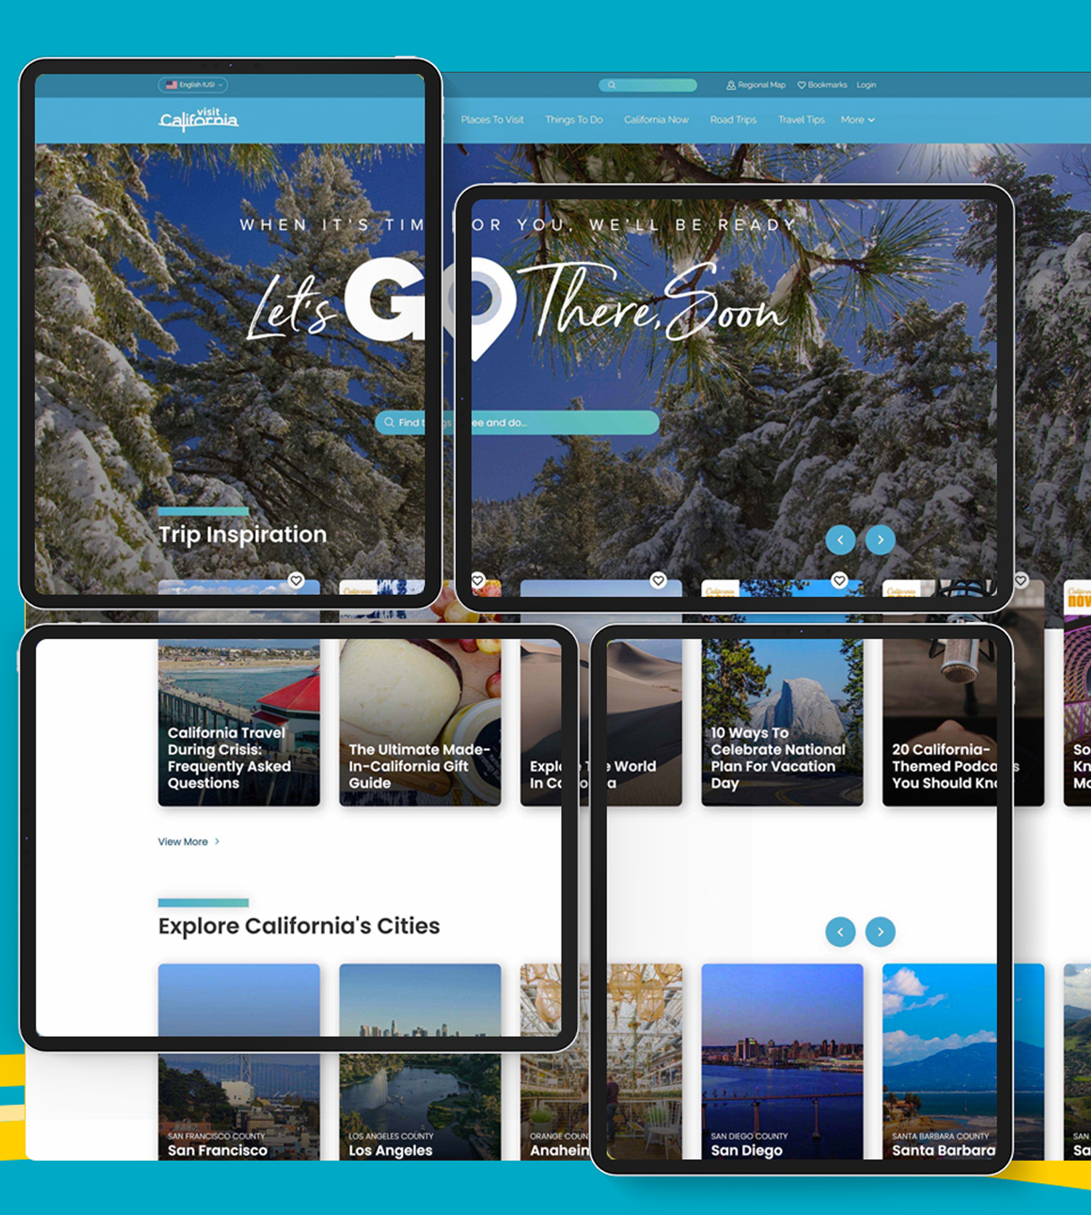
Visit California’s responsive website
EXAMPLE
Their site adapts well to different screen sizes and includes easy navigation and booking options.
VISIT: www.visitcalifornia.com

Slide 20

2. Social media marketing
INSTAGRAM
Use Instagram Stories and Reels to showcase daily life and behind-the-scenes content
Leverage Instagram Shopping for direct product tagging and purchasing
Host Instagram takeovers with influencers or local personalities

Slide 21
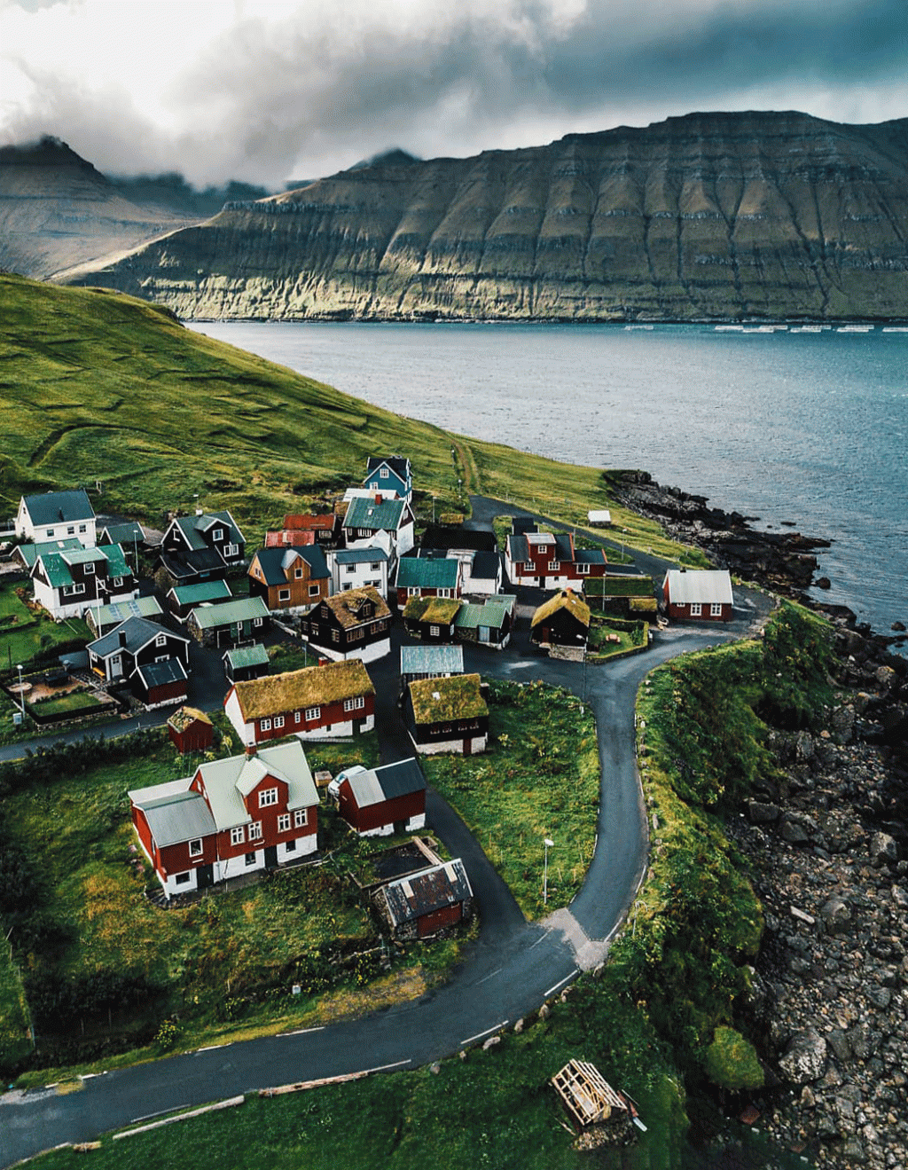
#visitFaroe
INSTAGRAM EXAMPLE 1
The Faroe Islands, a rural archipelago between Iceland and Norway, effectively uses Instagram to promote their unique destination.
They encourage visitors to use the hashtag #VisitFaroe
Their official account @visitfaroeislands regularly reposts user-generated content
They showcase the islands' dramatic landscapes, traditional villages, and unique experiences
VISIT: www.instagram.com/explore/tags/visitfaroe/

Slide 22
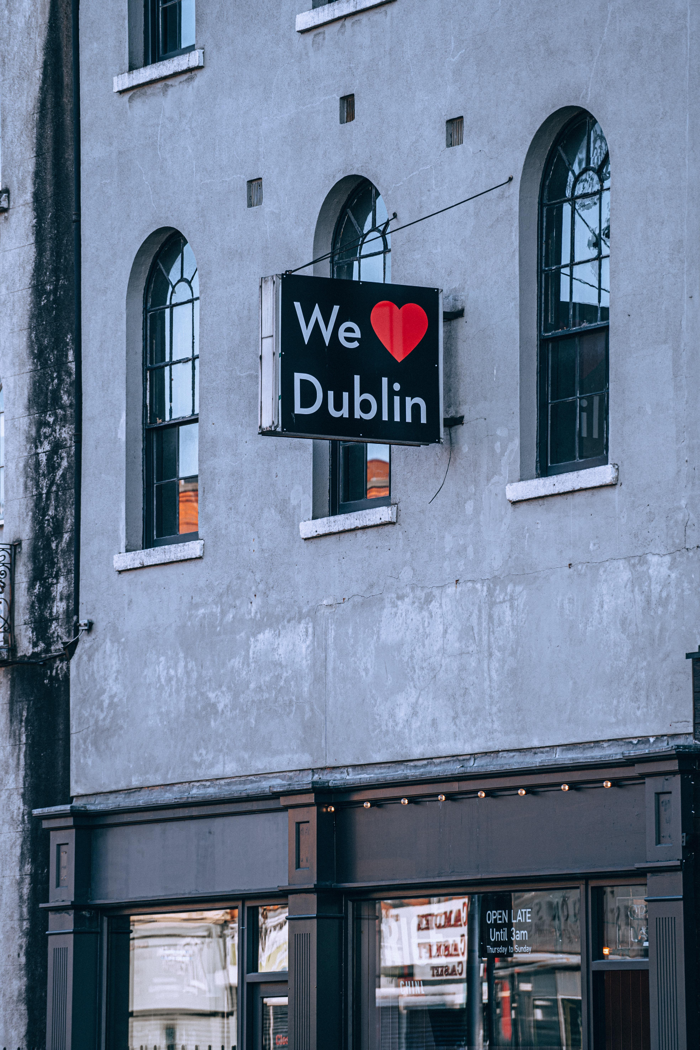
#LoveDublin
INSTAGRAM EXAMPLE 2
Example: Tourism Ireland's #LoveDublin campaign on Instagram
This campaign effectively uses user-generated content and a branded hashtag.
VISIT: www.instagram.com/explore/tags/lovedublin

Slide 23
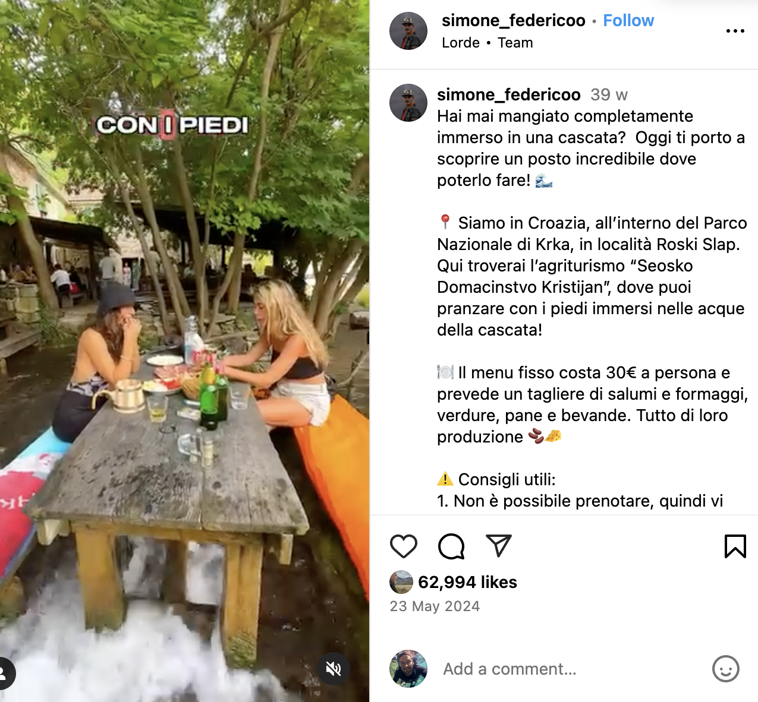
Krka National Park, Croatia
INSTAGRAM EXAMPLE 3
At the “Seosko Domacinstvo Kristijan” farm it is possible to have lunch with your feet immersed in the waters of the waterfall
VISIT: www.instagram.com/reel/C7UhfONsUlz/?igsh=MWhyenZ6MzE4cXJyaw==

Slide 24

2. Social media marketing
FACEBOOK
Create and manage Facebook Groups for niche interests (e.g., hikers, foodies)
Use Facebook Live for virtual tours or Q&A sessions
Implement Facebook Pixel for retargeting ads to interested visitors

Slide 25
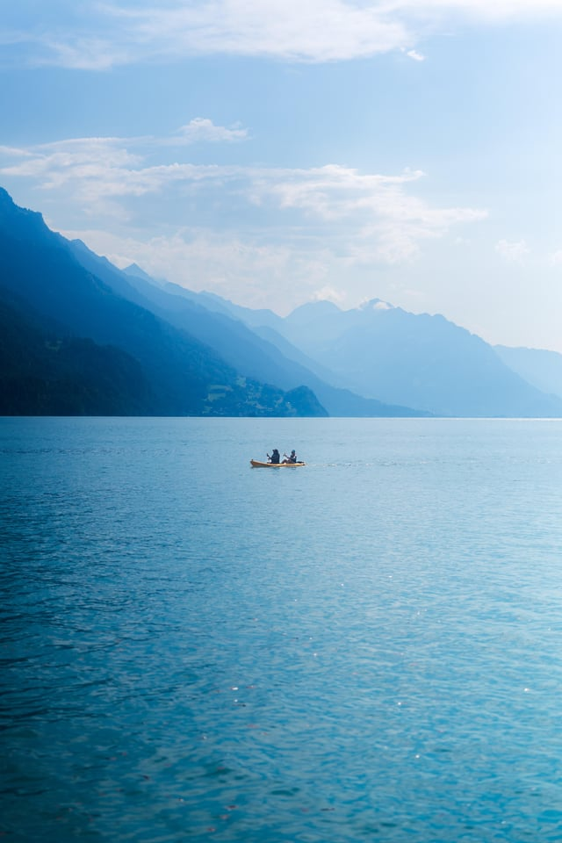
My Switzerland
FACEBOOK EXAMPLE
Switzerland Tourism's Facebook page effectively uses user-generated content to promote rural and urban areas alike.
They regularly share user-submitted photos and stories
They run contests encouraging users to share their Swiss experiences
The page showcases a mix of famous landmarks and hidden rural gems
VISIT: www.facebook.com/MySwitzerland

Slide 26

2. Social media marketing
YOUTUBE
Develop a series of themed videos (e.g., local recipes, wildlife spotting guides)
Create 360-degree videos for immersive experiences
Optimize video descriptions and tags for SEO

Slide 27
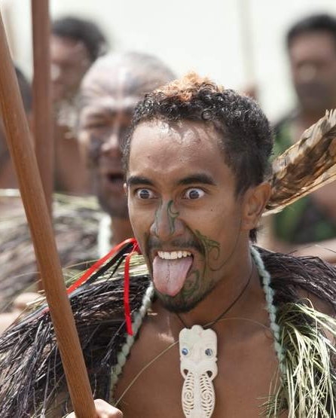
New Zealand 100% Pure
YOUTUBE EXAMPLE
Tourism New Zealand's YouTube channel effectively uses a mix of professional content and user-generated videos to showcase the country's rural beauty.
They have a series called "New Zealand through the eyes of..." featuring traveler experiences
They encourage visitors to submit their own video content
Many videos highlight rural experiences like hiking, farm stays, and small-town exploration
VISIT: www.youtube.com/user/PureNewZealand

Slide 28

2. Social media marketing
LINKEDIN
Create a compelling company page showcasing your rural tourism offerings
Use high-quality images and videos to highlight your facilities and experiences
Regularly post updates about your services, local events, and industry news

Slide 29
2. Social media marketing
LINKEDIN Content marketing
Share long-form articles about the benefits of rural retreats for businesses
Post infographics on topics like "The Impact of Nature on Productivity"
Create slideshows showcasing your venues and team-building activities

Slide 30
2. Social media marketing
LINKEDIN groups
Join and participate in relevant groups like "Corporate Event Planning" or "Business Travel"
Share valuable insights and subtly promote your offerings within these communities

Slide 31
2. Social media marketing
LINKEDIN Sponsored content
Use LinkedIn's targeting options to reach decision-makers in specific industries
Create ads showcasing your unique value proposition for corporate events

Slide 32
2. Social media marketing
LINKEDIN Events
Promote webinars or virtual tours of your facilities
Use this feature to highlight upcoming business-focused events at your location

Slide 33
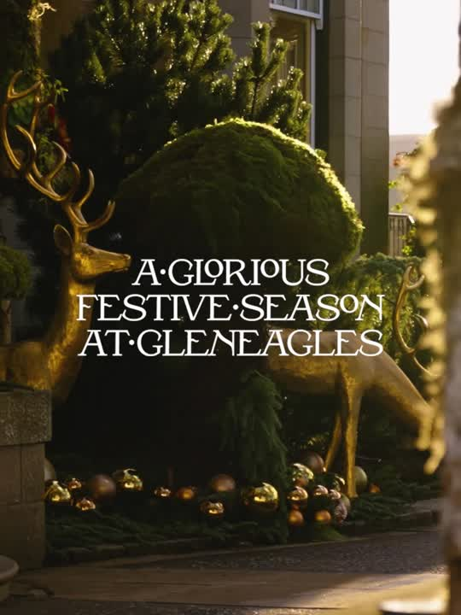
Gleneagles Hotel, Scotland
LINKEDIN EXAMPLE
Gleneagles effectively uses LinkedIn to promote its luxury rural resort for both leisure and business travelers.
VISIT: www.linkedin.com/company/the-gleneagles-hotel

Slide 34
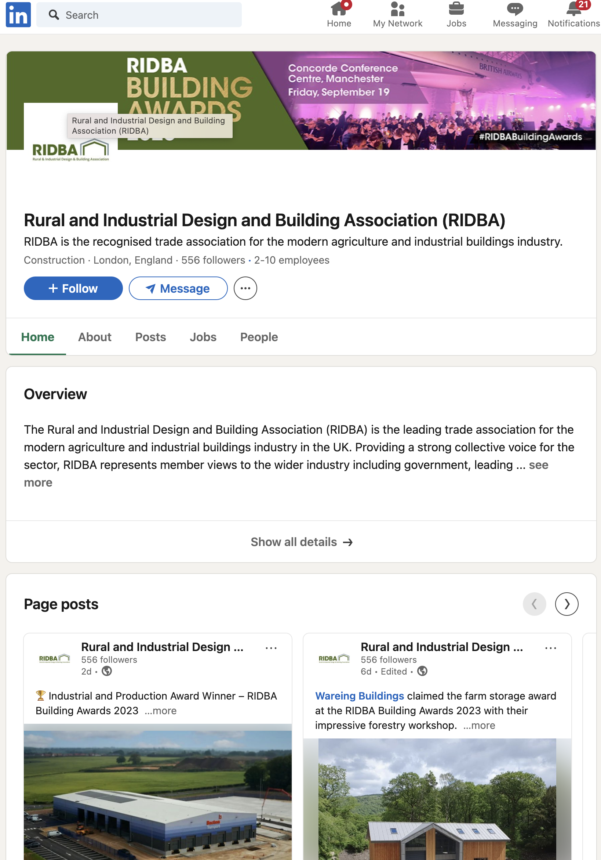
Rural & Industrial Design and Building Association (RIDBA)
LINKEDIN EXAMPLE
While not a tourism-specific page, this association uses LinkedIn effectively to promote rural businesses and could be a model for rural tourism organizations.
VISIT: www.linkedin.com/company/ridba

Slide 35
3. Content marketing
BLOG POSTS
Develop a content calendar aligned with seasonal activities and events
Create in-depth guides on local flora, fauna, and ecosystems
Write about lesser-known attractions and off-the-beaten-path experiences

Slide 36
3. Content marketing
SEASONAL GUIDES AND ITINERARIES
Develop downloadable PDF guides for different traveler types
Create interactive online itinerary builders
Offer suggested itineraries for varying trip durations (weekend, week, etc.)

Slide 37

Wonderful Copenhagen’s neighborhood guides
CONTENT MARKETING EXAMPLE
These in-depth blog posts highlight different areas of the city for various traveler types.
VISIT: www.visitcopenhagen.com/copenhagen/neighbourhoods/guides

Slide 38

4. E-mail marketing
PERSONALIZED NEWSLETTERS
Segment email lists based on interests, past bookings, and behavior
Use dynamic content to show relevant offers based on user preferences
Implement automated email series for different stages of the customer journey

Slide 39
4. E-mail marketing
PRE AND POST-TRIP COMMUNICATION
Segment email lists based on interests, past bookings, and behavior
Use dynamic content to show relevant offers based on user preferences
Implement automated email series for different stages of the customer journey

Slide 40
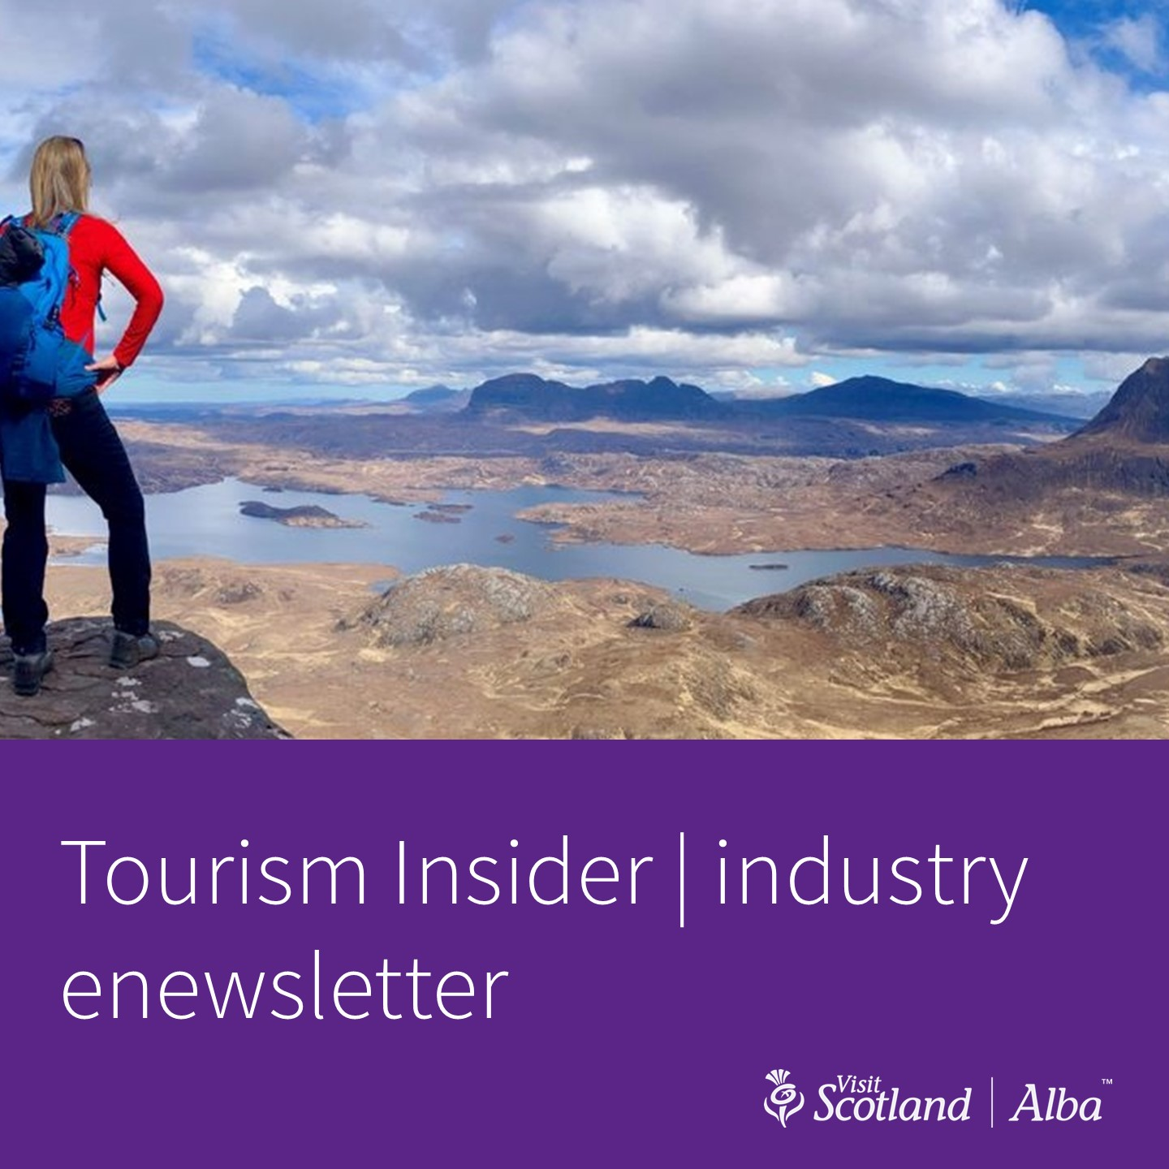
Visit Scotland’s personalized newsletters
E-MAIL MARKETING EXAMPLE
They offer tailored content based on user preferences and interests.
VISIT: www.visitscotland.com/newsletter

Slide 41

5. Search engine optimization (SEO)
LOCAL SEO
Optimize Google My Business listings for all properties and attractions
Encourage and respond to Google reviews
Create location-specific landing pages for each area or property

Slide 42
5. Search engine optimization (SEO)
LONG-TAIL KEYWORDS
Conduct thorough keyword research for niche activities and experiences
Optimize content for voice search queries
Create FAQ pages addressing common questions about rural tourism

Slide 43
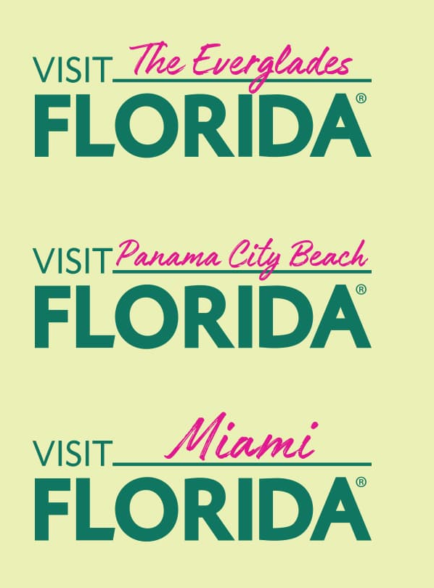
Visit Florida’s extensive use of location-specific pages
SEO EXAMPLE
They have individual pages for different regions, cities, and attractions, optimized for local search.
VISIT: www.visitflorida.com/places-to-go/

Slide 44

6. Influencer partnerships
Collaborate with travel bloggers and social media personalities

Slide 45
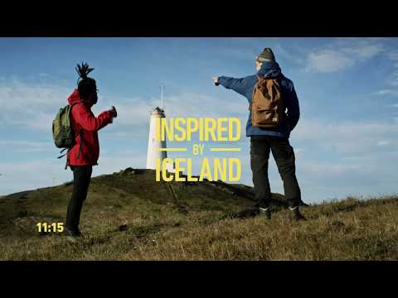
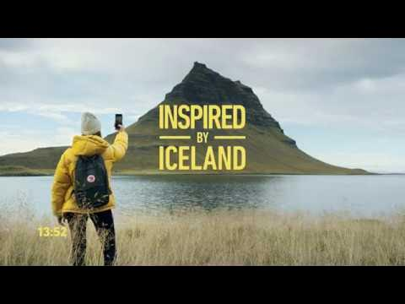
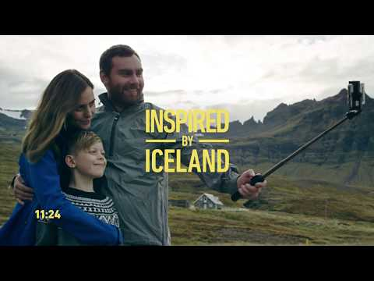
Visit Iceland’s “Inspired by Iceland” campaign
INFLUENCER PARTNERSHIPS EXAMPLE 1
This campaign involved various influencers sharing their experiences in Iceland across social media platforms.
VISIT: www.visiticeland.com

Slide 46
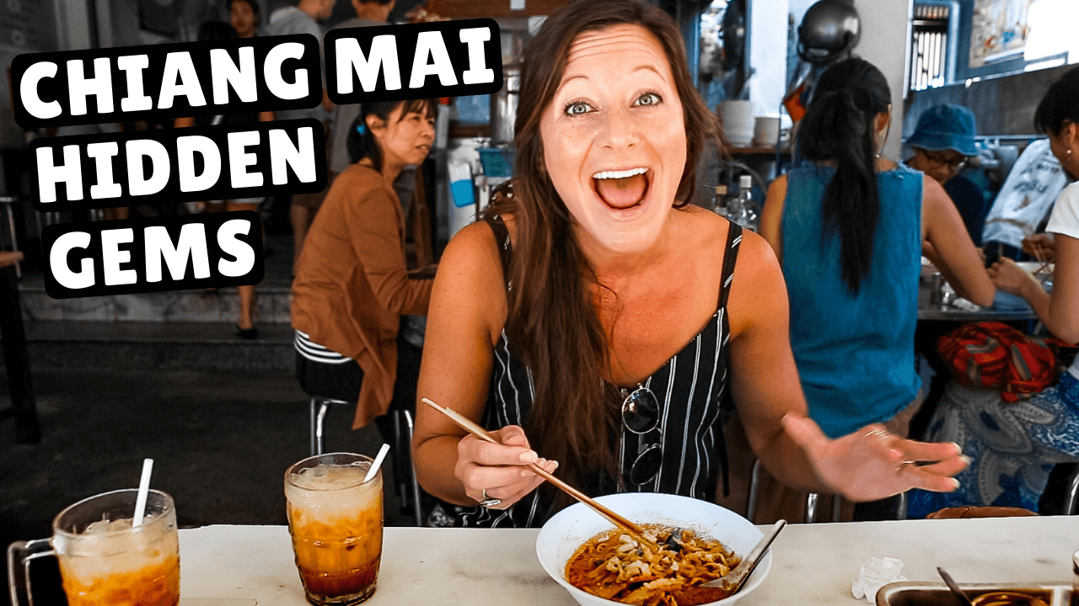
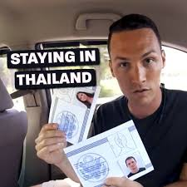
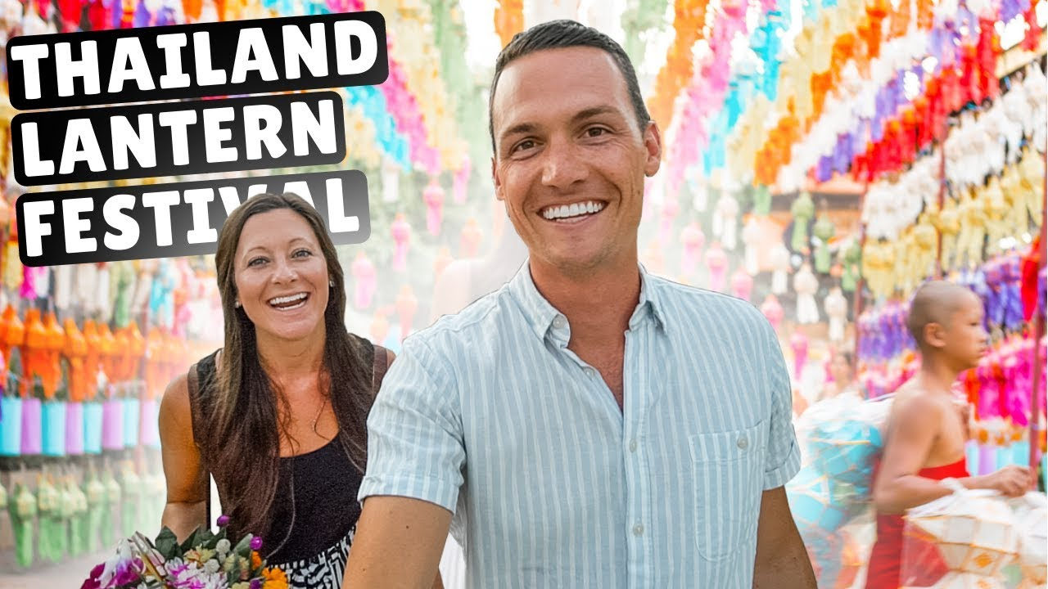
Thailand’s collaboration with travel vloggers
INFLUENCER PARTNERSHIPS EXAMPLE 2
The Tourism Authority of Thailand has worked with popular YouTube travel vloggers like Kara and Nate to promote lesser-known destinations.
VISIT: www.youtube.com/watch?v=YDO9EXyFarc&list=PLirGII1_qwvtDYYPCN744su2a_oXluZt3

Slide 47


7.Online travel agencies (OTAs) and metasearch engines
List products on platforms like Booking.com, Expedia, and TripAdvisor

Slide 48
Booking.com’s promotion of rural and eco-friendly accomodation
OTAs AND METASEARCH EXAMPLE
Booking.com has a dedicated section for sustainable stays, including many rural options.
VISIT: www.booking.com/sustainable-travel

Slide 49

Airbnb’s “Farm Stays” category
OTAs AND METASEARCH EXAMPLE
Airbnb has a category specifically for farm stays and rural accommodations.
VISIT: www.airbnb.com/

Slide 50
TripAdvisor's rural destination pages
OTAs AND METASEARCH EXAMPLE
TripAdvisor provides comprehensive information about rural destinations, including accommodations, activities, and user reviews.
Explore various rural destinations on TripAdvisor by searching for specific locations.

Slide 51
3
Offline strategies

Slide 52

Offline strategies
1
2
3
Partnerships with local businesses and attractions
Participation in tourism fairs and exhibitions
Brochures and print materials in local information centers
4
5
6
Collaboration with travel agencies specializing in rural tourism
Word-of-mouth marketing through satisfied customers
Local community engagement and events
7
Traditional media engagement

Slide 53

1. Partnerships with local businesses and attractions
Create package deals combining accommodation with local experiences
Cross-promote with complementary businesses (e.g., local restaurants, craft shops)
Develop a local discount card for tourists

Slide 54
The “Cumbria Pass” in the Lake District, UK
EXAMPLE
This pass offers discounts at various attractions and businesses in the rural Lake District area.
VISIT: www.golakes.co.uk/inspiration/cumbria-pass.aspx

Slide 55

2. Participation in tourism fairs and exhibitions
Attend both general and niche tourism fairs (e.g., adventure travel, eco-tourism)
Create an eye-catching booth showcasing your rural destination
Offer immersive experiences at your booth (e.g., VR tours, local product tastings)

Slide 56

ITB Berlin, the world's largest tourism trade fair
EXAMPLE
Many rural destinations showcase their offerings here.
VISIT: www.itb-berlin.com/en

Slide 57
3. Brochures and print materials in local information centers
Design visually appealing brochures highlighting your unique selling points
Create themed maps (e.g., hiking trails, local producers, historical sites)
Distribute materials at regional airports, train stations, and visitor centers

Slide 58
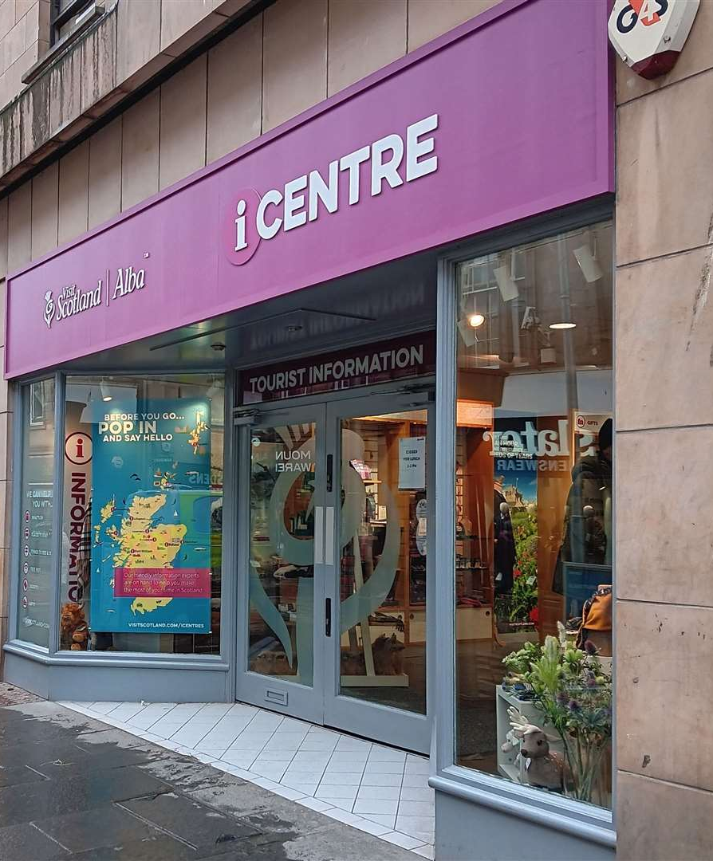
Visit Scotland’s iCentres
EXAMPLE
These information centers distribute a wide range of local tourism materials.
VISIT: www.visitscotland.com/about/practical-information/vic

Slide 59

4. Collaboration with travel agencies specializing in rural tourism
Partner with agencies focused on eco-tourism, agritourism, or adventure travel
Offer familiarization trips (“fam trip”) for travel agents to experience your destination
Provide comprehensive information and high-quality images for their marketing

Slide 60

Responsible travel
EXAMPLE
This agency specializes in sustainable and rural tourism experiences worldwide.
VISIT: www.responsibletravel.com

Slide 61

5. Word-of-mouth marketing through satisfied guests
Implement a referral program offering discounts for recommendations
Encourage guests to share their experiences on social media
Create shareable moments or photo opportunities at your location

Slide 62
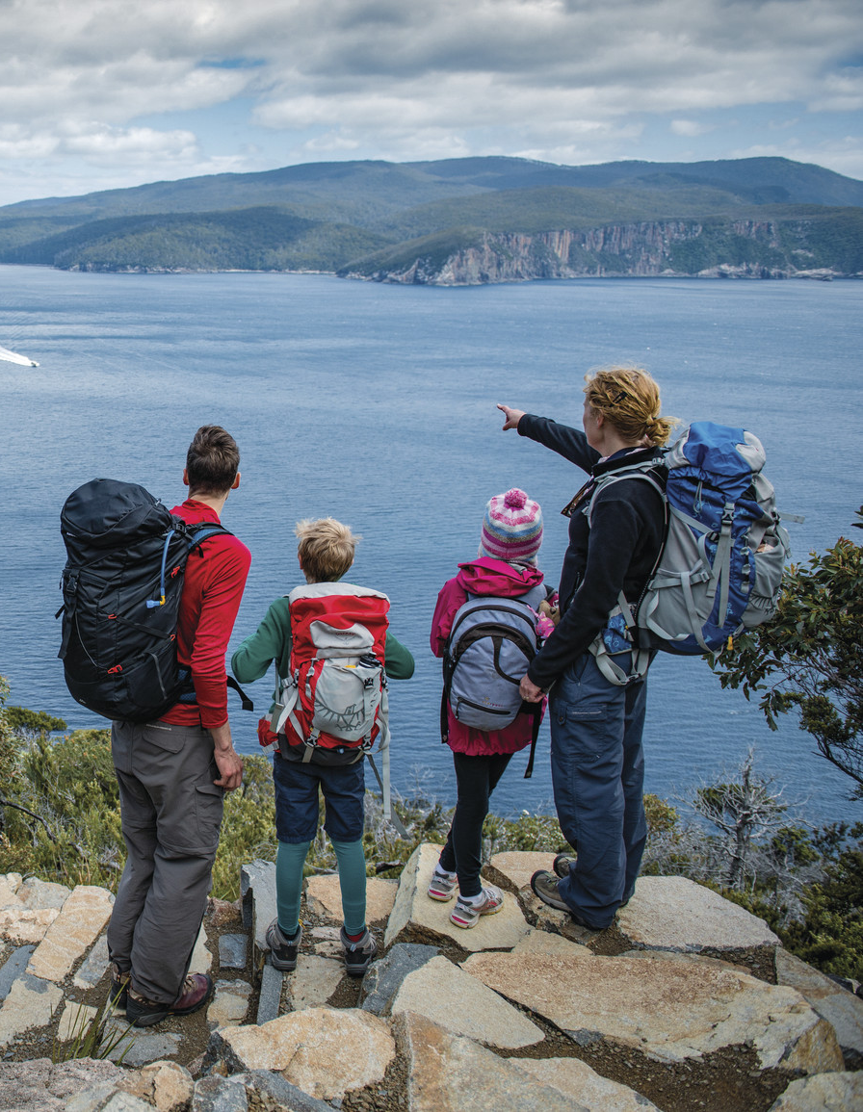
Tasmania’s “Tassie Specialist” program
EXAMPLE
While primarily online, this program encourages word-of-mouth promotion by creating destination experts.
VISIT: www.discovertasmania.com.au/trade/tassie-specialist-program

Slide 63
6. Local community engagement and events
Host or sponsor local festivals celebrating regional culture, food, or crafts
Organize volunteer opportunities for tourists to engage with the community
Collaborate with local schools or organizations for educational programs

Slide 64
Sani Festival in Greece
EXAMPLE
This annual festival in a rural resort area combines local culture with international performers.
VISIT: www.sani-resort.com/en_GB/sani-festival

Slide 65
7. Traditional media engagement
Invite journalists and travel writers for press trips
Pitch story ideas to regional and national publications
Collaborate with TV travel shows or documentaries

Slide 66
Escape to the Country TV show in the UK
EXAMPLE
This program often showcases rural tourism destinations and properties.
VISIT: www.bbc.co.uk/programmes/b006vb2f

Slide 67
4
Specialization aspects

Slide 68

1. Family Holidays
Emphasize safety, child-friendly activities, and family accommodations
Create content focused on multi-generational experiences

Slide 69
Center Parcs (Europe)
EXAMPLE
This program often showcases rural tourism destinations and properties.
VISIT: www.centerparcs.eu

Slide 70
2. Active holidays (biking, horsing, hiking, trekking)
Highlight trail maps, difficulty levels, and equipment rentals
for Partner with sports and outdoor brands cross-promotion

Slide 71
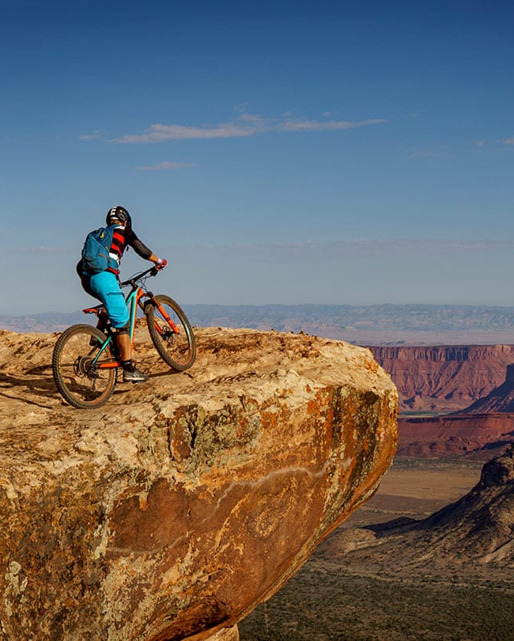
Moab, Utah (USA)
EXAMPLE
This program often showcases rural tourism destinations and properties.
VISIT: www.discovermoab.com/biking

Slide 72
3. Agrotourism
Showcase farm-to-table experiences and hands-on agricultural activities
Use storytelling to connect visitors with local farmers and producers

Slide 73
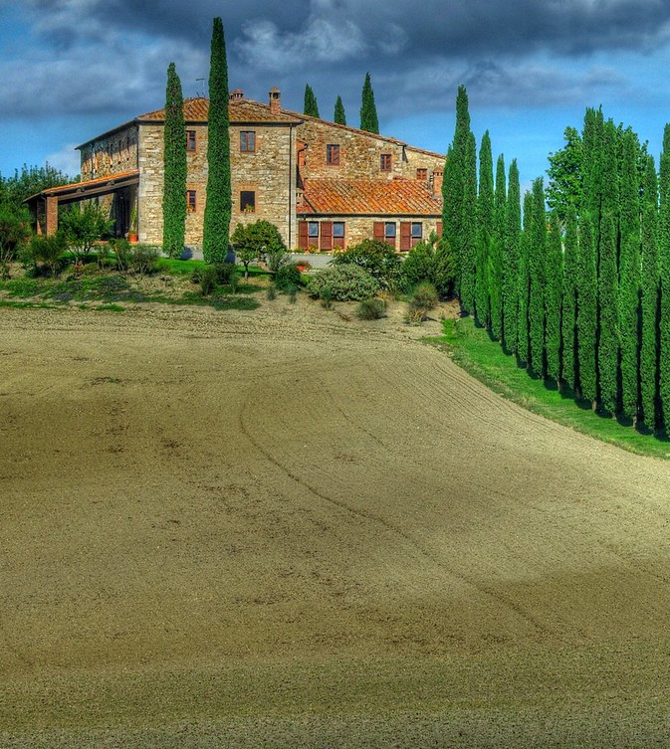
Agriturismo Poggio Covili (Tuscany, Italy)
EXAMPLE
This farm stay offers authentic agricultural experiences in the Tuscan countryside.
VISIT: www.poggiocovili.it/en

Slide 74
4. Cultural tourism
Develop themed itineraries around local history, art, and traditions
Collaborate with museums, galleries, and cultural institutions

Slide 75
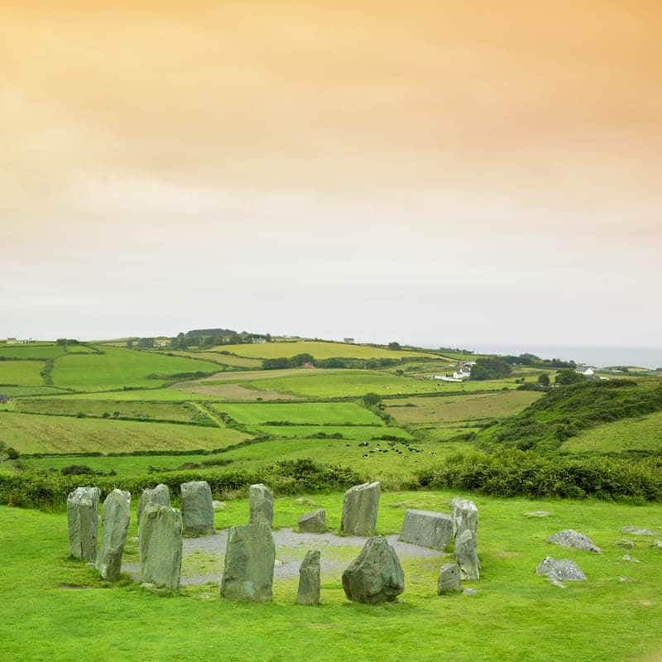
Cultureway
(Ireland)
EXAMPLE
This company offers curated cultural experiences and themed tours across Ireland.
VISIT: www.cultureway.ie

Slide 76

5. Educational tourism
Partner with schools and universities for field trips and study programs
Offer workshops and courses on local crafts, language, or cuisine

Slide 77
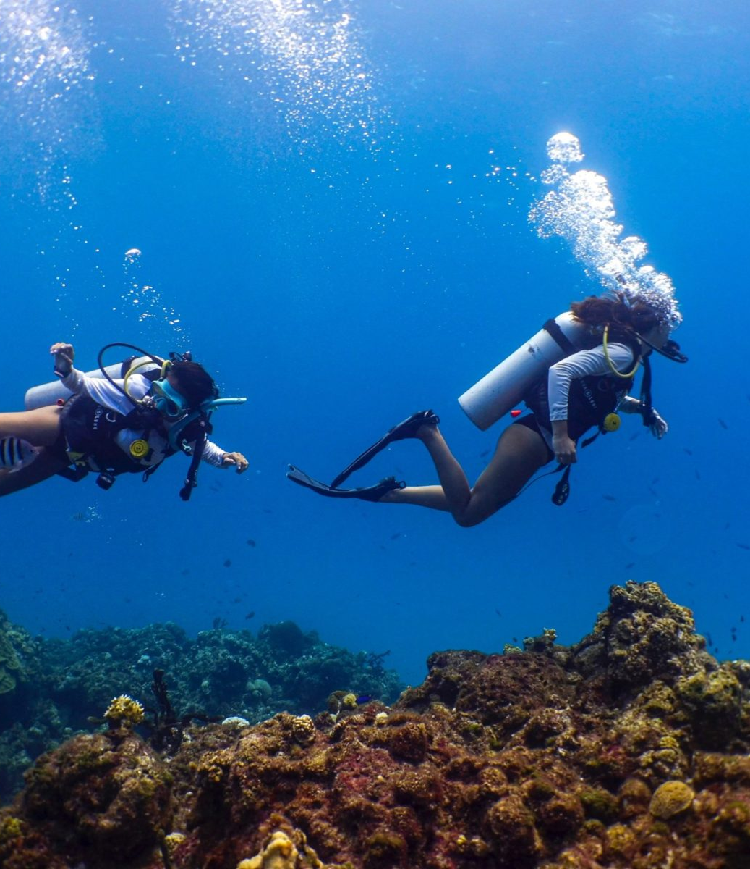
The Island School (Bahamas)
EXAMPLE
This semester program for high school students combines academics with hands-on environmental studies.
VISIT: www.islandschool.org

Slide 78
6. Gastronomy
Create food and wine trails
Organize cooking classes and tasting events
Collaborate with local chefs and food producers

Slide 79
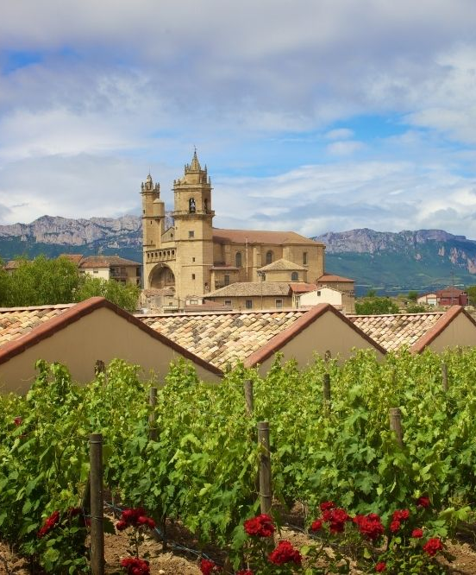
La Rioja (Spain)
EXAMPLE
This region is famous for its wine routes and gastronomic experiences.
VISIT: www.lariojaturismo.com/en/gastronomy-wine

Slide 80
7. Spa and thermal
Highlight unique natural resources and health benefits
Develop wellness packages combining treatments with other activities

Slide 81
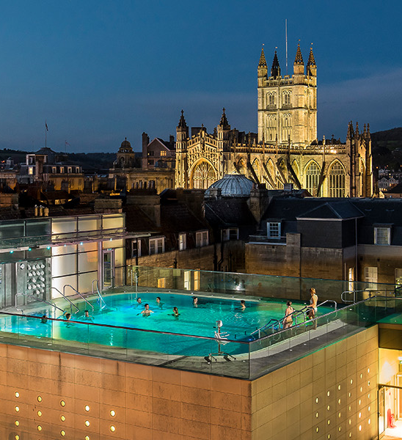
Thermae Bath Spa (UK)
EXAMPLE
This spa combines historic Roman baths with modern wellness facilities.
VISIT: www.thermaebathspa.com

Slide 82
8. Nature-based tourism (birding, flora and fauna watching)
Focus on unique local ecosystems and biodiversity
Offer guided tours with expert naturalists
Provide high-quality viewing equipment (binoculars, spotting scopes)
Create wildlife viewing blinds or hides
Develop educational programs about local conservation efforts

Slide 83
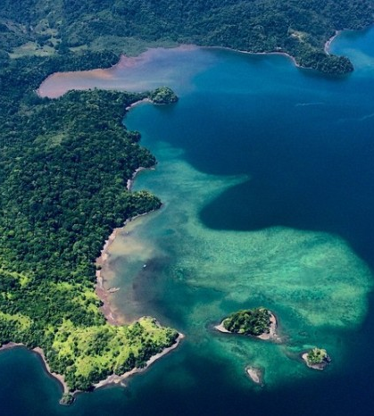
Costa Rica’s Osa Peninsula
EXAMPLE
Known for its incredible biodiversity, the Osa Peninsula offers world-class birding and wildlife watching opportunities.
VISIT: www.osapeninsulacostarica.com

Slide 84
9. Romantic tourism
Create intimate experiences for couples
Offer secluded accommodations with scenic views
Provide couples' spa treatments and romantic dining options
Organize special events like sunset cruises or private picnics
Develop photography services to capture romantic moments

Slide 85
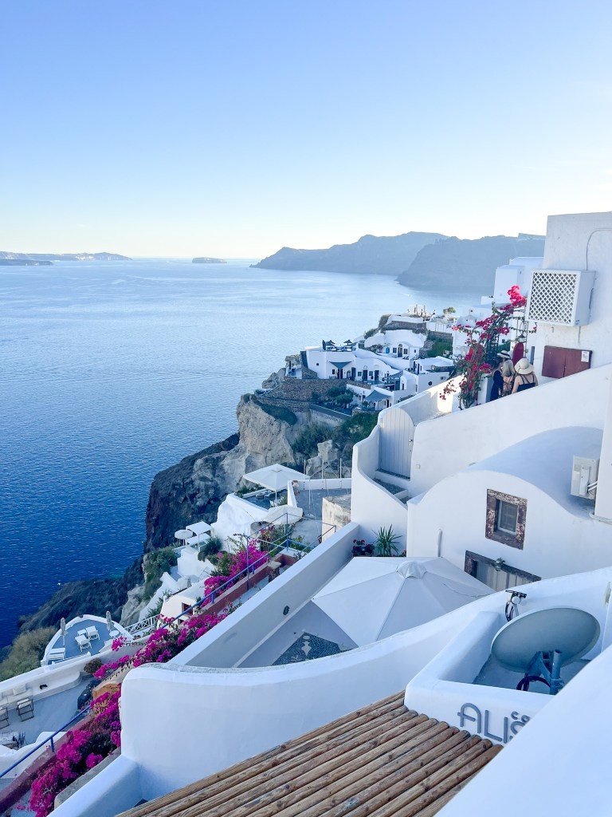
Santorini
(Greece)
EXAMPLE
While not exclusively rural, Santorini's villages offer romantic experiences with stunning views and intimate settings.
VISIT: www.santorini.gr

Slide 86

10. Holistic (forest bathing, herbal medicine, etc.)
Develop programs that integrate local natural healing traditions
Offer guided forest bathing experiences
Create herbal medicine workshops using local plants
Provide meditation and yoga retreats in natural settings
Offer detox programs incorporating local, organic cuisine

Slide 87
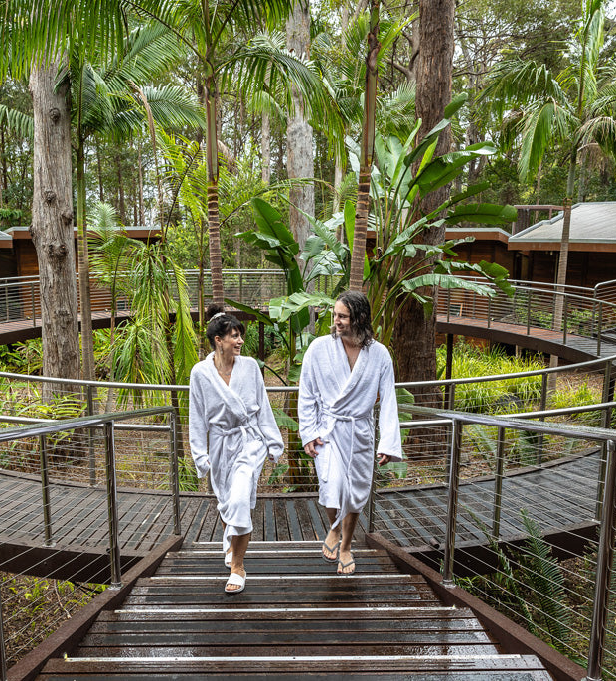
Gwinganna Lifestyle Retreat, Australia
EXAMPLE
Located in rural Queensland, this retreat offers holistic wellness programs including forest bathing and herbal medicine.
VISIT: www.gwinganna.com

Slide 88
4
Product specific marketing strategies

Slide 89
1. Develop specialized content
Create detailed guides about local flora, fauna, and ecosystems
Share romantic itineraries and couple's testimonials
Produce videos demonstrating wellness practices in your natural setting

Slide 90

2. Partner with relevant organizations
Collaborate with bird watching societies or wildlife conservation groups
Partner with wedding planners and honeymoon specialists
Work with wellness influencers and holistic health practitioners

Slide 91
3. Utilize social media
Encourage visitors to share their nature photos with specific hashtags
Run Instagram contests for most romantic photo taken at your location
Share short wellness tips or meditations on platforms like TikTok or Instagram Reels

Slide 92
4. Develop unique packages
Create multi-day birding tours with local experts
Offer all-inclusive romantic getaways with special amenities
Develop immersive wellness retreats combining various holistic practices

Slide 93
5. Leverage user reviews and testimonials
Encourage guests to leave detailed reviews about their nature experiences
Share couples' stories and testimonials on your website and social media
Collect and showcase before-and-after testimonials from wellness retreat participants

Slide 94
Thank you!

