Slide 1


MODULE 2 | Hands on tourist destination development
Developing eco-cultural tourism
Gianluca Sarti
Maria Celeste Clarembaux

Slide 2

Eco-cultural tourism
Eco-cultural tourism is a holistic approach to tourism that seeks to promote sustainable development, protect natural environments, and celebrate local cultures and traditions valorizing natural and cultural heritage.

Slide 3

Key steps to develop Eco-cultural tourism
1
2
3
Assess the potential of the territory
Engage local communities
Create authentic experiences
4
5
6
Develop sustainable infrastructure
Promote environmental conservation
Foster partnerships and collaboration
7
Monitor and adapt

Slide 4

1
Assess the territory’s potential

Slide 5


BASELINE ASSESMENT
Identify unique natural and cultural assets that can be sustainably promoted for tourism:
FAS analysis
01
Factors/Resources, Attractions and Services (quantitative analysis).
POIs identification
02
Identify Tourist Points of Interests (POI). Qualitative assessment.

Slide 6

BASELINE INFORMATION
BASELINE INFORMATION is the foundation for the development of tourism products. It requires a comprehensive understanding of the destination:
01
Its stakeholders
03
Its natural and cultural tourist assets
02
Its context and characteristics
Resources (Factors)
Ready-made Experiences (Attractions)
Geographical References and Characteristics
Main Statistical Information
Context, History, and Cultural Characteristics
Relevant Tourism Development References
Institutional Description in Tourism Sector
Public Plans on Sustainable Development and Tourism
Relevant Projects on Tourism
04
Its tourist services
Facilities
Infrastructures
Ancillary Services

Slide 7

2
Engage local communities

Slide 8

What is Community Engagement ?
Duration: 2:20
CLICK TO PLAY

Slide 9

Engage local communities
Map all the relevant local stakeholders
Involve local communities in the planning and decision-making process for eco-cultural tourism development.
Ensure that the benefits of tourism are equitably distributed among the local population.
Provide training and capacity building to enable locals to participate in and benefit from tourism activities.

Slide 10
How to involve local community?
Involving the community is important and necessary for successful eco-cultural tourism development. Always respect the existing social and community structures and achieve benefits for the community.
Have an understanding of the legal rights and responsibilities towards the community.
Promote eco-cultural tourism development in the community and increase the level of involvement which can develop over time.

Slide 11

Work out a strategy with a local community
Eco-cultural tourism initiatives must be focused on a clear strategy that has been agreed, supported or respected upon with the local community and the stakeholders.
This allows the community to have the tools and knowledge necessary for decision making.
  This strategy should, at least, include the following:
  Consultation with the local people covering how they feel about tourism being attracted to their area, possible opportunities and problems, concerns and levels of interest.
  A market research assessment.
  Assess the natural and cultural heritage in the local area.
  Have a vision for the project with an identification of aims, objectives and strategic priorities.

Slide 12
Ensuring community’s ecological and social trust
Natural resources and cultural heritage of the area should be enhanced by tourism and not damaged.
Identify the limits of the change that tourism can bring to the area and decide with the community the level of tourism allowed.
Two significant standards are:
  Products created should be made on the local area's traditional knowledge, qualities and abilities
  The community can offer resources, ideas, and even significative contributions to the project.

Slide 13
3
Smart Communities

Slide 14
What is a Smart Community?
Duration: 2:48
CLICK TO PLAY

Slide 15

Smart communities
Eco-cultural tourism development and smart communities can work hand in hand to create sustainable, resilient, and culturally rich destinations.
Smart communities are those that leverage technology and data to improve the quality of life for residents, enhance visitor experiences, and optimize resource management.
When combined with eco-cultural tourism development, smart communities can foster a more sustainable and engaging form of tourism.

Slide 16

Sustainable resource management
INTERSECTION 1
Smart communities can use data-driven approaches and innovative technologies to monitor and manage natural resources, such as water, energy, and waste.
This can help eco-cultural tourism destinations minimize their environmental footprint, conserve resources, and protect natural habitats.

Slide 17

Visitor management
INTERSECTION 2
Smart technologies, such as real-time visitor tracking and crowd management systems, can help eco-cultural tourism destinations manage visitor flows and minimize the impact of tourism on sensitive areas.
This can help prevent overcrowding, reduce environmental degradation, and ensure a better experience for both visitors and local communities.

Slide 18

Immersive and interactive experiences
INTERSECTION 3
Smart technologies, such as augmented reality (AR) and virtual reality (VR), can enhance eco-cultural tourism experiences by providing immersive and interactive ways to explore natural and cultural heritage.
For example, AR apps can provide visitors with information about local flora and fauna, while VR experiences can showcase traditional crafts or historical events.

Slide 19
Community engagement and empowerment
INTERSECTION 4
Smart communities can use digital platforms and tools to engage local communities in the planning and management of eco-cultural tourism development.
This can include online forums for public participation, digital storytelling initiatives to showcase local culture, and e-learning platforms to build local capacity in sustainable tourism practices.

Slide 20
Data-driven decision making
INTERSECTION 5
Smart communities can leverage data analytics and monitoring systems to inform decision-making in eco-cultural tourism development.
This can include tracking environmental indicators, measuring the socio-economic impact of tourism, and evaluating the effectiveness of sustainability initiatives.

Slide 21

Smart mobility
INTERSECTION 6
Smart communities can promote sustainable transportation options, such as electric vehicles, bike-sharing systems, and intelligent public transit, to reduce the carbon footprint of tourism activities.
This can help eco-cultural tourism destinations minimize air pollution, conserve energy, and create a more enjoyable experience for visitors and residents alike.

Slide 22
Eco-cultural tourism and smart communities: recap
By integrating smart technologies and data-driven approaches into eco-cultural tourism development, destinations can create more sustainable, resilient, and engaging experiences that benefit both visitors and local communities.
This holistic approach can help preserve natural and cultural heritage, foster economic development, and promote a more responsible form of tourism.

Slide 23
4
Slow
Communities

Slide 24
Eco-cultural tourism development and slow communities share common values and principles, focusing on sustainability, cultural preservation, and community well-being.
Slow communities, inspired by the slow food movement, promote a more mindful and intentional approach to living, emphasizing local traditions, craftsmanship, and a connection to the natural environment.
When combined with eco-cultural tourism development, slow communities can offer unique and authentic experiences that benefit both visitors and local residents.

Slide 25
Slow Food Italian Official Video
Duration: 2:55
CLICK TO PLAY

Slide 26
Authentic experiences
INTERSECTION 1
Slow communities offer visitors the opportunity to immerse themselves in local culture, traditions, and daily life.
Eco-cultural tourism experiences in slow communities can include participating in traditional crafts, learning about local history and customs, and enjoying locally sourced cuisine.

Slide 27
Sustainable practices
INTERSECTION 2
Slow communities often prioritize sustainable practices, such as organic farming, renewable energy, and waste reduction.
Eco-cultural tourism development in slow communities can showcase these practices and educate visitors about the importance of environmental conservation and sustainable living.

Slide 28

Community engagement
INTERSECTION 3
Slow communities place a strong emphasis on community involvement and social cohesion.
Eco-cultural tourism development in slow communities can create opportunities for visitors to engage with local residents, participate in community events, and contribute to local projects.

Slide 29
Slow travel
INTERSECTION 4
Slow communities encourage a more relaxed and immersive approach to travel, allowing visitors to fully experience and appreciate the local culture and environment.
Eco-cultural tourism experiences in slow communities can include slow food tours, walking or cycling tours, and extended stays in local accommodations.

Slide 30
Local economic development
INTERSECTION 5
Eco-cultural tourism development in slow communities can support local economies by promoting local businesses, products, and services.
This can include showcasing local artisans, supporting small-scale farmers, and encouraging visitors to purchase locally made goods.

Slide 31

Preserving cultural heritage
INTERSECTION 6
Slow communities often place a strong emphasis on preserving and celebrating local cultural heritage.
Eco-cultural tourism development in slow communities can help safeguard traditional knowledge, customs, and practices by creating a demand for authentic cultural experiences and products.

Slide 32
Integrating slow communities' principles into eco-cultural tourism development: recap
By integrating the principles of slow communities into eco-cultural tourism development, destinations can create more meaningful, authentic, and sustainable experiences that benefit both visitors and local residents.
This approach can foster a deeper appreciation for local culture, support community well-being, and contribute to the long-term preservation of natural and cultural heritage.

Slide 33
4
Social inclusion in eco-cultural tourism development

Slide 34
Integrating tourism for individuals with disabilities into eco-cultural tourism development is an essential aspect of promoting social inclusion and creating accessible, equitable, and sustainable tourism experiences for all.
By ensuring that eco-cultural tourism destinations, activities, and services are designed to accommodate the needs of individuals with various disabilities, the tourism industry can foster a more inclusive and diverse environment that benefits both visitors and local communities.

Slide 35
Accessible tourism – What is it?
Duration: 1:58
CLICK TO PLAY

Slide 36
UN Convention on the rights of people with disabilities (2006) promotes social model.
Disability
Impairment
Social model of disability
long-term physical, mental, intellectual or sensory impairments which in interaction with various barriers may hinder full and effective participation in society on an equal basis with others.
an injury, illness, or congenital condition that causes or is likely to cause a loss or difference of physiological or psychological function.
identifies systemic barriers, derogatory attitudes, and social exclusion, which make it difficult or impossible for individuals with impairments to attain their valued functioning.

Slide 37




4 major groups of people with disabilities
There are numerous subgroups to these categories…
Although the sign of person in wheelchair is international symbol for all people with disabilities, it’s just 0,5 % of them from total population of disabled people.
The majority (over a 50%) are people with intellectual disabilities or combined (multiple disabilities).
Physical disability
Visual impairment
Hearing impairment
Mental disability

Slide 38

Legal framework
Numerous international and national legislature regulate this topic
Not respected enough
Not understood enough
Not promoted enough
Shifting paradigm from invisible citizens to people with special abilities and respectable costumers

Slide 39
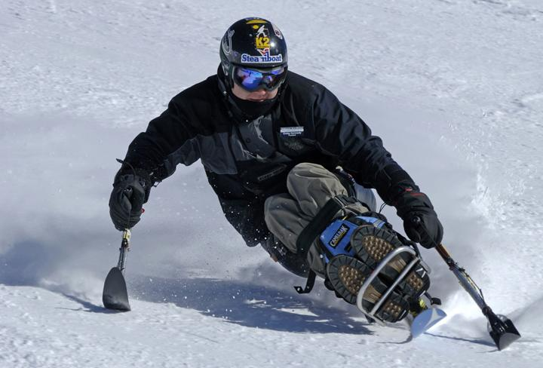
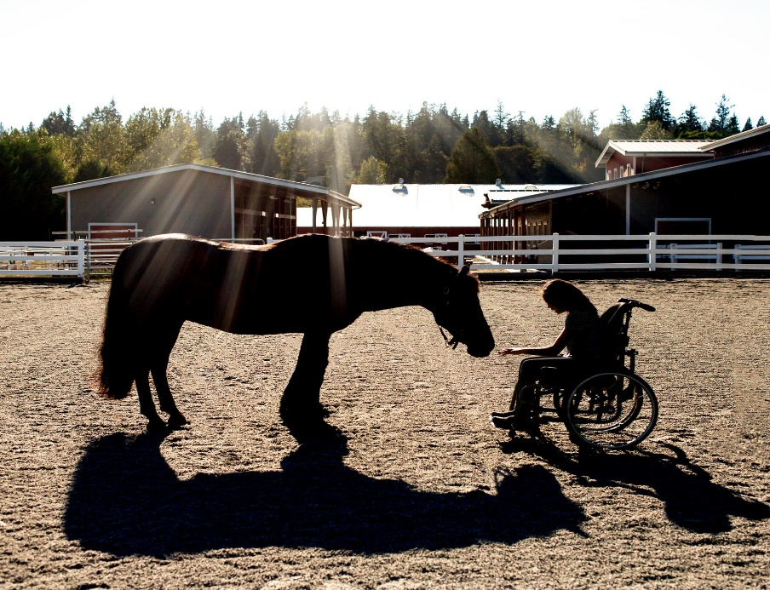
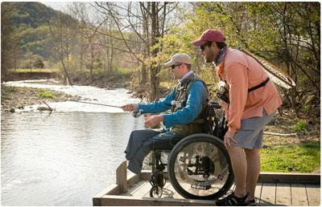
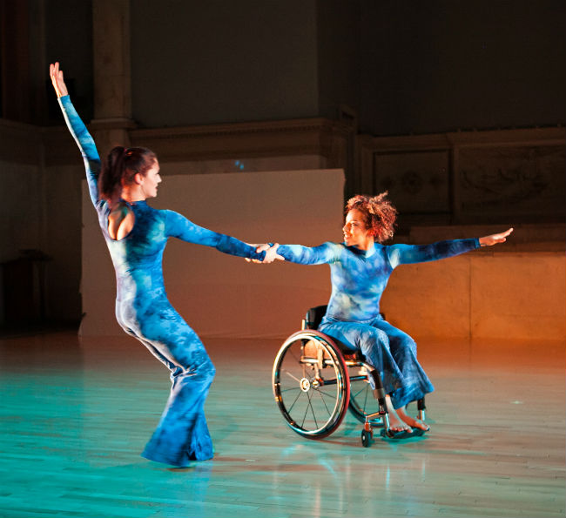
Abilities vs. Disabilities
People with disabilities (or people with special needs) in fact, don’t have any different needs as the other citizens.
The needs are the same for ALL.
Only the way of fulfilling and realizing their needs is different.

Slide 40
Challenges
Simple formula, but how to understand?
A + A + A
AVAILABILITY – does this adaptive service exist?
ACCESSIBILITY – how to get there?
AFFORDABILITY – what is the cost?
QUALITY – is it appropriate or improvised?
CHOICE – is it the only service or I have a choice?
Q + C

Slide 41
How many people need it?
According to the UN, over 1 billion people, or 15% of the world’s population, have some form of disability.
Together with their families, app. 3 billion people are directly affected (40% of the population).
Around 40% of the world population temporarily need accessible services!

Slide 42
Accessible infrastructure and facilities
INTEGRATION 1
Tourism for individuals with disabilities can be integrated into eco-cultural tourism development in the following ways:
Eco-cultural tourism destinations should ensure that their infrastructure, such as accommodations, attractions, and transportation, are accessible to individuals with disabilities.
This can include features like ramps, wheelchair-accessible rooms, braille signage, and audio descriptions for visual exhibits.

Slide 43

Inclusive activities and experiences
INTEGRATION 2
Eco-cultural tourism activities should be designed to accommodate individuals with various disabilities, providing alternative ways to experience and engage with natural and cultural heritage.
For example, tactile exhibits, sign language tours, and adapted outdoor activities can make eco-cultural tourism experiences more inclusive and enjoyable for all.

Slide 44
Empowering local communities
INTEGRATION 3
Eco-cultural tourism development that prioritizes accessibility can create opportunities for individuals with disabilities within local communities, such as employment, entrepreneurship, and cultural expression.
By fostering an inclusive environment, eco-cultural tourism can contribute to the social and economic empowerment of individuals with disabilities in destination communities.

Slide 45
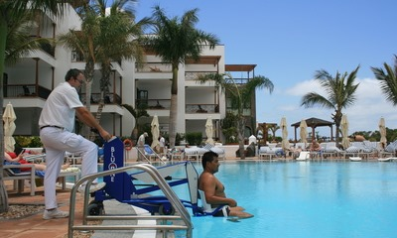
BEST PRACTICE EXAMPLE
Lanzarote, Canary Islands (Spain)
Lanzarote, a UNESCO Biosphere Reserve, has prioritized accessibility in its eco-cultural tourism development.
The island features accessible beaches with amphibious chairs and wheelchair ramps, as well as adapted cultural attractions like the Timanfaya National Park.
Lanzarote's commitment to accessibility has made it a popular destination for travelers with disabilities.

Slide 46
Thank you!

